Slide 1

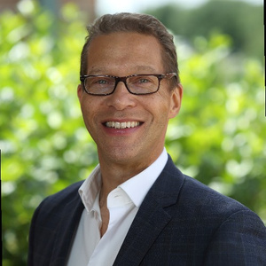
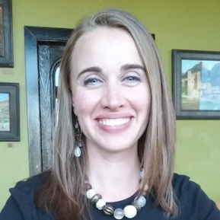
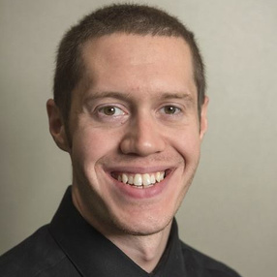
The New Central Ohio Industry Landscape
It's a Really Big Deal!
Scot Mclemore
Natalia Colvin
Geoff Bauer
Executive in Residence
Career Navigator
Supervisor

Slide 2

U.S. Manufacturing
WHY IT NEEDS TO BE ON YOUR PROFESSIONAL RADAR
Total U.S. Manufacturing Jobs?
12,820,000
Notes:
We will start with providing data on US and Ohio Manufacturing
Ask audience to guess the total manufacturing jobs in the U.S
Manufacturing has seen a resurgence in the U.S. over the last several years through investment in reshoring and new technologies.
Ohio is a state the is benefiting from that investment

Slide 3
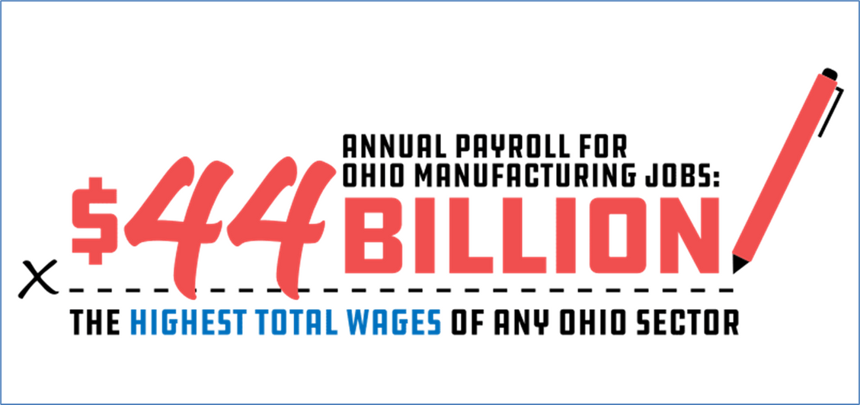
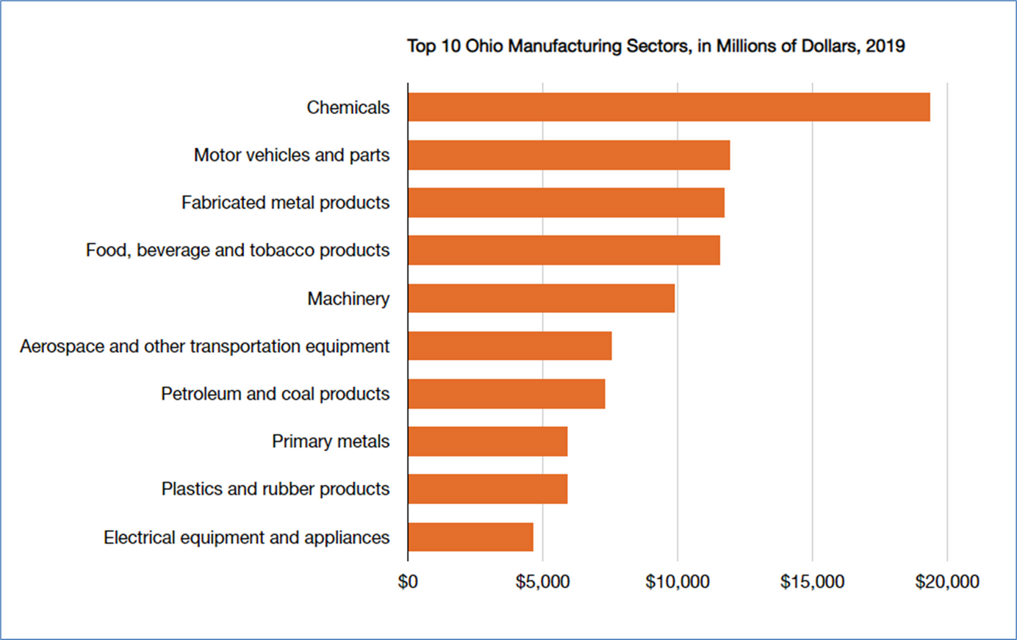
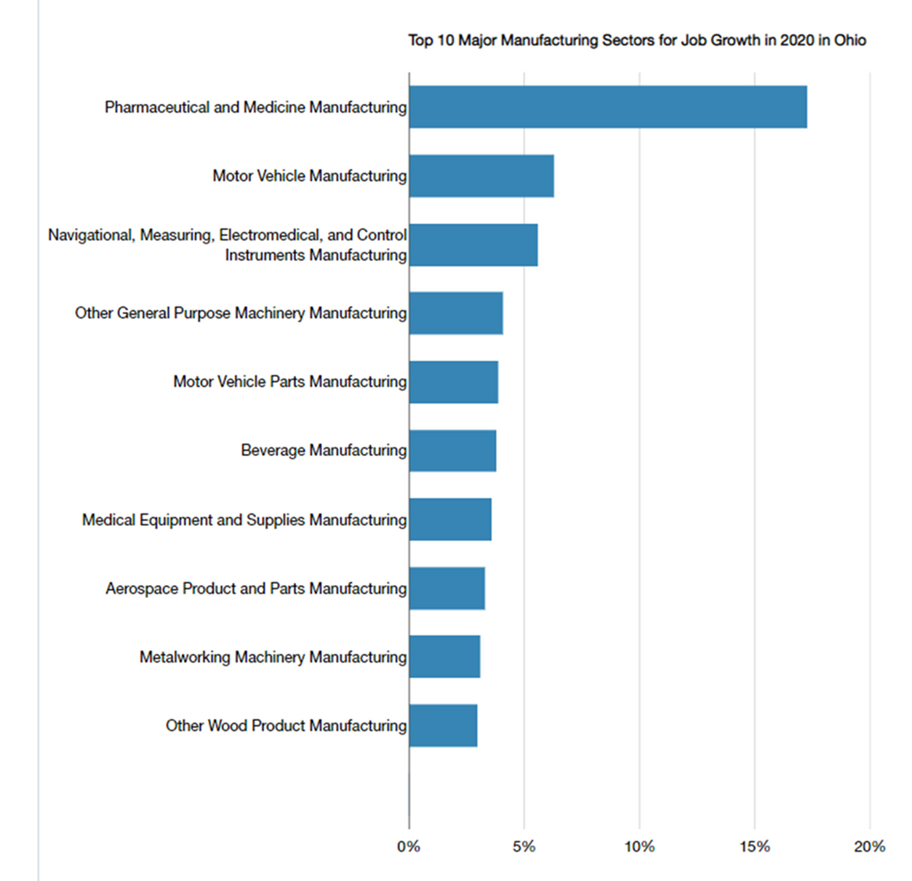
Notes:
-Ohio Manufacturing annual payroll is $44 Billion (Highest in any sector in the state)
-Top 10 Ohio manufacturing sectors listed are all represented in Central Ohio
-As many of the new jobs in the field are requiring an Associates degree or less, it's time we start helping students explore STEM pathways that have direct connection to industry.
-Not only are these careers innovative, and highly technical, but they offer a family sustaining wage and door-opening career path.

Slide 4

The Challenge:
How do we effectively connect our communities to these potentially life-changing opportunities?
Notes:
Advanced Manufacturing is here and growing in Central Ohio and we feel it is our responsibility to connect communities to these life-changing opportunities with family sustaining wages.
The challenge: How do we do it effectively?
Geoff, Natalia and I are going to share how Columbus State continues to partner with industry to meet this challenge!

Slide 5



The Solution
Direct Connection to Industry & Industry Input at Every Step
Short-Term Bootcamps & Certificate Programs
Earn-and-Learn Models
Notes:
What we will share:
Examples of
Earn-and Learn models
Short-Term Bootcamps and Certificate programs
How we partner with industry for alignment

Slide 6

The Earn-and-Learn Model
FULL-TIME CLASSES
FULL-TIME CLASSES
WORK EXPERIENCE WITH
INDUSTRY PARTNER
FULL-TIME CLASSES
INTERVIEWS
GRADUATION & COMPLETION
CAREER PREP
CAREER PREP
CAREER PREP
CONTINUED CLASSES
CONTINUED CLASSES
CONTINUED CLASSES
AUTUMN
SPRING
SUMMER
AUTUMN
SPRING

Slide 7
Career READY
The program consists of:
Continuous Improvement Efforts
Four Career READY workshops
Approved Resume Review
Approved Practice Interview
Approved Elevator Speech
All students must attain Career READY Status prior to interviews with employers

Slide 8
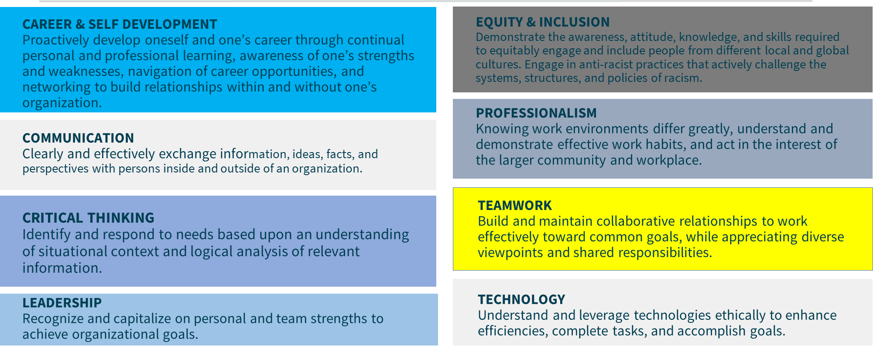
NACE Career Competencies

Slide 9
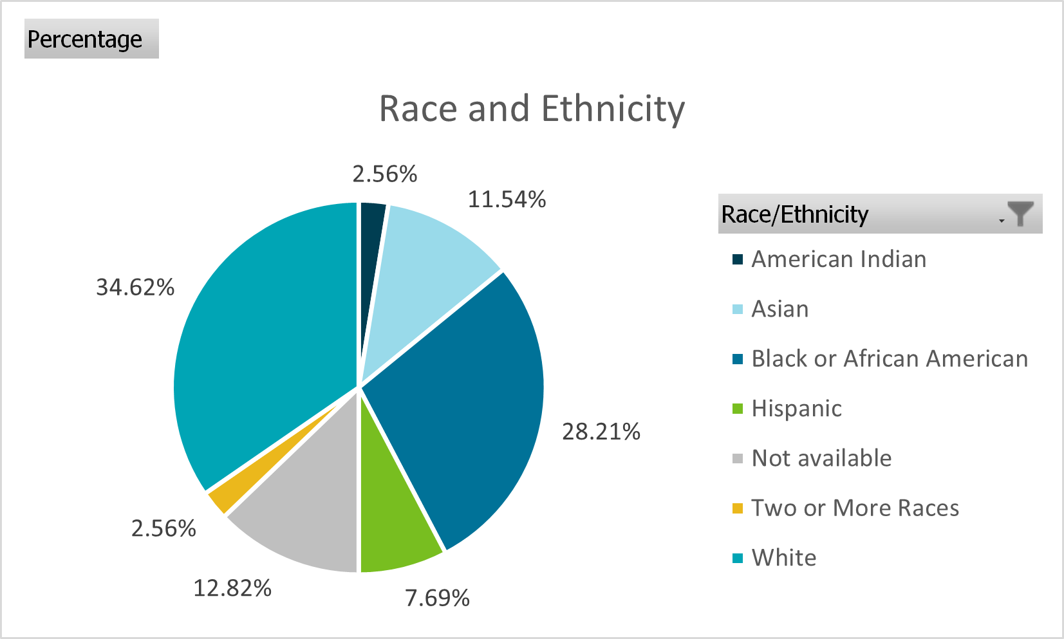
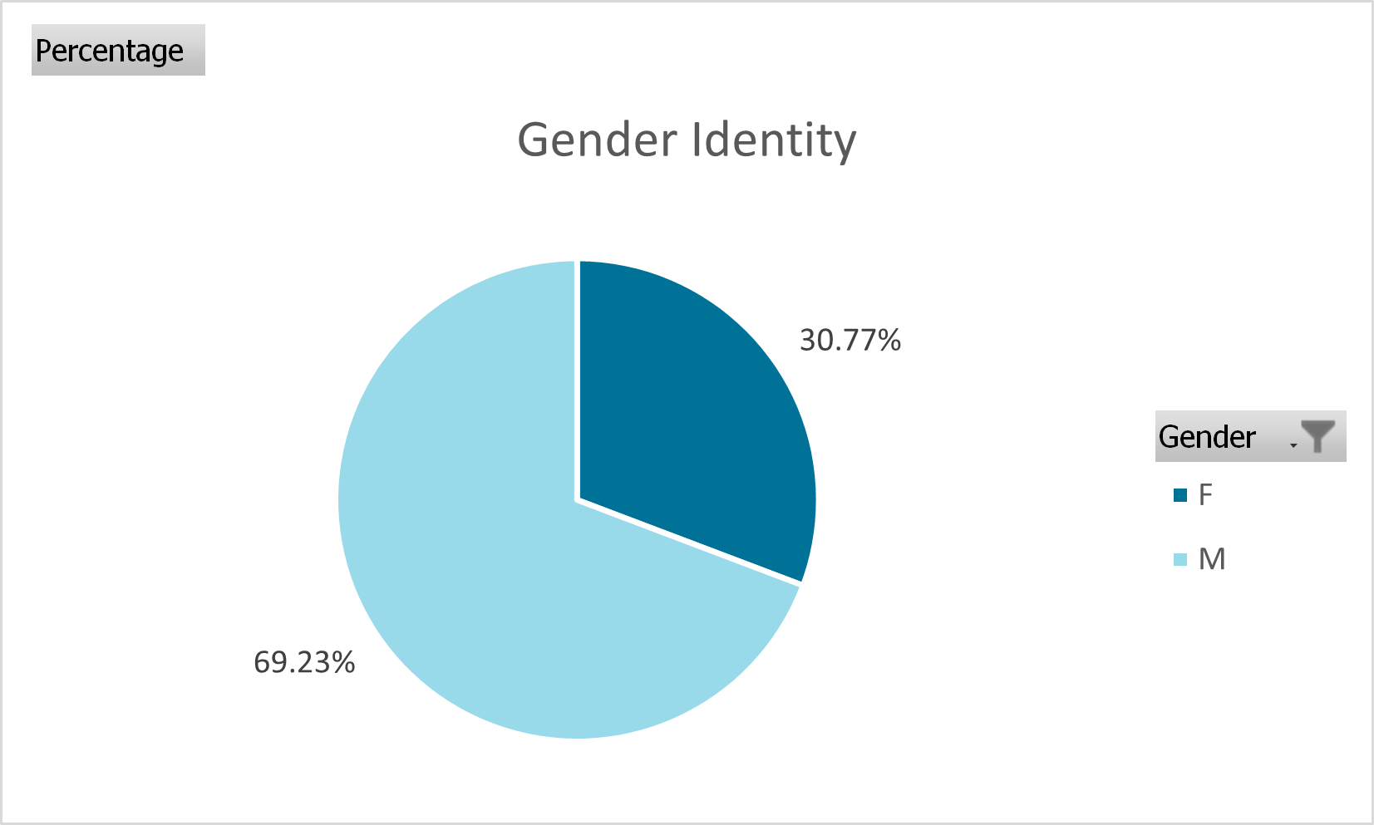
Diverse Talent

Slide 10
Employer Engagement
Provide feedback on students’ technical and employability skills
Assess number of openings for spring Centralized Hiring Process
Participate in Gamification Mentorship
Dec
Jan
Nov
Feb
Host an Employer Spotlight
Oct
Mar
Participate in networking event
Sep
Apr
Participate in Employer Roundtable
Aug
May
Centralized Interviews
Jul
Jun
Participate in summer programs and/or camps
On-boarding and student apprentices begin working

Slide 11
Employer Engagement
Annual Employer Roundtable Agenda – 2022
2021 Cohort in Historical Context
Apprenticeships, Wages, Demographics
2021 Cohort Hiring Outcomes
Candidate Demographics vs. Apprentice Demographics
Assessment of Candidate Quality
2021 Process and Communication Assessment
What Worked and What Didn’t
2022 Cohort
Demographics and Majors
Gamification Mentorship
Additional Partnership Opportunities
Cybersecurity Business & Industry Leadership Team
Workforce Certificates

Slide 12
Curriculum Development
The Business & Industry Leadership Team (BILT) model puts industry in a co-leadership role for college technical programs so they have direct input into KSAs that program graduates should possess
Members must be cybersecurity SMEs (e.g., high-level technical executives, first-line hiring managers, technicians currently holding a cybersecurity position)
Members meet 3-4 times per year - one longer meeting for KSA evaluation (2-3 hours) and the remaining to discuss feedback and industry trends (1 hour)
The goal is to produce candidates that businesses are more likely to hire

Slide 13
Win-Win Outcomes
On the Job
$18-26/hour range in 2022
20-40 hours per week depending on employer
Professional support
Continued learning
Upon Completion
Potential for full-time conversion making $50,000-75,000 per year
80% conversion rate

Slide 14


Slide 15
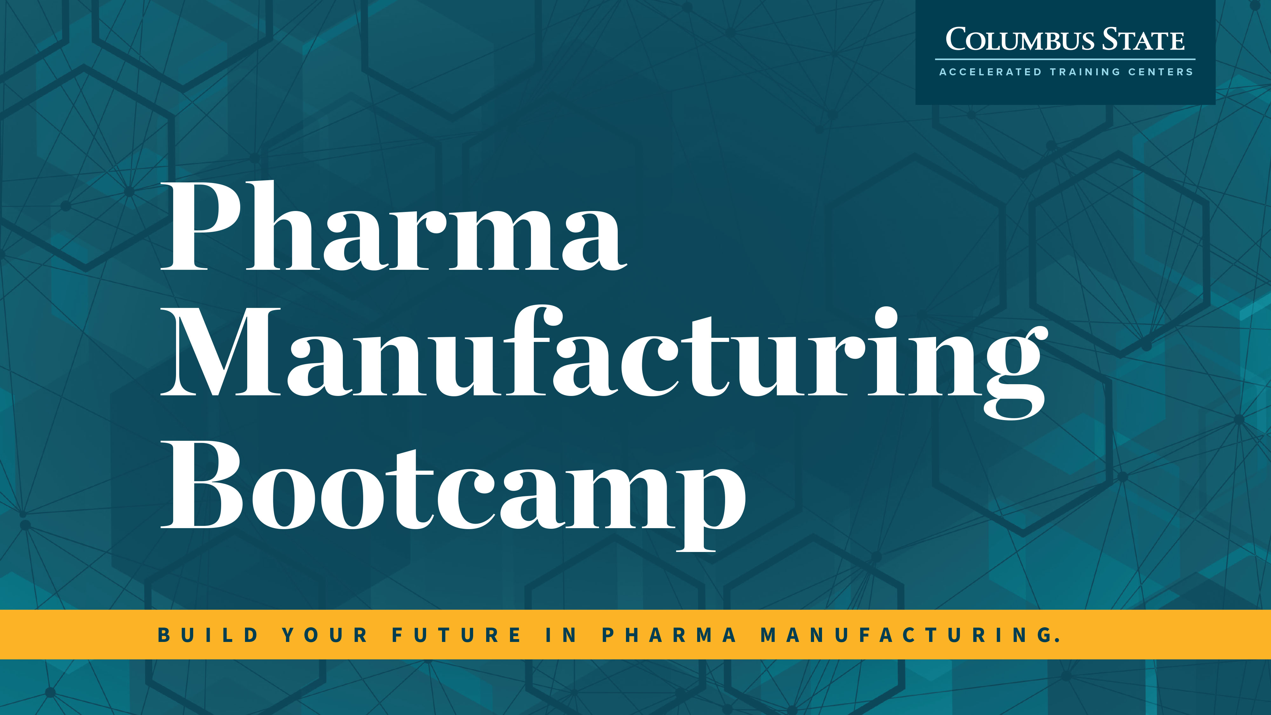

Slide 16
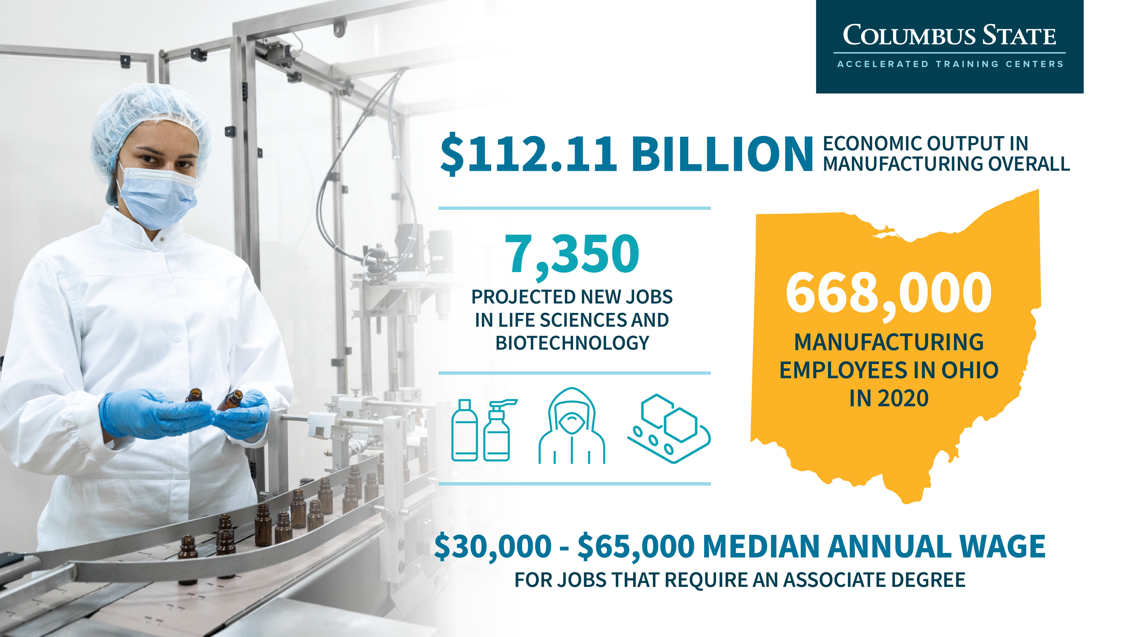

Slide 17
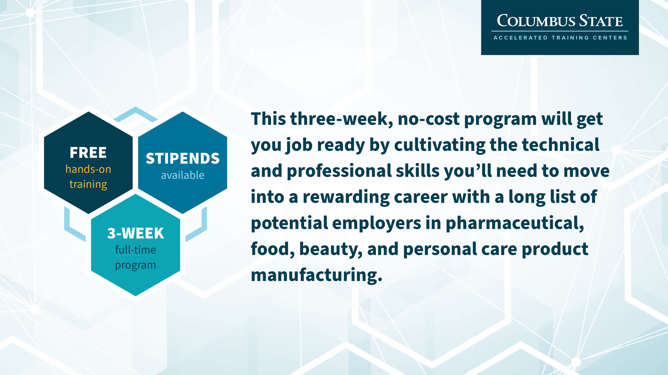

Slide 18
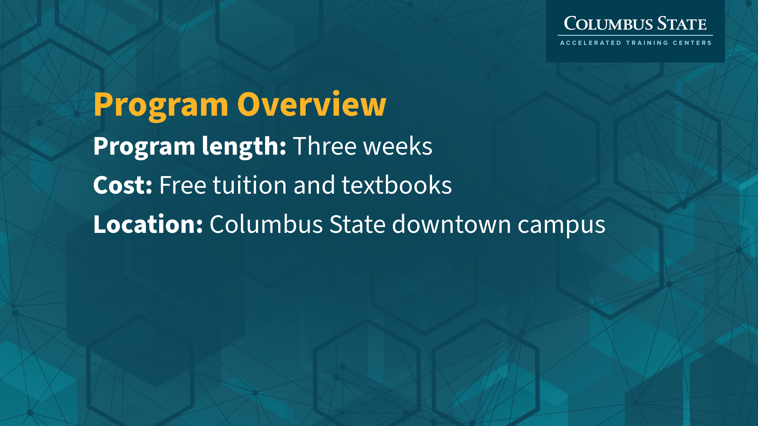

Slide 19
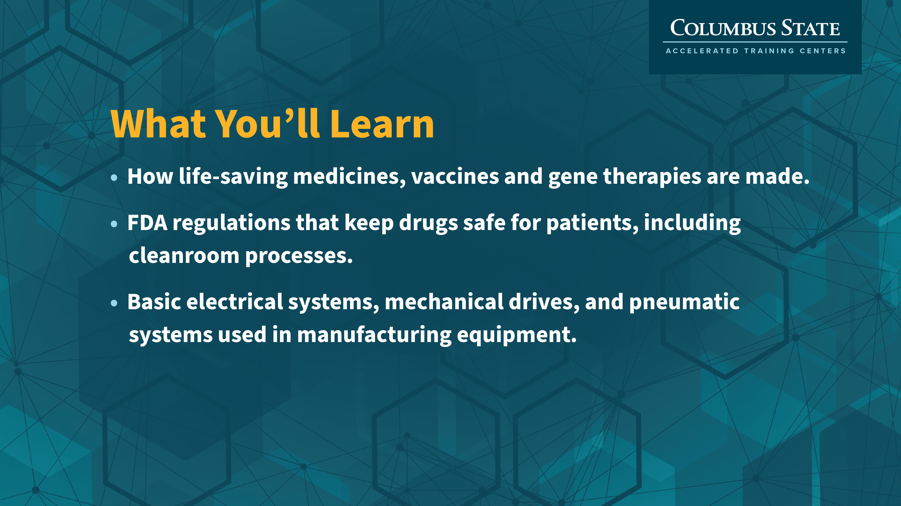

Slide 20
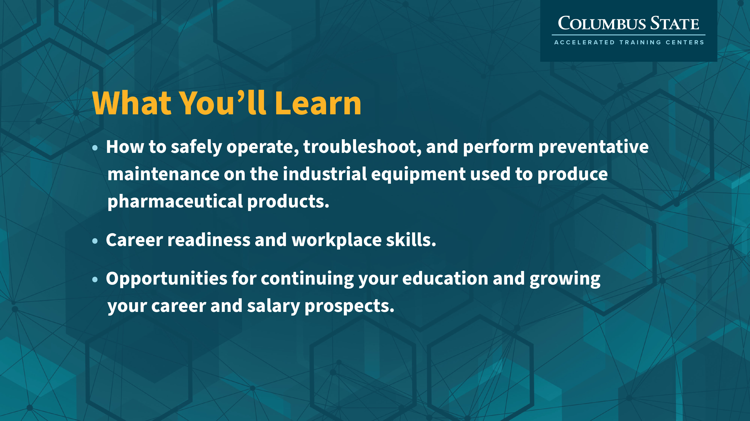

Slide 21
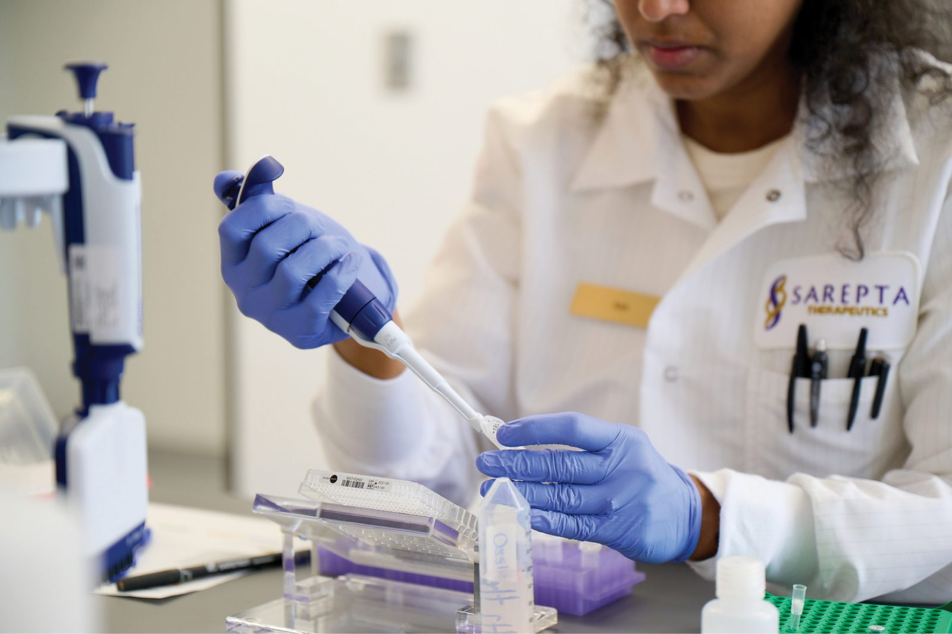
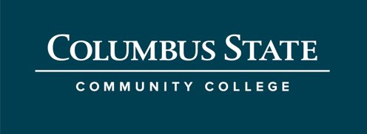
Biotechnology Pathways Integration

Slide 22
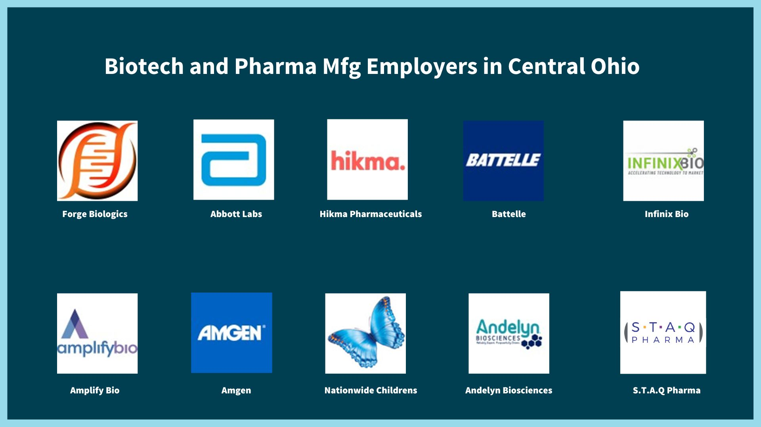
Background: Booming Industry, Few Training Providers
The college is tackling the rapidly growing biotech sector on multiple fronts:
Short term programming for entry-level jobs
Degree/certificate programs for advanced jobs.

Slide 23
Program Development
College Benchmarking
Labor Market Research
Industry Feedback
Curriculum Planning
Notes:
It all starts with curriculum planning!
CSCC began with benchmarking existing programs and skills standards
We conducted area Labor market research to understand current and future talent demand
We intentionally connected with local Biotech and Pharma Mfg industry to confirm research and plan
https://www.pakeys.org/get-professional-development/career-pathway/

Slide 24

The Solution- Cross Collaboration and Innovative Programming
A collaborative cross-functional response
Short Term Bootcamp
Degree and Certificate Programs
Employer Feedback
Outcomes
Programming aligned with industry needs and technical skills
Intentional seamless integration and unified pathway between short term and advanced educational programs.
Notes:
CSCC faculty and Office of Talent strategy developed collaborative cross-funcutional and innovative programming

Slide 25
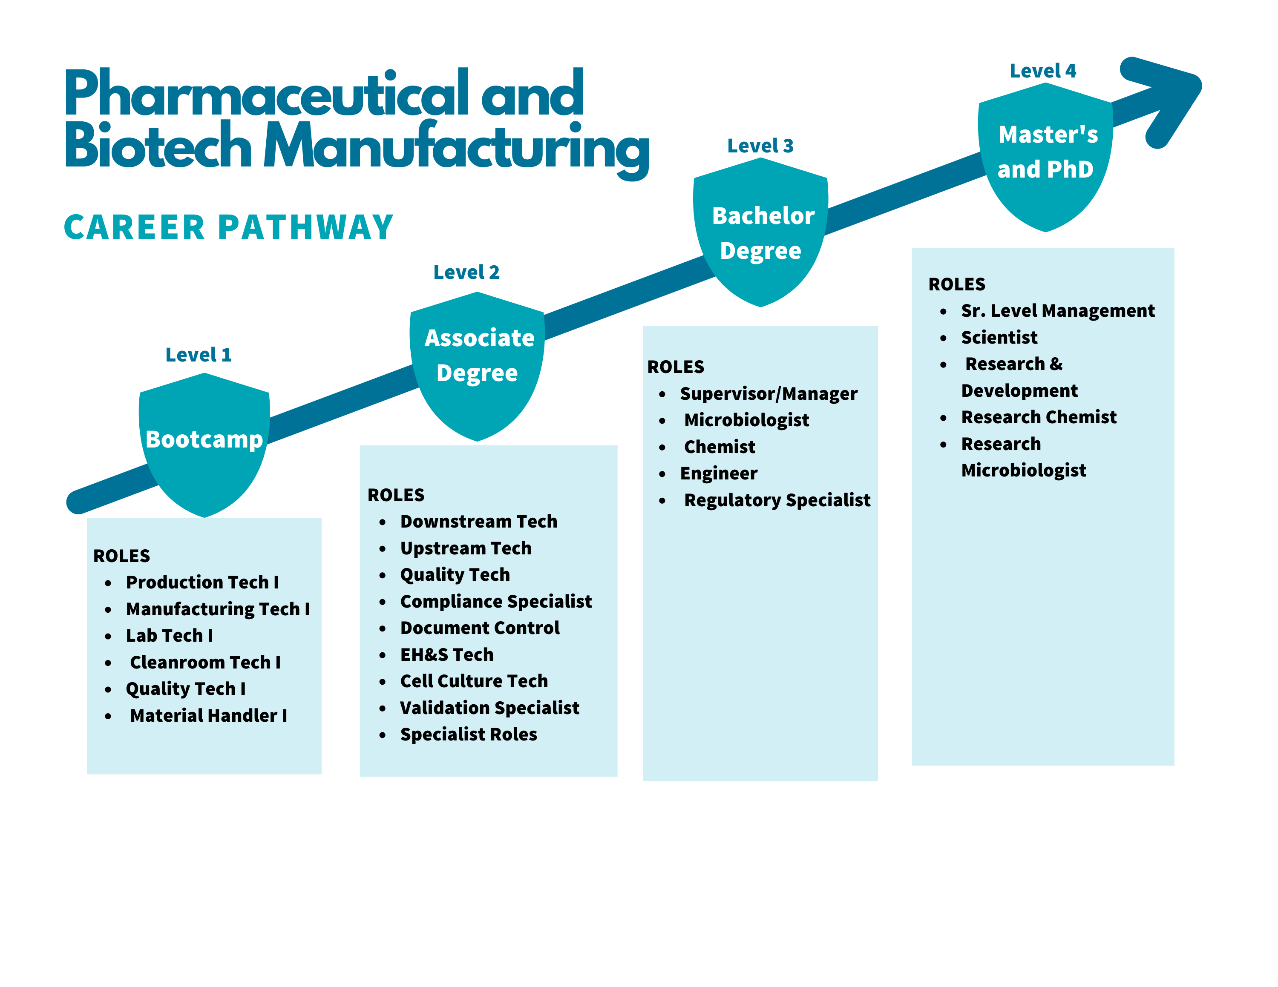
Options to fit each student's educational goals and life circumstances with "level up" options embedded into the program.
Employers have talent pools for roles at a variety of skill levels.
Notes:
Designed programs to align with career pathways and career ladders
https://www.pakeys.org/get-professional-development/career-pathway/

Slide 26

Where we are NOW
Biotech Bootcamp- Third Cohort is underway with a growing waitlist.
Pharmaceutical Manufacturing Bootcamp- Second Cohort starts today, with another cohort in June.
Associate Degree -First classes launch Autumn 23
Registered Apprenticeship Program -In partnership with Amgen, a global biotech manufacturer, to provide alternative pathways to careers in biomanufacturing. (www.ohiomeansjobslickingcounty.com/amgen/)
Orientation and Workplace Training - Biotech and Pharmaceutical Manufacturers around central Ohio work with CSCC to provide employee training in cleanrooms, Good Manufacturing Practice, and more.
Future Goals - Advanced Standing Certificate for returning students with degree in another field of study.
Learn More at cscc.edu/manufacturing​

Slide 27
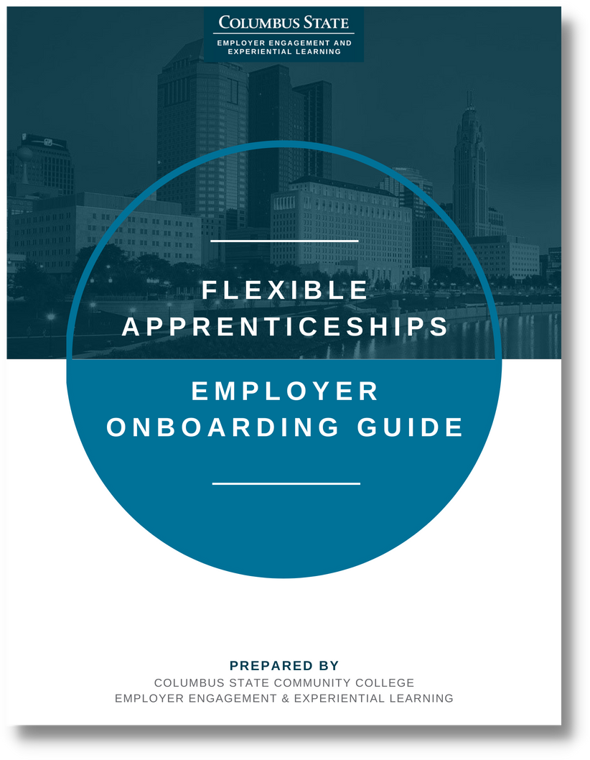
Education vs Industry Gap
Education and industry may not initially speak the same language or understand processes to build the pipeline.
Intentional Engagement that outlines the employer & educator expectations (ex. Employer Onboarding Guide)
Building trust, giving employers a voice in the programming that is created
Creating a framework for skills learning, program engagement, and recruitment
Notes:
In partnering, we recognize that education and industry may not initially speak the same language
Columbus State Community College has developed resources to meet industry talent needs through our Office of Talent Strategy and The Central Ohio MEP
There are a few key points to help insure success when building new programs between education and industry:
intentional Engagement
giving employers a meaningful voice
creating a framework for skills learning, program engagement, and recruitment

Slide 28
The New Central Ohio Industry Landscape
Contact Us
Scot Mclemore
Natalia Colvin
Geoff Bauer
smclemore3@cscc.edu
nkolnik@cscc.edu
gbauer1@cscc.edu

