Slide 1
The Journey to a High Functioning Business Advisory Council
John Hambrick
Christine Galvin
Notes:
Christine will open with first two slides

Slide 2
Where did we begin?
In 2016, due to an increasing shortage of Ohio workers caused by a skills gap, Governor Kasich challenged his Executive Workforce Board “to identify ways to prepare and continuously train Ohioans of all ages for the jobs of today and tomorrow.” In response, the Ohio General Assembly passed several provisions into law (HB49)
Establishment of the OhioMeansJobsReadiness Seal for high school diplomas
Development of an option for students to participate in pre-apprenticeship training programs
Creation of an in-demand jobs week
Development of a regional workforce collaboration model providing career services to students
A requirement that standards for school district and educational service center (ESC) business advisory councils be established
Notes:
Christine

Slide 3
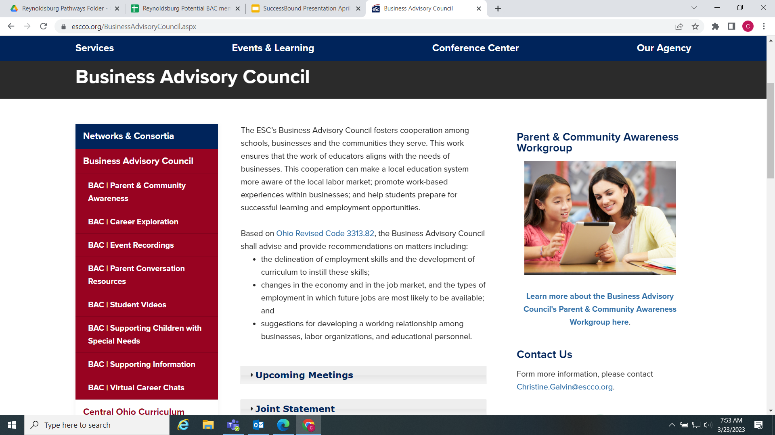
Starting Out
Did initial outreach to member districts & business partners
Created a BAC webpage
Shared the BAC compliance requirements
Drafted first BAC plan
Notes:
Christine

Slide 4
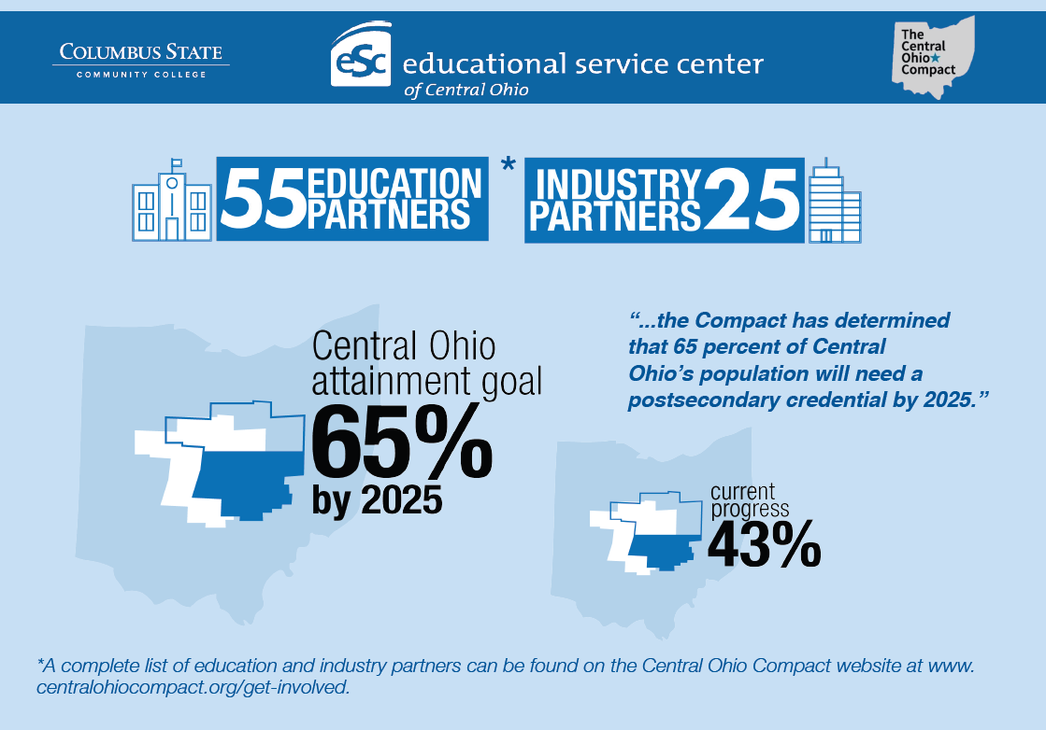
We Began With a Focus On the Central Ohio Compact
Connected work of the Business Advisory Council to the regional initiative in order to supplement and support the goals of the compact.
Notes:
Christine

Slide 5

ODE Focused on Three Best Practices
Develop Professional Skills for Future Careers
Build Partnerships
Develop Experiences
Notes:
Christine

Slide 6

Continuous Improvement
Created workgroups
Recruited additional business partners/ partnerships
Established call to action
Provided opportunity for feedback
Worked regionally to create more opportunities for students
Notes:
Created a structure

Slide 7
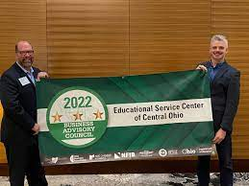
Business Advisory Council Awards
Next Steps
The Business-Education Leader Awards for Excellent Business Advisory Councils recognizes two-, three- and four-star rated Business Advisory Councils throughout the State of Ohio for their exceptional work building strong partnerships to instill professional skills for future careers and coordinating experiences for students.

Slide 8
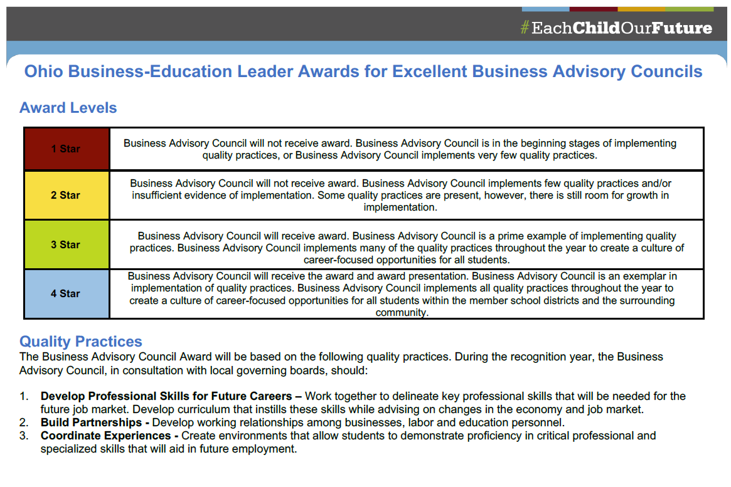
Notes:
Talk about the feedback from Michelle

Slide 9
Feedback from Committee on Three Star Award
Need specific data to identify impact of BAC work
Provide details on which districts/businesses were involved with specific initiatives
Demonstrate impact on curriculum/skills students were learning

Slide 10

Where are we now?
Develop Professional Skills for Future Careers & Coordinating Experiences
Curriculum Focus
Pre-apprenticeship
Pathways
WBL Opportunities
Industry Credentials
Career Exploration
Employer connection opportunities
Mentoring
Notes:
John - speak to timing and how the infrastructure started to shift

Slide 11
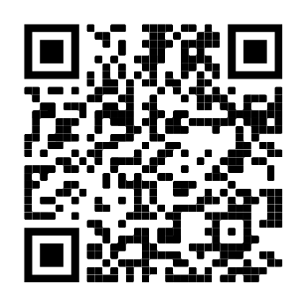
Pre-Apprenticeship Expansion
Industry Sectors:
Architecture & Construction
Education & Training
Engineering
Hospitality & Tourism
Information Technology
Manufacturing
Transportation, Distribution, & Logistics

Slide 12





Goodwill Partnership
21st Century Skills
Work-Readiness Skills
Career Pathway Exploration
Credentialing Program
Certified Training Site
District support
Classroom engagement
Notes:
Credentialing and the Development of professional skills
CCMEP - Comprehensive Case Management for Employment Program - Franklin County - AMP

Slide 13









Chatstrike Healthcare Pathway Event
Central Ohio juniors and seniors (and parents!) connected directly with career training programs and employers who are hiring straight out of high school.
Notes:
WIET - Workforce Inventory of Education and Training - resources available through ODJFS

Slide 14
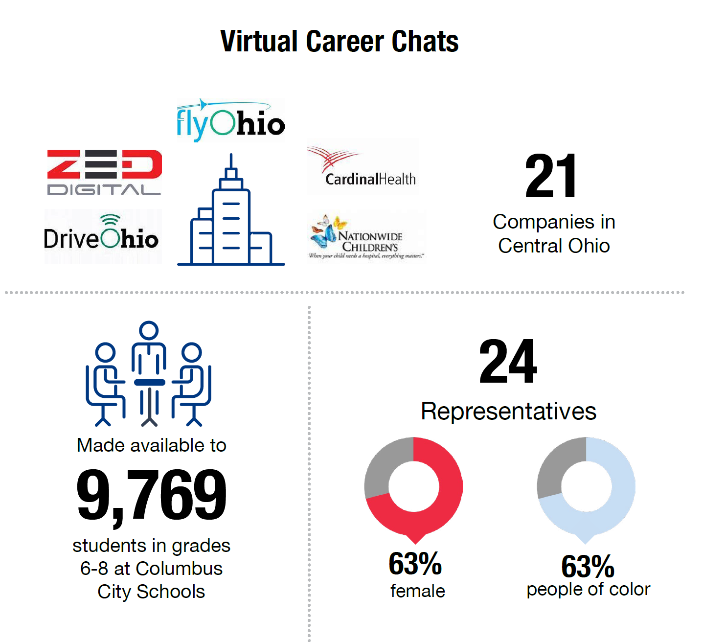

Slide 15







State of Ohio H.S. Tech Summer Internships
Total of thirteen summer interns from across four Central Ohio school districts for a total of 2,796 hours

Slide 16


Cardinal Health Information Technology Mentorship
Reynoldsburg City Middle Schools
Female middle grade students mentored by Cardinal Health professionals
Notes:
29 Cardinal Health mentors supporting 90 mentees. Provided mentors with 3 hours of SEL training & support for a total of 87 hours of professional development

Slide 17
Where Are We Now?
Develop Partnerships
Workforce Development Boards
Non-Profit
Chambers
Organizations
Regional Initiatives
Government Agencies

Slide 18
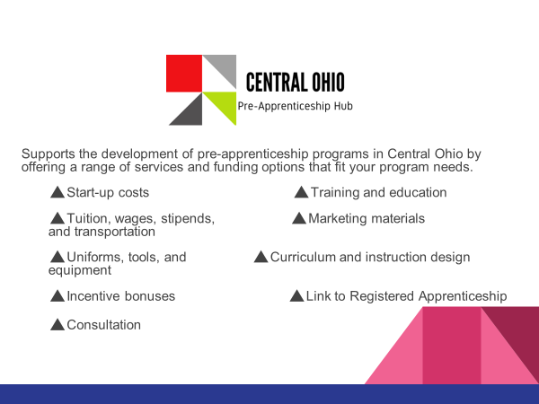

Slide 19

Big Brothers Big Sisters
Partnered with BBBS to start their ‘Big Futures’ program in Delaware County.
Working with Delaware City Schools, Buckeye Valley Schools and Big Walnut to find mentors for high school students.

Slide 20

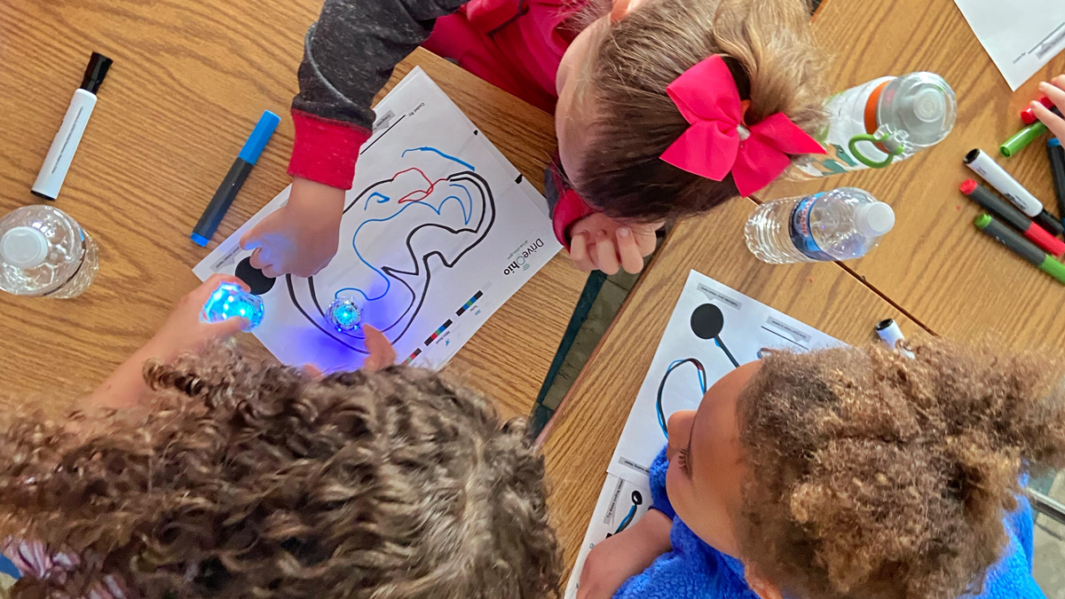
Smart Mobility
The Smart Mobility Ambassador Equipment Grant directed towards educators in ESC of Central Ohio Member Districts who are interested in implementing smart mobility activities into their classroom or after-school programs. This grant helps educators purchase the necessary resources and technology needed to implement smart mobility activities at their school.
The grant is providing equipment such as drones and Ozobots for Avalon Elementary.

Slide 21

New Skills For Youth

Slide 22
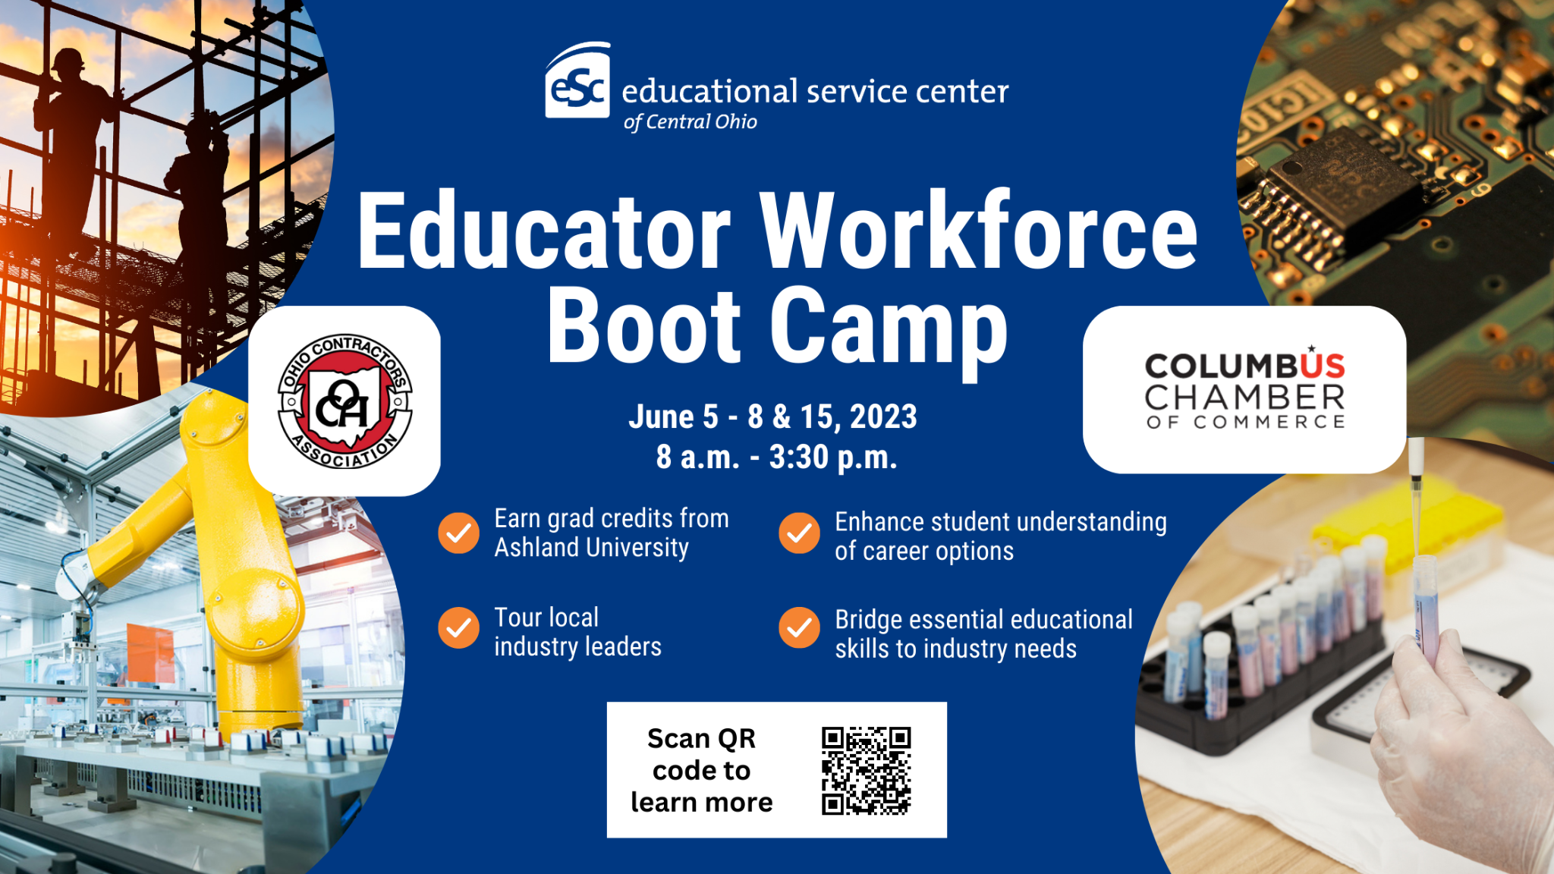
Educator Bootcamp

Slide 23














Franklin County Children Services - Career Exploration Event
Notes:
BAC partners were invited employers to participate in the event- targeted towards foster youth.

Slide 24


B﻿ridgED with Delaware County School Districts
Bridge Ed is a consulting company, built by corporate engagement professionals in academia, that strives to solve the fundamental challenges of helping companies and districts work together. Through this exciting partnership, the districts will create opportunities for students to receive career path exposure, workforce development, internships, and so much more.
Christy Bertolo, Co-Founder of UNITE and BridgED
Chris Svec, Co-Founder of UNITE and BridgED

Slide 25

Where Are We Going Next?
Systems Thinking
Members drive the work
One point of connection for business partners
Scaling experiences
Information sharing

Slide 26
Contact Information
Christine Galvin
Director of College and Career Success
Christine.Galvin@escco.org
John Hambrick
Work-based Learning Coordinator
John.Hambrick@escco.org
Jama Cobb
Work-based Learning Coordinator
Jama.Cobb@escco.org
Mike Kerr
Career Intervention/Workforce Development Specialist
Michael.Kerr@escco.org

