Slide 1
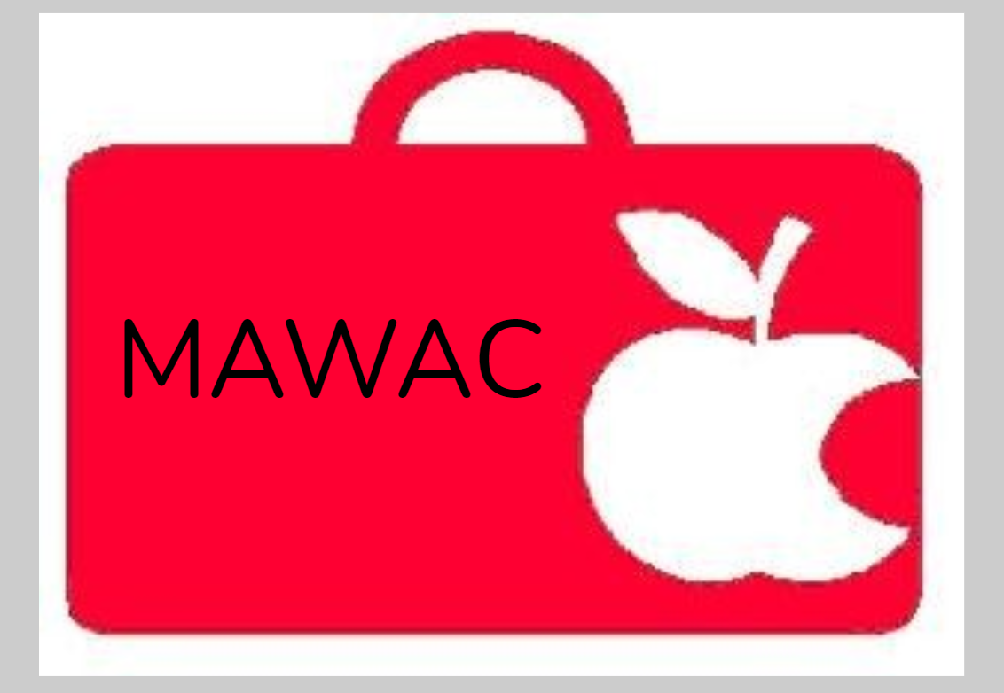




Slide 2
Marion Area Workforce Acceleration Collaborative
MAWAC
Develop Professional Skills for Future Careers – Work together to delineate key professionals skills that will be needed for the future job market.
Build Partnerships- Develop a working relationship between industry and education personnel.
Coordinate Experiences - Create environments that allow students to demonstrate proficiency in critical professional and specialized skills that will aid in future employment.

Slide 3
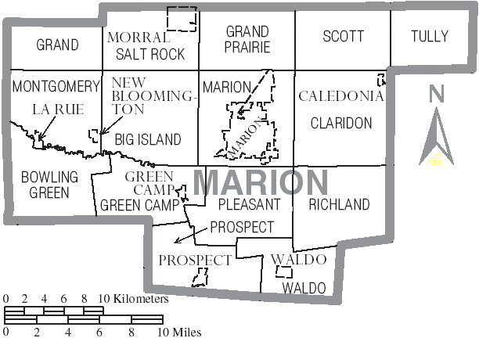
City and Townships of Marion, Ohio

Slide 4
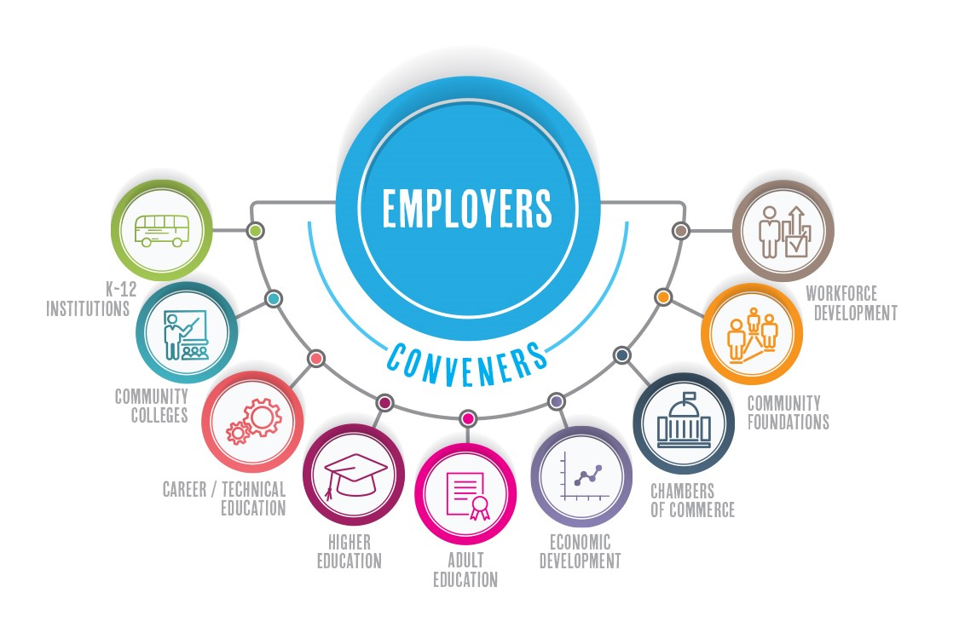
MAWAC

Slide 5


























Slide 6
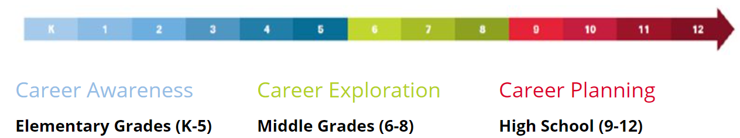
Workplace visits with career interviews
Career connections learning strategies
Classroom career speakers
Introduction to Ohio career fields and pathways
Workplace visits with career interviews
Career courses
Career mentorships
Career research
Service learning
Career Portfolio- OMJ Backpack
Technical education
College Credit Plus
Career pathways
Industry-recognized credentials
Student Success Plan
Work-based Learning
Career mentorships
Pre-apprenticeship programs
Job Shadowing
Service learning
OhioMeansJobs K-12

Slide 7
Partnership Survey
MAWAC Partnership Survey
Worked with members of advisory council to develop questions for the survey in order to streamline communication between educational partners and industry partners.
Sample Responses

Slide 8
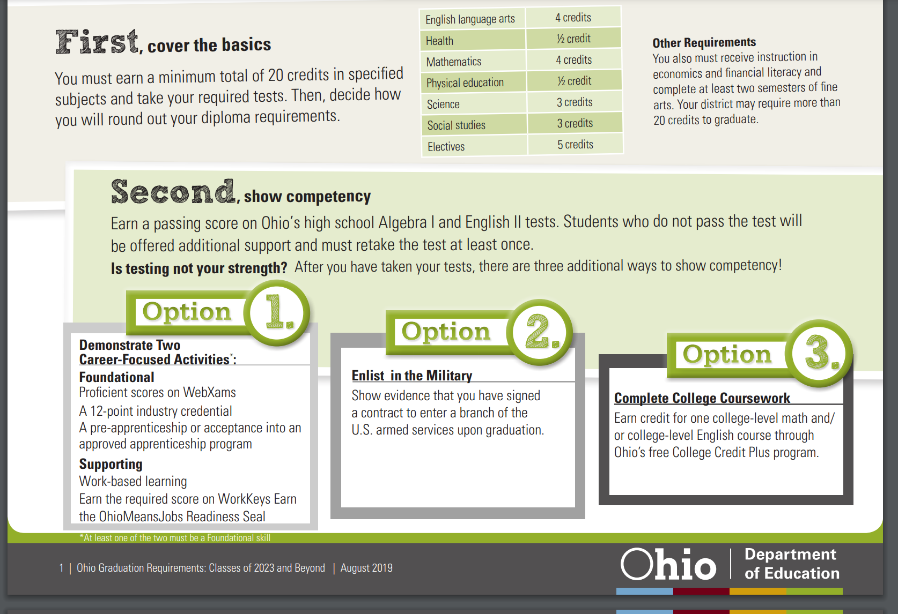
Graduation Requirements
BUSINESS
PARTNERSHIPS NEEDED FOR OPTION 1- HOWEVER BEST PRACTICE IS FOR ALL STUDENTS!

Slide 9
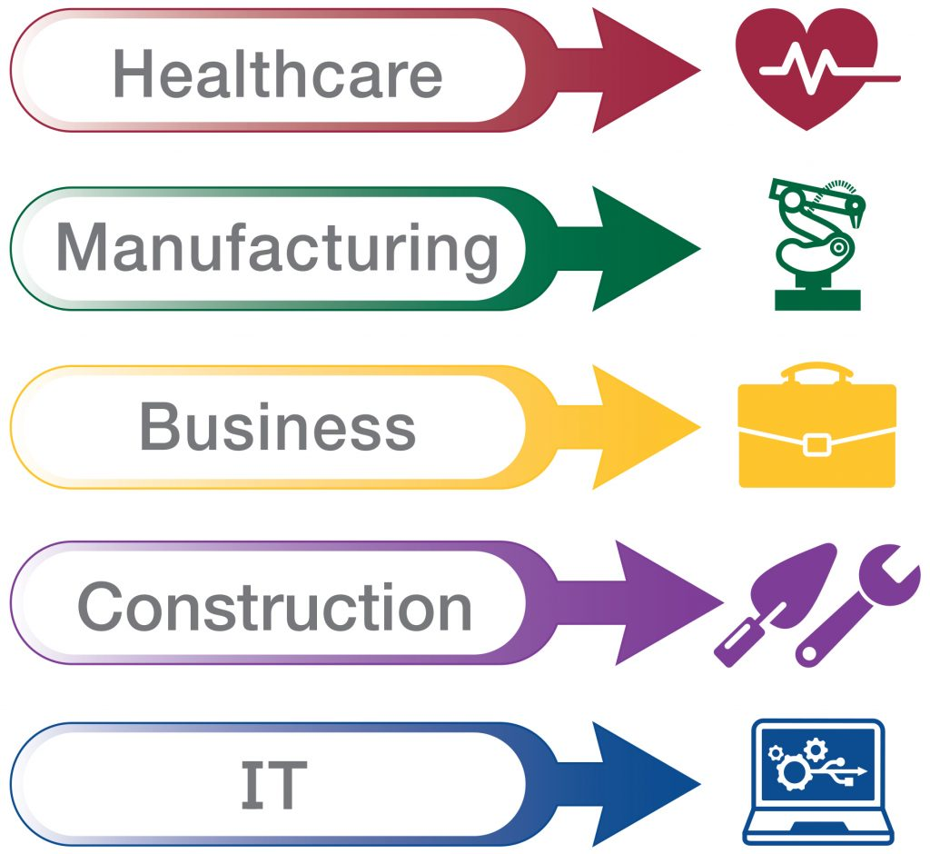
ALL CAREER PATHS HAVE SEVERAL “AVENUES” TO EXPLORE!

Slide 10
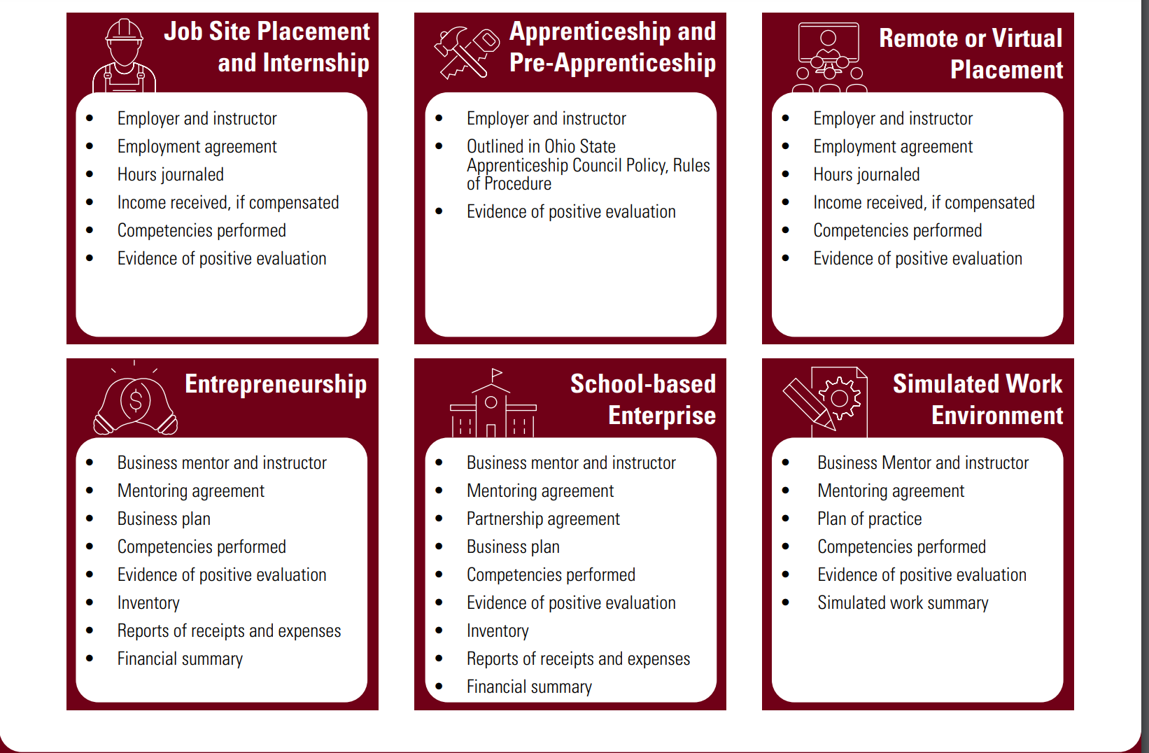

Slide 11


Partnership Guidelines for WBL
Business/mentor
Partnership agreement
Program coordinator
Learning/training plan
  Description of experience
  Competencies performed
Evaluation/assessment
  Student OMJ Readiness Seal Validation
Notes:
Guidelines adopted from Ohio Department of Education on Work-Based Learning

Slide 12


Slide 13
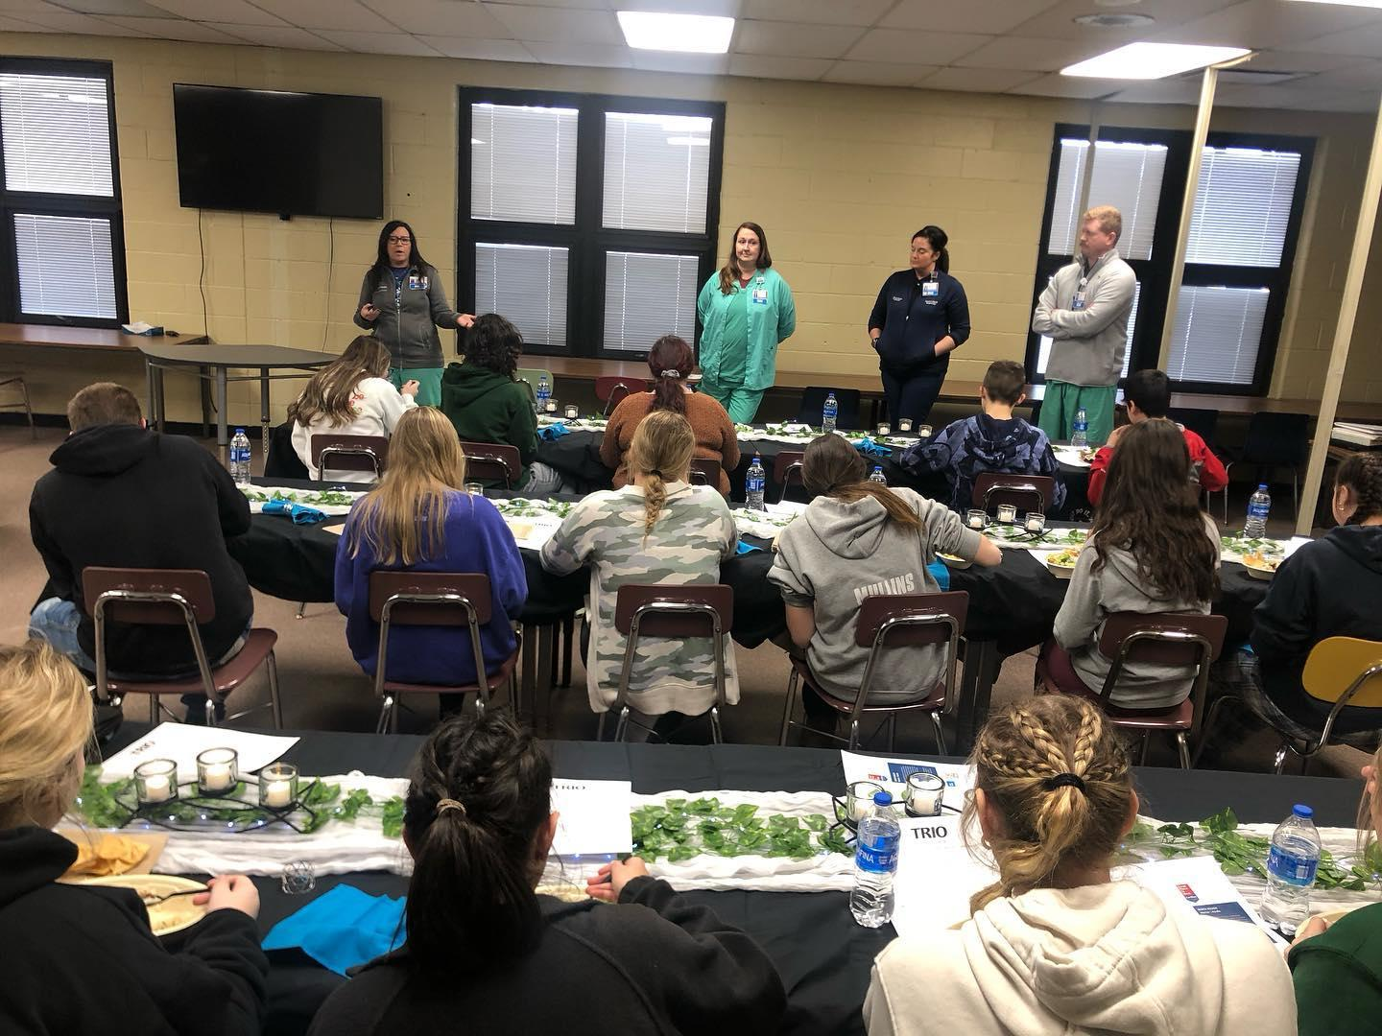
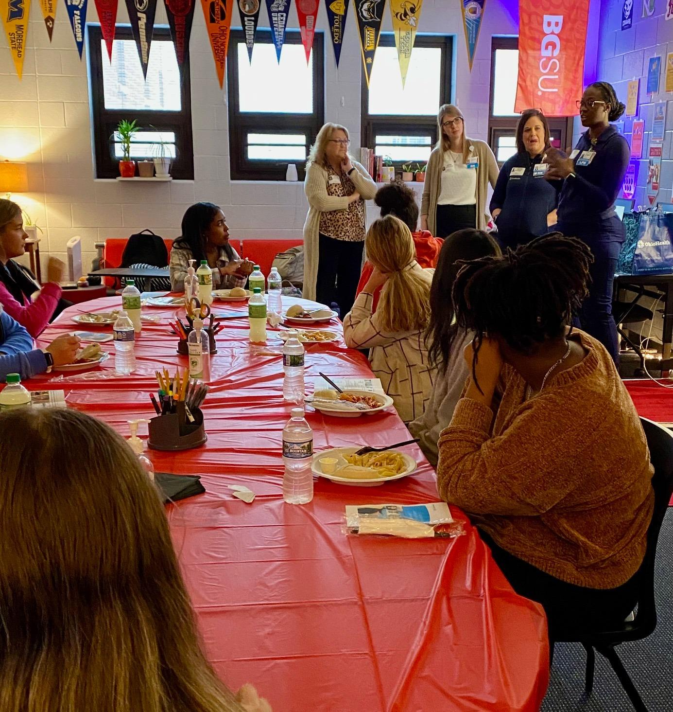

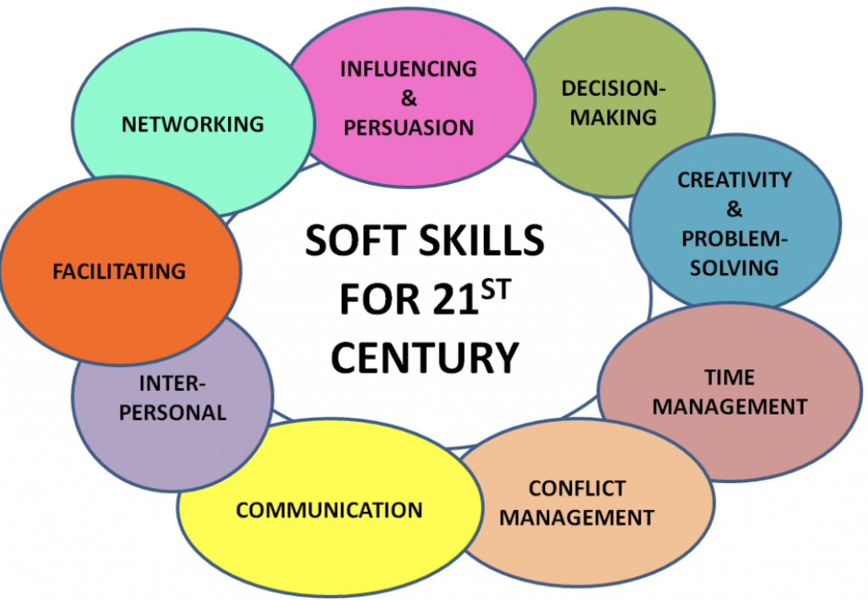
Promote Learning & Engagement for Students
Connecting school and work
Introduce students to variety of careers
Share about the uniqueness of the workplace
Practice soft skills
Encouraging productivity & accountability
Notes:
Guidelines adopted from Ohio Department of Education on Work-Based Learning

Slide 14
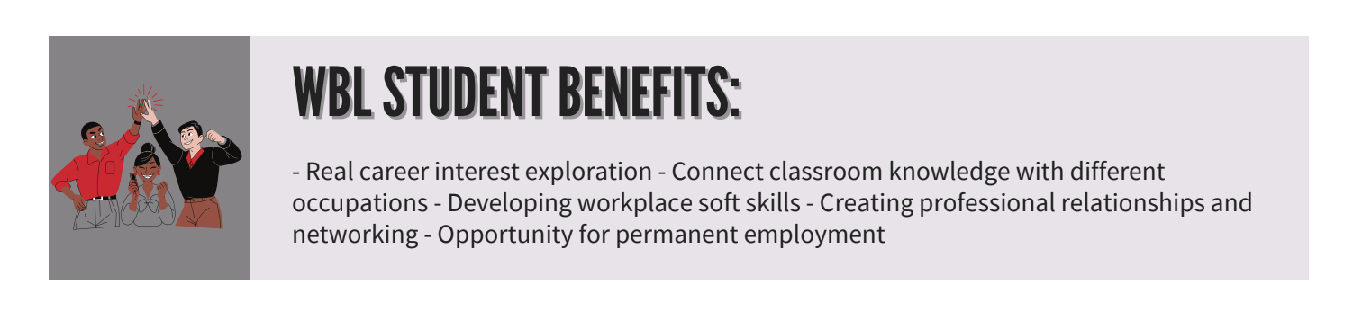
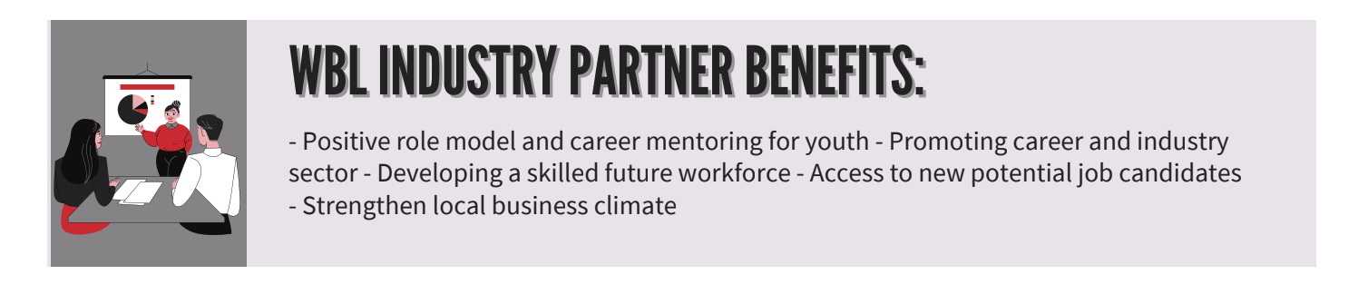

Slide 15


Minor Labor Laws: Prohibited Occupations
The Ohio Department of Education encourages companies to contact The Adecco Group if they are interested in offering work-based learning opportunities or enhancing their current training programs and want to minimize their youth-employment risks.
Resources: Adecco – Work-Based Learning
Notes:
Guidelines adopted from Ohio Department of Education on Work-Based Learning

Slide 16

What: 47 Agencies/Resources In One Place!
Who: Students/Families with Disabilities
Where: TRCC of Marion- 3 Counties
When: 9/27/22 at 5:30-7:30pm
Why: Transition focus on Vocational, Educational, and Independent Living Skills.

Slide 17
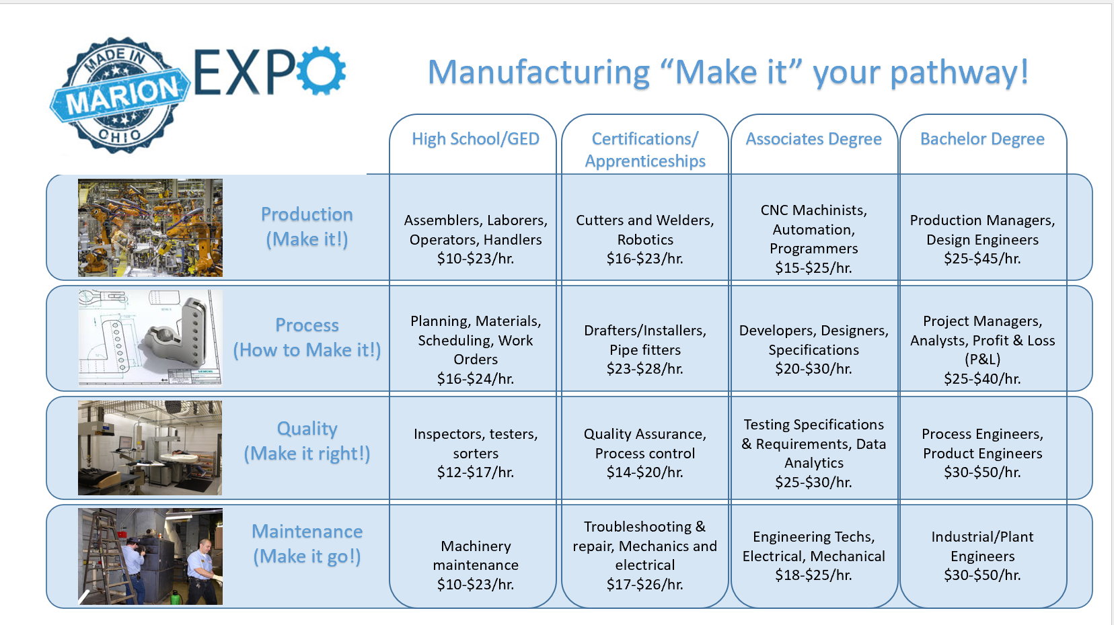
Made In Marion Expo

Slide 18
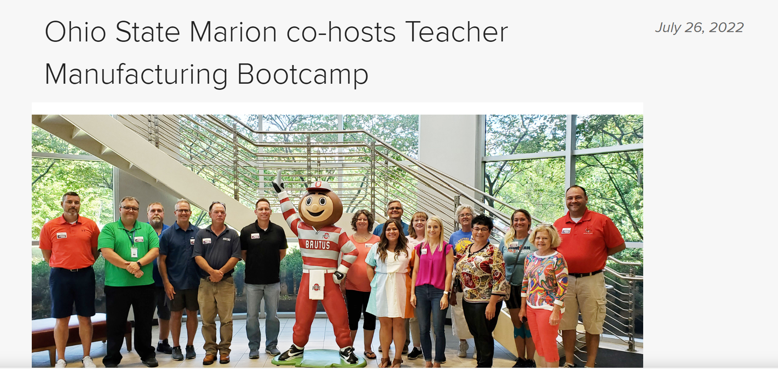
Manufacturing Bootcamp Video

Slide 19

MAWAC
Interested in becoming a Work Based Learning (WBL) site and or want more information on joining the MAWAC School/Business Advisory Council?
Contact: Marcia Pitts and Dr. Shelly Dason : MAWACMade@gmail.com

