Slide 1






FOUNDED IN 1993
NATIONALLY RECOGNIZED
AWARDED BEST PRACTICE MODEL
25 YEARS OF COMMUNITY ENGAGEMENT

Slide 2
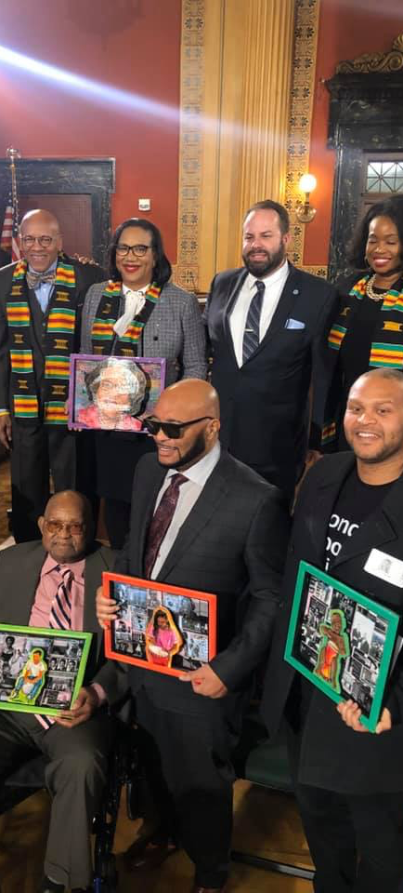
RECOGNITION
WE HAVE RECEIVED OVER 65 ACCOLADES FROM FORMER PRESIDENTS, GOVERNORS AND GOVERNING OFFICIALS
Nationally Recognized by Former Presidents George Bush Jr, Bill Clinton and Barack Obama for excellent service
State of Ohio Executive Department Office of the Governor Columbus Resolution- African American Male Wellness Walk Initiative Month
Recognized by the Department of HUD as best practice model
Government Finance Officers Association Certificate of Achievement for Excellence in Financial Reporting Presented to Academy for Urban Scholars
Awarded the prestigious governor’s award of excellence for community service
Invited to White House along with program participant
EDUCATION
WORKFORCE
HEALTH
COMMUNITY ENGAGEMENT

Slide 3




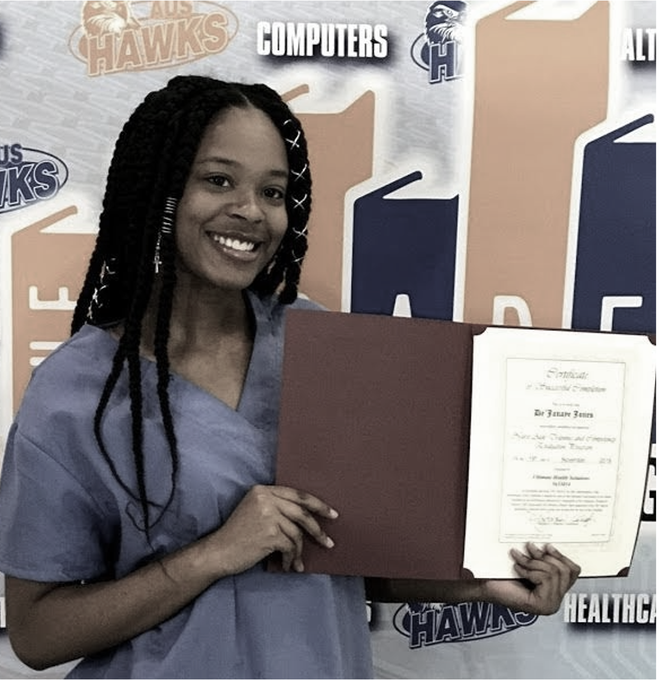
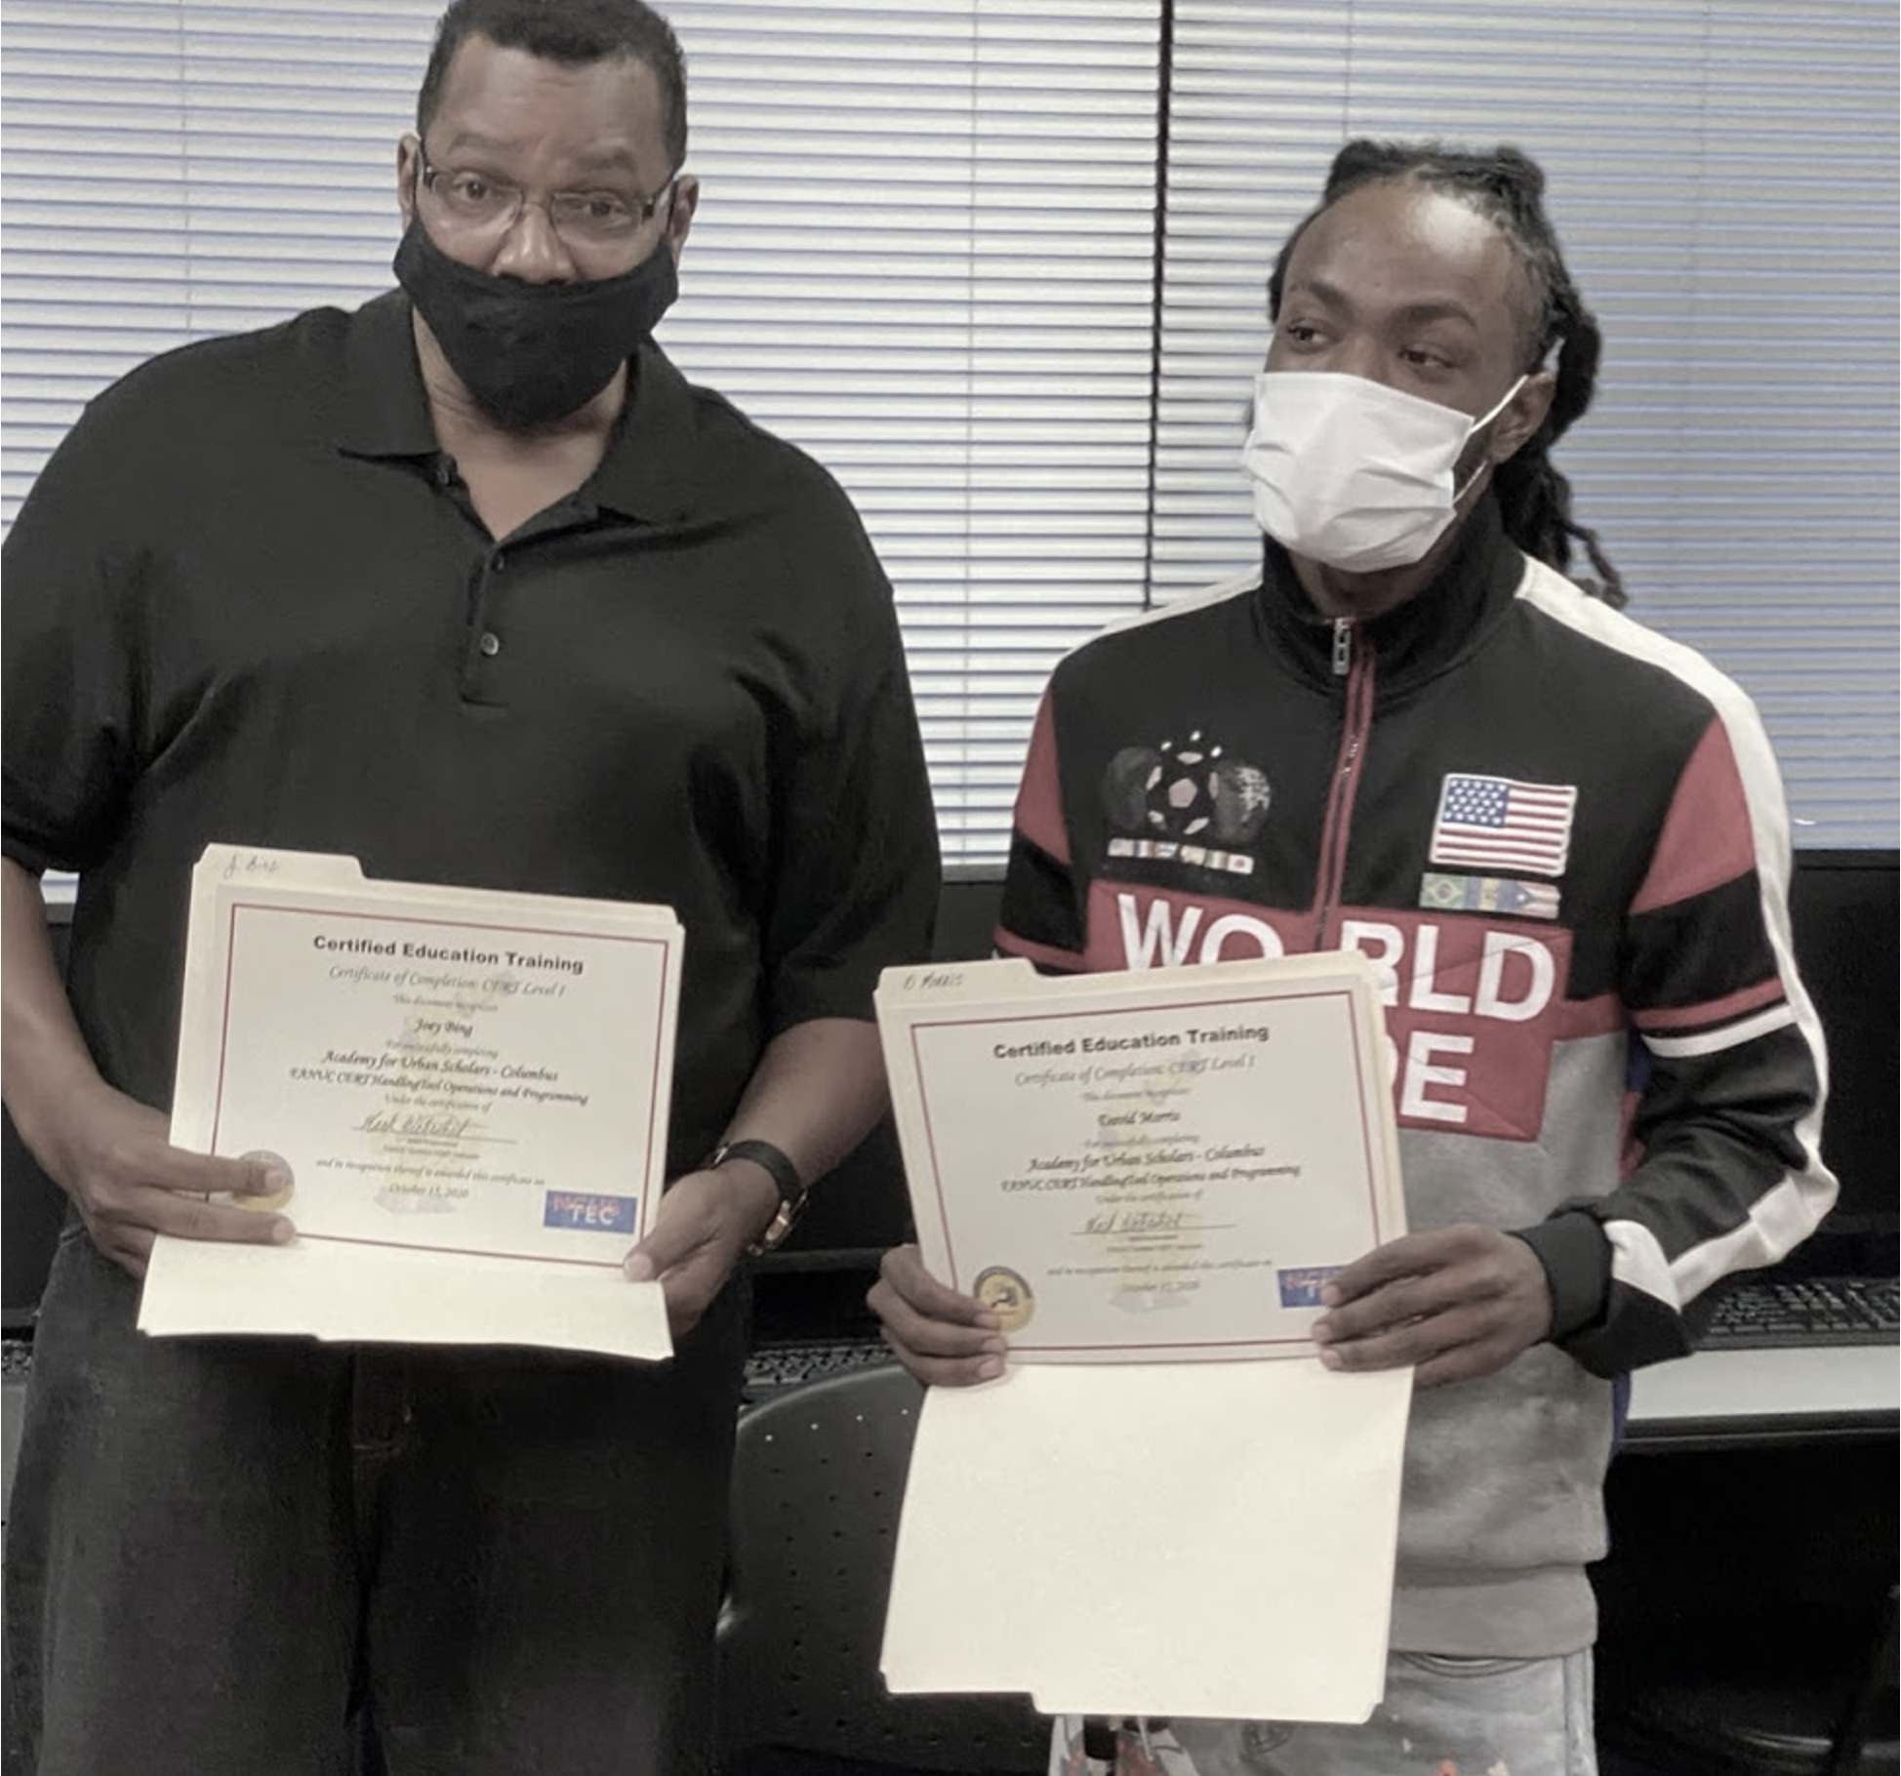
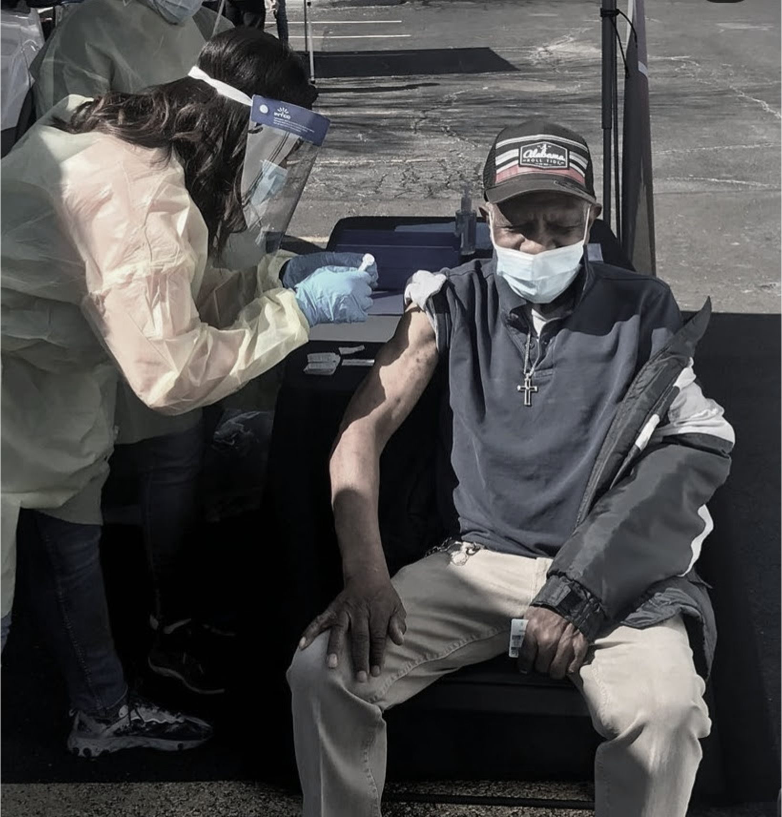
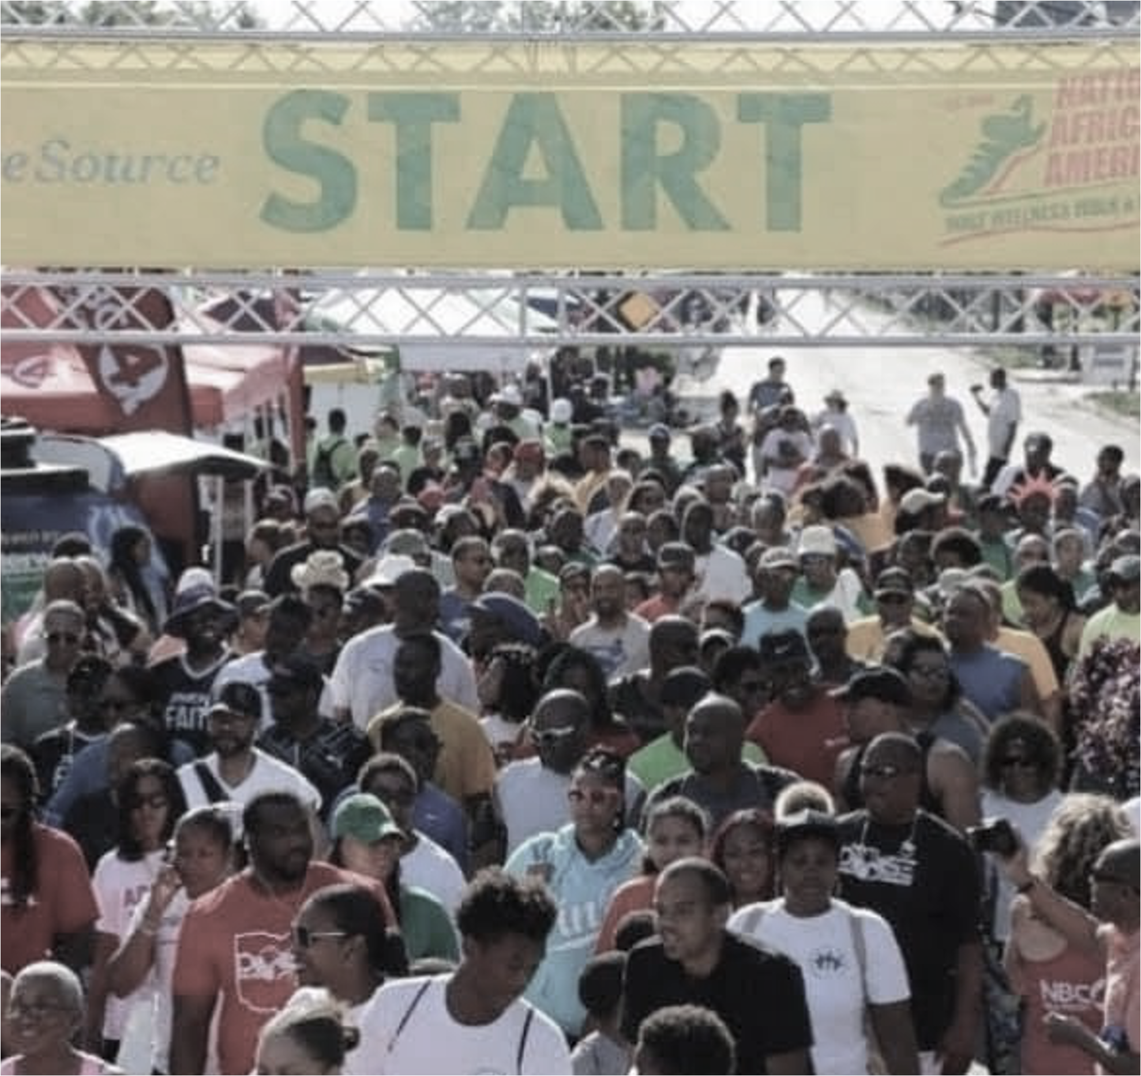
WE BUILD PEOPLE…
EDUCATION
WORKFORCE
HEALTH
COMMUNITY ENGAGEMENT
We offer high school diplomas to adults from 22 –100 years old and non-traditional tech high school ages 14 – 21.
We offer technology certifications for adults and high school students in high demanding industry careers.
We offer holistic health and wellness programming for African Americans to eliminate health disparities.
We specialize in diversity and inclusion training and community development.

Slide 4

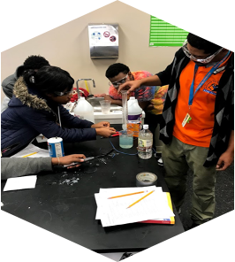
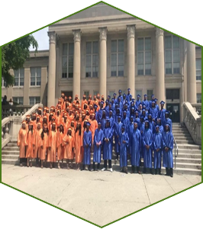
EDUCATION
URBAN EDUCATION: PATHWAY TO 2025
EMPLOYMENT
ENLISTMENT
ENROLLMENT
ENTREPRENEURSHIP
Academy for Urban Scholars High School
Spend $500,000 on student support
Providing cutting edge technology certifications,
Hands on approach to learning, with rigorous and relevant curriculum
Academy for Urban Scholars Adult Education Program
22+ and ASPIRE Provider
Over 725,000 adults in Ohio without a high school diploma
Serve adults 22 - 102
Over the past 5 years, 1000 adults earn high school diploma / GED
KEY FUNDERS
Key Bank
AEP
Perkins Foundation
IWIP (Innovative Workforce Incentive Program)
25%
GO TO COLLEGE
75%
GO INTO THE WORKFORCE

Slide 5
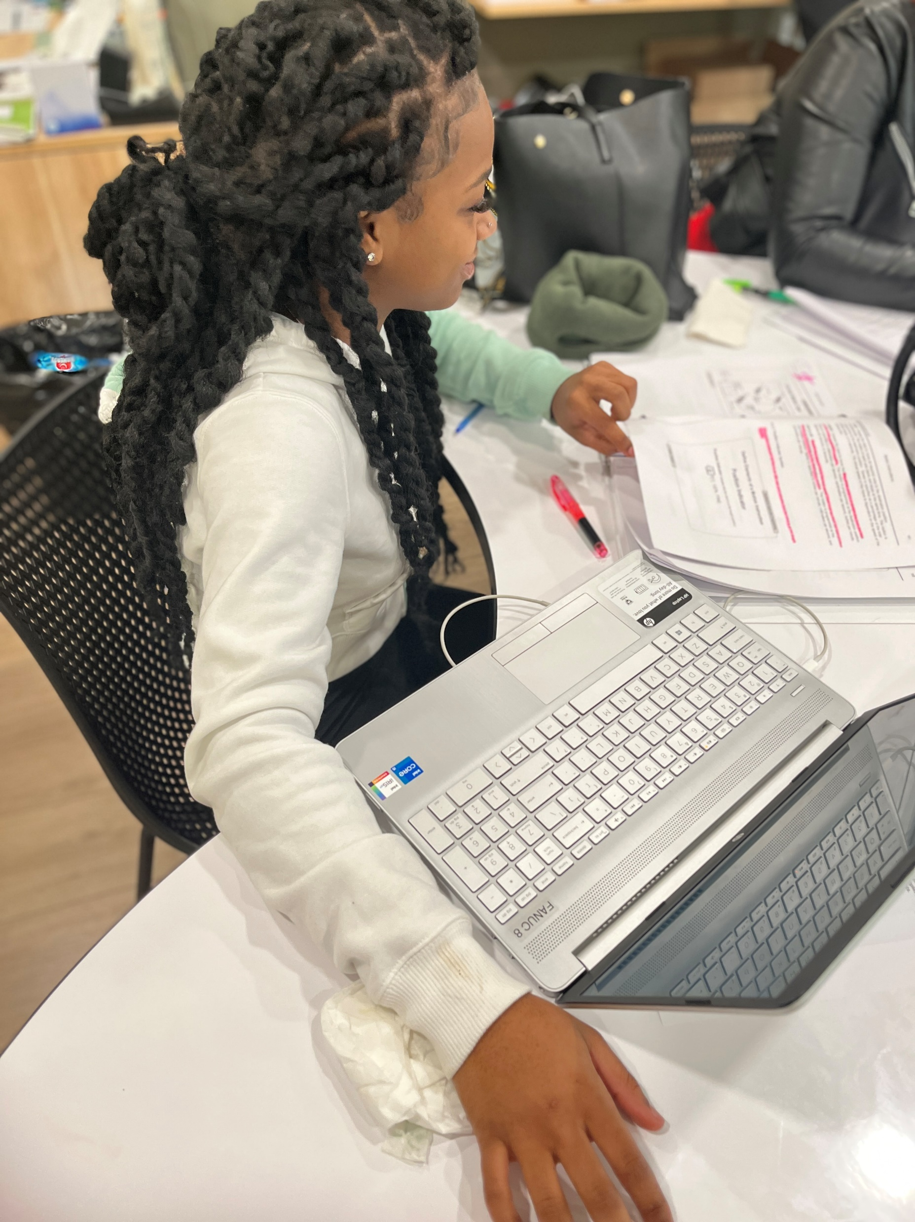
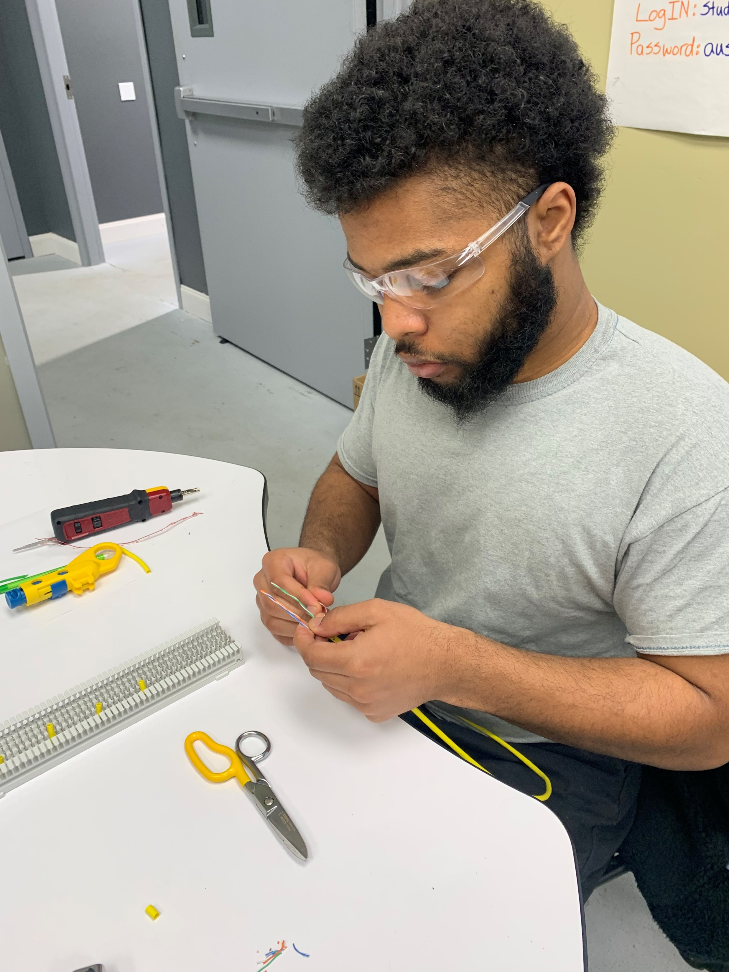
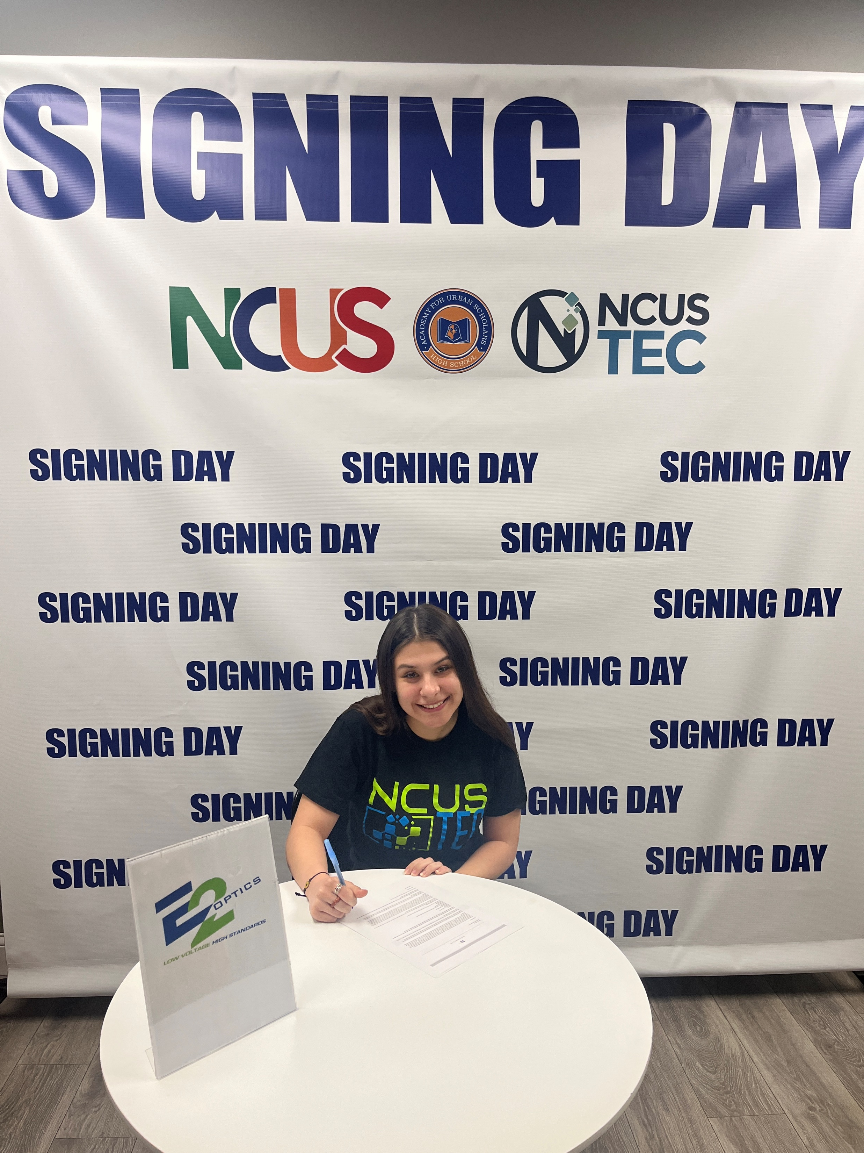
EDUCATION
WE BUILD PEOPLE IN…
Annually, we serve over 1,000 disengaged youth and adults by preparing individuals to earn a high school diploma.
Recognized as a top 10 dropout recovery program in the State of Ohio.
To date, we have graduated over 2,000 vulnerable individuals from Ohio’s most challenging communities.
Awarded for excellent financial reporting by the State of Ohio Auditor of State Award in both Youngstown and Columbus, Ohio.

Slide 6
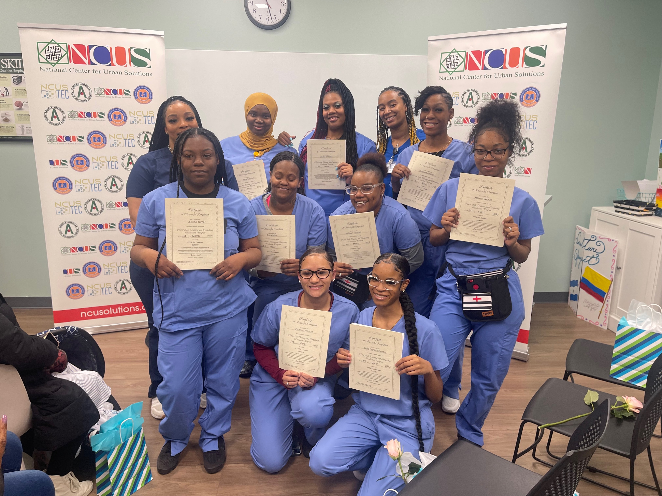
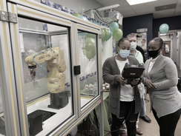
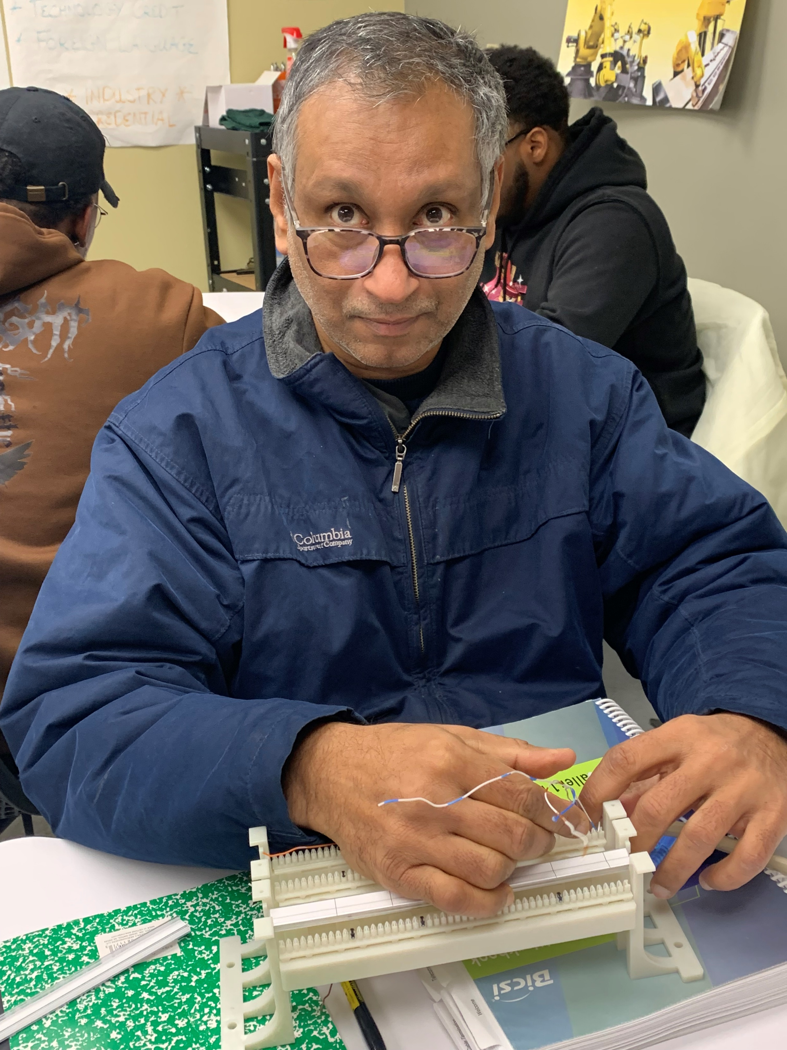
NCUS TEC
WE BUILD PEOPLE IN…
Approved through The Ohio Board of Colleges and Careers
Offer training in the following pathways:
Advanced Manufacturing, Construction, Healthcare, IT, Hospitality and Tourism
Work with students ages 16 yeas of age and up
Engage with over 360 individuals since July
Dual enrollment opportunities for high school students
Access to over 60+ employer partners

Slide 7

WORKFORCE DEVELOPMENT
LIFE WORKS WHEN YOU WORK
Employment & Job Skills Training (FCDJFS)
Closing skills gaps with underrepresented minority populations (NCUS TEC)
Direct placement employment recruiting
Diversity & Inclusion professional development training
“When it comes to job
placement and retention,
NCUS is the best agency in town.”
Scott Frazier, L Brands Talent & Acquisition
KEY PARTNERS
Franklin County Department of Jobs and Family Services
Governor's Office of Workforce Transformation
Workforce Development Board of Central Ohio
Ohio Development Agency
Franklin County Economic Office
Amazon, JP Morgan Chase, SK Food Groups, LBrands, Covermymeds, Google

Slide 8
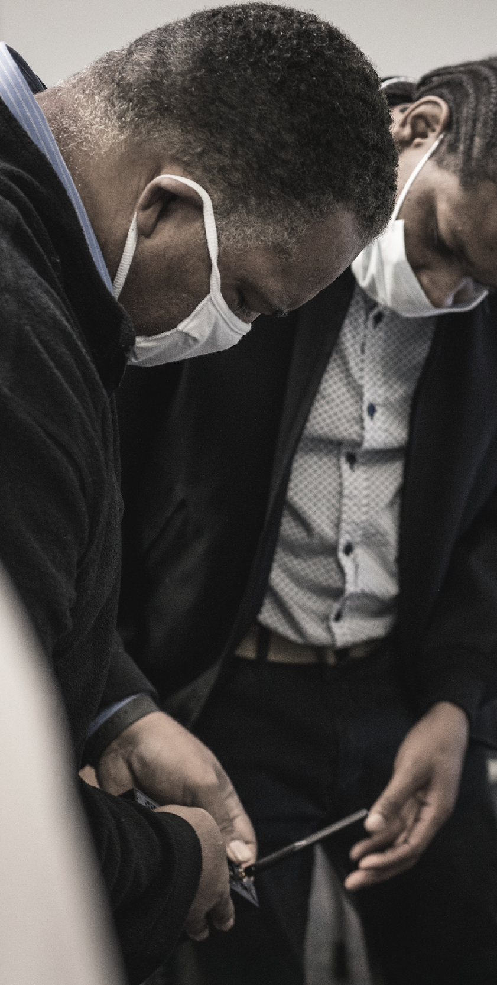
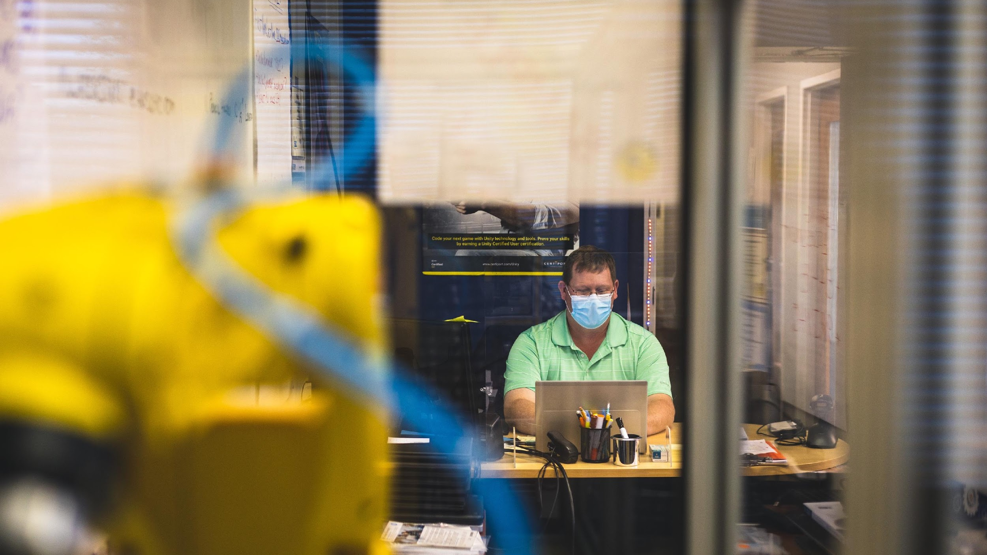
WORKFORCE
WE BUILD PEOPLE IN…
NCUS has moved over 25,000 individuals African American women towards self-sufficiency through programming with TANF, One Stop Workforce Development Systems, parenting programming and other economic development initiatives.
30 years of combined experience working with workforce development systems, and expertise in developing employer partnerships.
Engage over 5,000 job seekers annually.
Current Tech Initiatives: Information Technology Accelerator Partnership (ITAP), Individualized Microcredential Assistance Program (IMAP) and TECH CRED.
Columbus, OH, Youngstown, OH, Philadelphia, PA and Pittsburgh, PA.
HANDS ON TRAINING

Slide 9




HEALTH & WELLNESS
A HOLISTIC BLACK IMPACT FOR AFRICAN AMERICAN MEN AND THEIR FAMILIES
Reducing the health disparities plaguing the African American community through the focus areas of physical health, mental health, financial health, fatherhood, mentorship and research.
Providing awareness and education to help African American males live longer.
Providing health screenings to African American men and their families for diabetes, COVID-19, prostate screening, HIV, BMI, glucose and blood pressure.

Slide 10
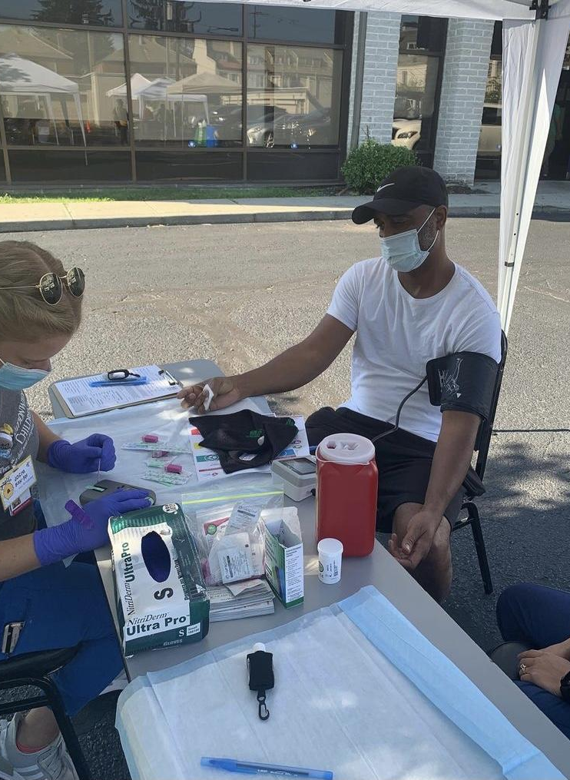
WE BUILD PEOPLE IN…
HEALTH
Our health initiatives
150,000 PARTICIPANTS
Engages over 150,000 individuals annually through the African American Male Wellness Walk and the agency’s programming
16 CITIES NATIONALLY
Has a presence in over 16 cities across the United States
10,000 SCREENINGS
Performs over 10,000 health screenings annually
100 PHYSICIANS
Supported by over 100 African American physicians across the nation
15 HOSPITAL NETWORKS
Works with 15 of the nation's largest hospital networks : New Orleans East Hospital
New Orleans , Novant Health Hospital - Charlotte, Howard University Hospital - DC , Wayne State University Hospital - Detroit , Mercy Health Hospital - Youngstown, Toledo, Cincinnati
KEY PARTNERS
Caresource
Abbott
Meijer
Wright Patt Credit Union
Franklin County Public Health
Franklin County Commissioners
Equitas
Big Lots
Cigna
Covermymeds
Columbus Parks and Recreation
Franklin County Department of Jobs and Family Services
COMMUNITY HEALTH SCREENINGS

Slide 11







COMMUNITY
ENGAGEMENT
WHEN A COMPANY WANTS TO ENGAGE WITH THE AFRICAN AMERICAN COMMUNITY THEY CALL US....
ONE
TWO
Grassroots Outreach and Engagement
#1 Approach
Community Revitalization: Safety Planning
THREE
Economic Development
KEY PROJECTS
Partners Achieving Community Transformation (PACT)
City of Columbus WIFI Project (PACT)
Walsh/Turner Joint Venture Construction and The Ohio State State University
Weinland Park Collaborative
American Diabetes Association (Baxter & Abbott)

Slide 12
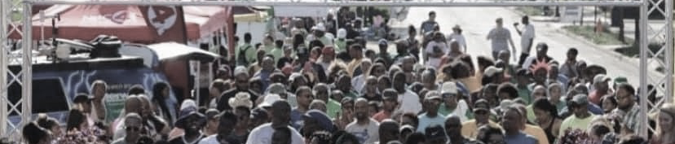
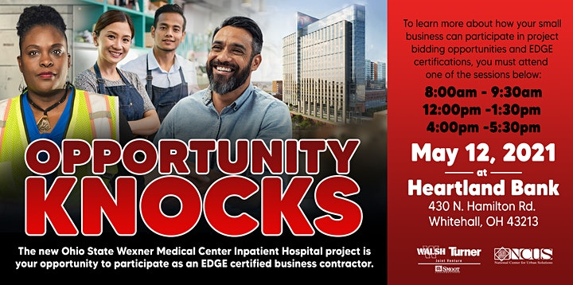



WE BUILD PEOPLE THROUGH…
COMMUNITY
ENGAGEMENT
OPPORTUNITY KNOCKS!
NCUS exceeded the state of Ohio’s EDGE Workforce goals by having 36% Edge participation, 17% Minority male participation and 5% female participation in construction of the billion dollar construction of OSU Wexner Medical James Cancer Center.
THE PACT
In 2016, Partners Achieving Community Transformation (PACT) in Columbus, OH partnered with NCUS to develop an-in-depth comprehensive safety plan.
SMART COLUMBUS
Providing 700 residents on the south and near east side with FREE fiber internet access.
MASC UP
Distributed 90,000 mask kits to underserved communities during the COVID-19 pandemic.

Slide 13
“NCUS employment services has help significantly diversify our workforce at CMM.”
Deanna Springs Technical Recruiter, Cover My Meds
“In the history of my 27 years with the State of Ohio, I have never seen such large percentage of minority participation
on a State Funded project.”
Congresswoman Joyce Beatty

Slide 14
THANK YOU

