Slide 1
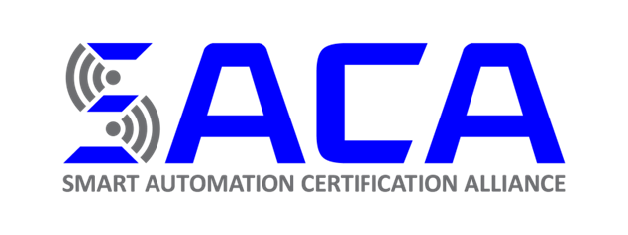
INDUSTRY 4.0 CERTIFICATIONS

Slide 2
Smart Automation Certification Alliance
Non-Profit Foundation - 501(c)(3)
Industry Supported
Mission: Develop occupational skills standards, promote careers, train teachers, and certify individuals in the many functions of Smart Automation (Industry 4.0 and Connected Enterprise) technologies.

Slide 3
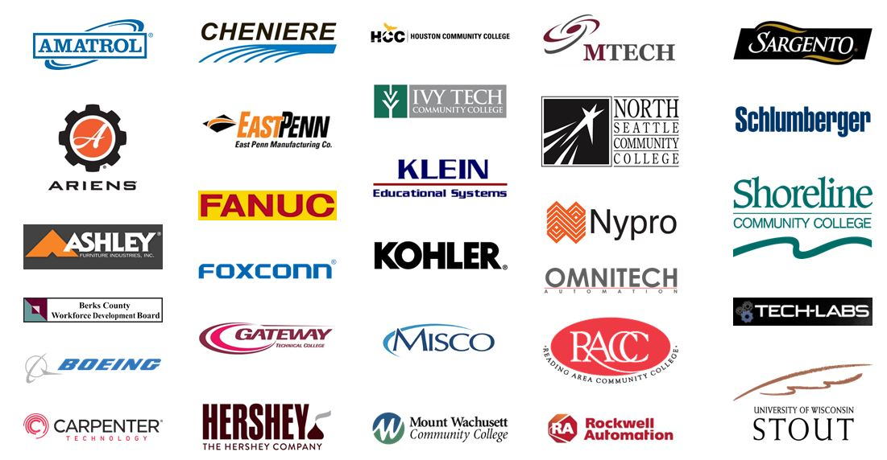
ORGANIZATIONS PROVIDING INDUSTRY SUPPORT

Slide 4
3M
Android Industries
Aggressive Tooling
Allergan
ALS Capris
Amatrol, Inc.
Amerequip Corporation
American Phoenix
Ariens Company
Ashley Furniture Industries, Inc.
Best Metal Products
Boeing
Boston Scientific
Cardinal FG
Carpenter Technology
Charterwire
Cheniere
CSM Ingenieria
Dos Pinos
East Penn Mfg. Co.
Espas Inc.
Fanuc America
FJR Automation Systems
Foxconn
Gamache Systems
Gateway Technical College
Generac
General Microcircuits
Grantek
Great Lakes Cheese
Greenheck
Harley-Davidson Motor Co
Hatch Stamping Company
Herbrucks
Hologic
i4Score.com
Jackson Area Manufacturers Association
JR Automation
Kohler
K-O Products Company
Lab Midwest
Metalcraft
MFP Automation Engineering
Michigan Automotive Compressor, Inc.
Misco Products
M-Tech Control
Muth Mirror Systems
Neon Nieto
Nolato
Nypro Inc.
Omnitech Automation, Inc.
Panduit
Parker Hannifin
Plexus Corp.
PMG, Inc.
Rockwell Automation
Sargento Foods, Inc.
SC Johnson
Schlumberger
Schneider
Smith & Nephew
TAC Manufacturing
Technique, Inc.
The Hershey Company
Trane
U.W. Stout
Vitec P.S.
Werner Electric
Willis Information Technologies
XCAL Tools

Slide 5

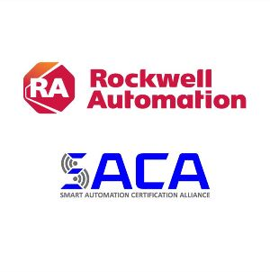

Michael Cook, Rockwell Automation’s Director Global Academic Partnerships, recently endorsed the Smart Automation Certification Alliance’s efforts to create standards ensuring industry that potential employees possess up-to-date Industry 4.0 skillsets.
Rockwell Automation also joined SACA as a Platinum Member, which allows them to offer SACA certifications to their employees and provide scholarships to sponsor educational institutions and teachers when they start new certification programs in Industry 4.0. This commitment will impact the standards and future direction of the certifications and promote the leadership in Industry 4.0 education.
“Technology disruption is widening the gap between student learning and industry relevance of learning. At the same time, it is also shortening the shelf life of degrees and opening up variable pathways of learning. To narrow this gap we are actively participating with the Smart Automation Certification Alliance and other industry stakeholders working alongside education to create relevant standards around Industry 4.0 and more importantly access to relevant stackable learning.”

Slide 6
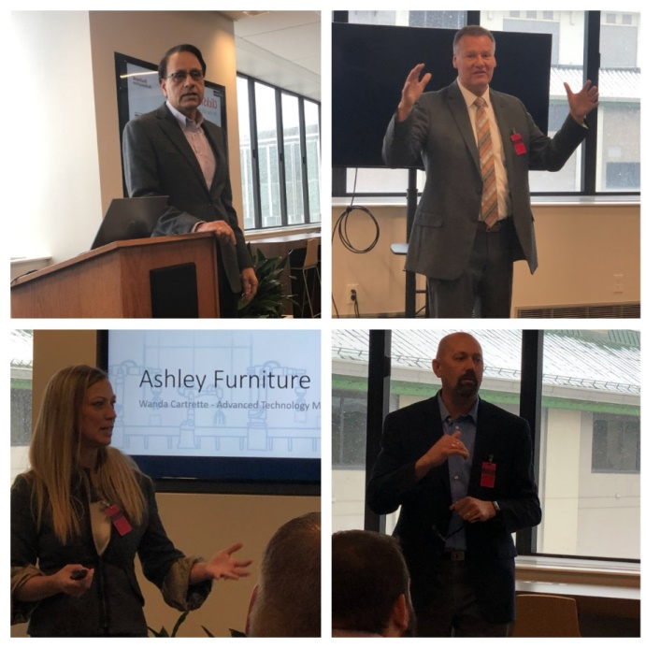

CERTIFICATION – FEATURES –
Professional Certification Development
– hosted by Rockwell Automation
Industry Driven Standards
Developed by industry for industry
Based on international skill requirements
Industry developed standards
Industry developed tests
ISO Certification Process
ISO 17024 compliant process
Industry groups developed the standards and tests
Validated by broad industry groups
Pilot testing & statistical analysis to ensure quality

Slide 7
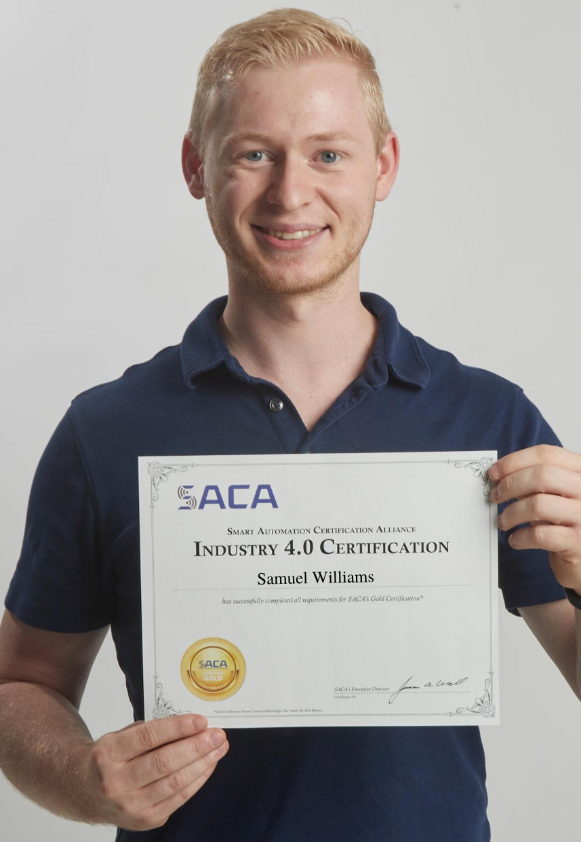
Silver & Gold Certifications
All SACA certifications can be attained on two levels: Silver and Gold.
SACA Silver Certifications: This certification is awarded to candidates who successfully pass the written knowledge exam. Silver Certification is ideal for those individuals who are seeking to validate online core achievement or when hands-on testing is not available.
SACA Gold Certifications: This certification is awarded to candidates that successfully pass the written knowledge exam and successfully complete the hands-on performance assessments on approved equipment.

Slide 8
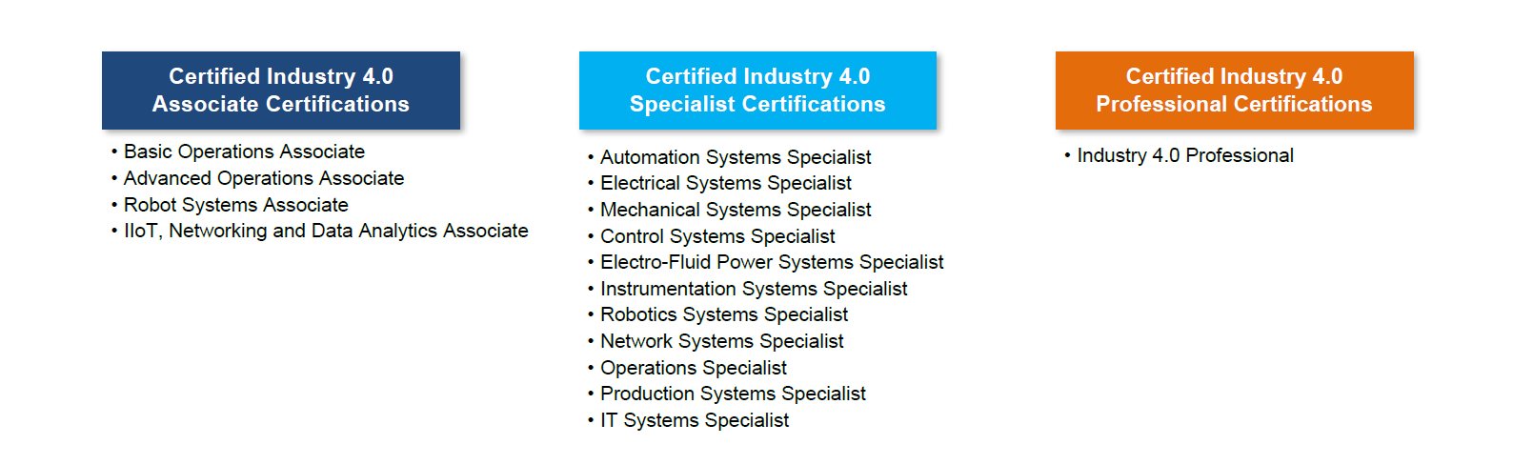
SACA OCCUPATIONAL CERTIFICATION TYPES
Associate Certifications – provides individuals a solid foundation of advanced manufacturing in an Industry 4.0 environment. Can be used to enhance the skills of IT technicians, maintenance technicians, and others. These certifications are applicable at the high school or college level and as a certificate for incumbent workers.
Specialist Certifications – certify Industry 4.0 technical skills in operations, troubleshooting, programming, maintenance, and systems integration. Each certification is keyed to a skilled occupation.
Professional Certifications – prepare for engineering positions in a Smart Factory/Industry 4.0 environment. Focuses on design & optimization of Industry 4.0 Systems

Slide 9
Certified Industry 4.0 Associate I Basic Operations
Outcome : Entry Level Operations
Competencies:
Concepts and terminology of Smart Manufacturing
Basic setup, adjustment and operation of automated machines
Safety and Hand Tools
Blueprint and Schematic Reading
Precision Measurement
Basic electrical control, pneumatic, and sensor systems operation
Basic robot operation and terminology
Production Monitoring via HMI, Internet, Ethernet, Smart Phones

Slide 10
Certified Industry 4.0 Advanced Operations Associate
Outcome: Advanced Level Operations
Competencies:
Smart Manufacturing system metrics and optimization
Setup, adjustment and operation of computer-controlled machines
Basic Ethernet network operation
Basic programmable controller programming and operation
Basic mechanical and hydraulics system operation/adjustment
Basic mechatronic systems programming and operation
Basic robotics and CNC programming/ operation
HMI interface and operation

Slide 11
Certified Industry 4.0 Robotic Systems Associate
Outcome : Robotic Systems Operations
Competencies:
Concepts and terminology of robots
Robot setup, adjustment
Robot operation and basic programming
Fixtures/End of Arm Tooling types and selection
Robot-Ethernet network communications
Robot I/O device and PLC system interfacing
Robot monitoring and cycle time optimization
Robot smart manufacturing concepts

Slide 12
Certified Industry 4.0 IIoT, Networking, and Data Analytics Associate
Outcome : Data Analytics and Networking
Competencies:
Concepts of Industrial Internet of Things (IIoT)
PLC Ethernet Messaging Communications
Barcode and RFID programming and operation
Smart Sensor programming and operation
Managed Ethernet Switch configuration and operation
Variable frequency drive programming
SQL Database Systems
Data Analytics and Manufacturing Execution Systems (MES)
Lean Manufacturing and System Optimization

Slide 13
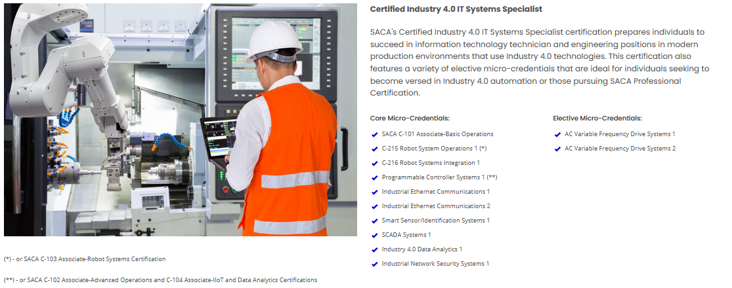
MICRO-CREDENTIALS
SPECIALIST & PROFESSIONAL
Specialist & Professional certifications are modular certifications, consisting of a series of core and elective micro-credentials, each with its own hands-on practical assessment and a written (online) knowledge assessment.
Core micro-credentials certify skills that are applicable to all companies
Elective micro-credentials can be added to match with regional or specific company needs.

Slide 14
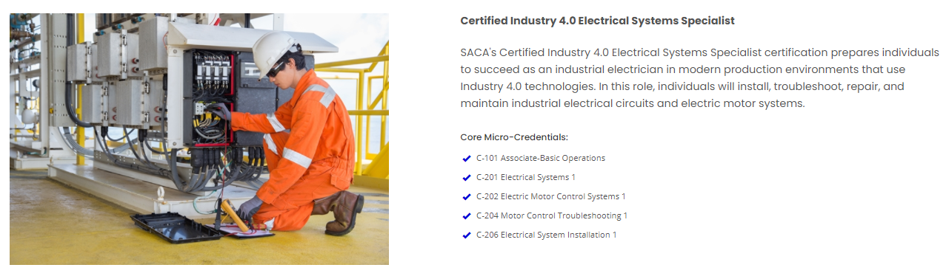
OCCUPATIONAL CREDENTIAL
EXAMPLE – ENTRY LEVEL
Industry 4.0 Electrical Systems Specialist
Approximately 250 - 350 hours preparation time

Slide 15
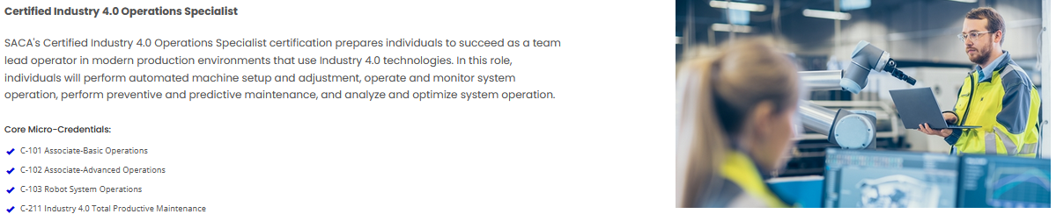
OCCUPATIONAL CREDENTIAL
EXAMPLE – ENTRY LEVEL
Industry 4.0 Operations Specialist
Approximately 280 - 350 hours preparation time

Slide 16
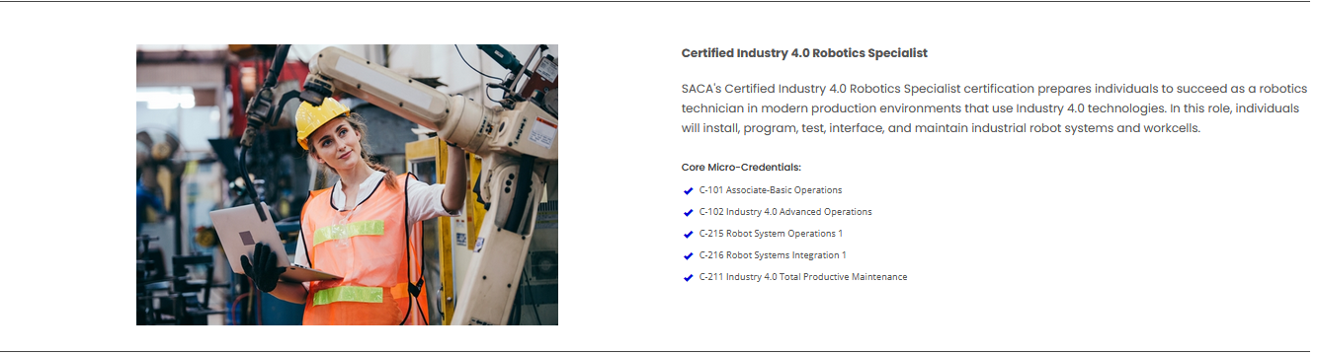
OCCUPATIONAL CREDENTIAL
EXAMPLE – ENTRY LEVEL
Industry 4.0 Robotics Specialist
Approximately 250 - 300 hours preparation time

Slide 17
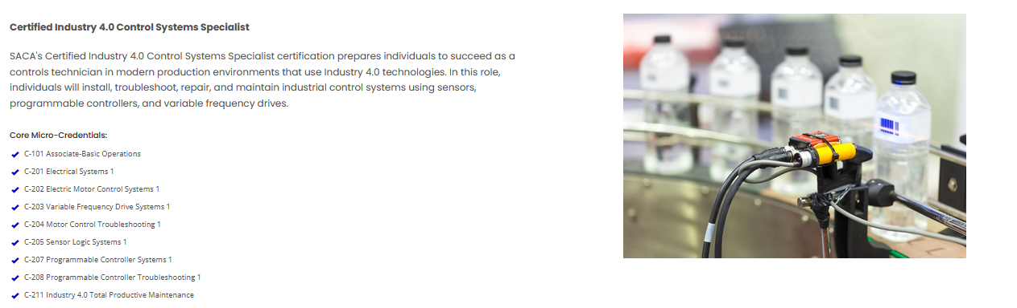
OCCUPATIONAL CREDENTIAL
EXAMPLE – Higher Skill Level Occupation
Industry 4.0 Control Systems Specialist
Approximately 400 - 450 hours preparation time

Slide 18
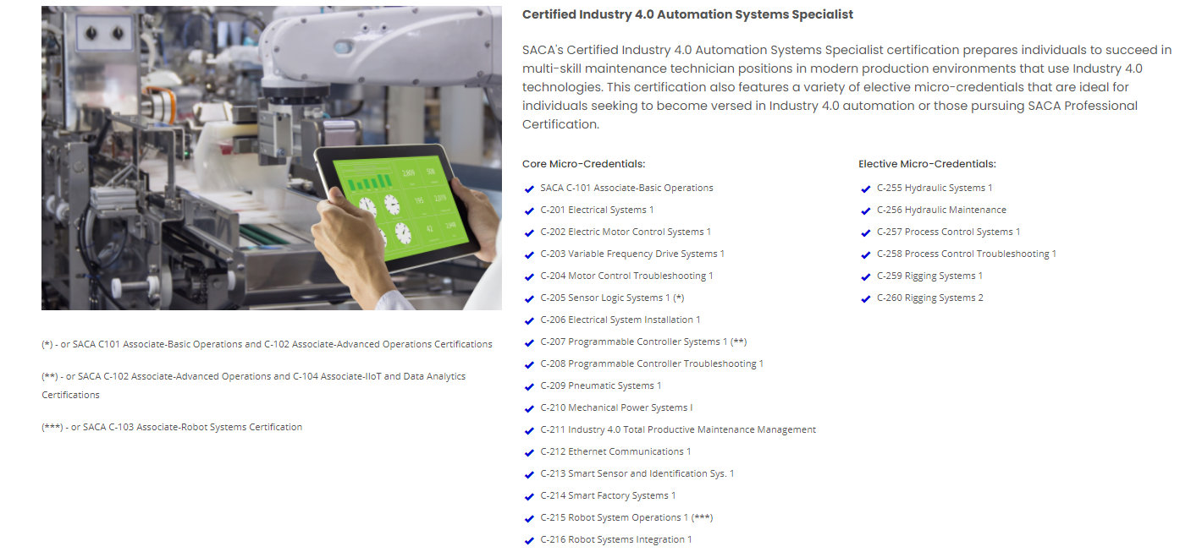
OCCUPATIONAL CREDENTIAL
EXAMPLE – Higher Skill Level Occupation
Automation Specialist I
Approximately 700-1000 hours preparation time

Slide 19

OCCUPATIONAL CREDENTIAL EXAMPLE – Advanced Skill Level Occupation
Automation Specialist II
Approximately 700 -1000 hours preparation time
Core Micro-Credentials:
✓ C-301 Mechanical Power Systems 2
✓ C-302 Laser Shaft Alignment 1
✓ C-303 Electric Motor Troubleshooting 1
✓ C-304 Pneumatic Troubleshooting 1
✓ C-305 Industrial Electronic Systems 1
✓ C-306 Industrial Electronic Systems 2
✓ C-307 Electronic Systems Installation 1
✓ C-308 Variable Frequency Drive Systems 2
✓ C-309 Programmable Controller Systems 2
✓ C-310 Ethernet Communications 2
✓ C-311 Data Analytics 1
✓ C-312 Robot Systems Integration 2
✓ C-313 Smart Factory Systems 2
Elective Micro-Credentials:
✓ C-351 Predictive Maintenance 1
✓ C-352 Mechanical Power Systems 3
✓ C-352 Mechanical Power Systems 3
✓ C-353 Mechanical Power Systems 4
✓ C-354 Hydraulics Systems 2
✓ C-355 Hydraulics Troubleshooting 1
✓ C-356 Process Control Systems 2
✓ C-357 Process Control Troubleshooting 1
✓ C-358 Autonomous Mobile Robot Systems 1
✓ C-359 Programmable Controller Systems 3
✓ C-360 Motion Control Systems 1
✓ C-361 Programmable Conveyor Systems 1
✓ C-362 Machine Vision Systems 1

Slide 20

SACA INDUSTRY 4.0 CREDENTIALS
Industry Relevant
High Quality Credentials
Tied to Occupations
Flexible
Low Cost
Instructor Training
Pathways

Slide 21

Questions? Support@saca.org

Slide 22
Development and Promulgation of National Industry Skill Standards
Identification of subject matter experts from industry-leading companies
Form technical workgroups
Technical Workgroup develops draft standard
Draft standard undergoes regional validation
Draft standard edited based on validation feedback
Standard published as a national industry skill standard

Slide 23
Development of Certification Exams and Procedures
Conduct a job task analysis based on national skill standards
Develop exam blueprint
Develop exam items - both cognitive and psychomotor
Review and validate exam items
Assemble and deliver pilot examinations
Statistically analyze pilot exam results
Construct equivalent exam forms
Establish the passing score
Administer / score operational exams
Provide ongoing test maintenance

