Slide 1
State Supported Internships
Michelle Washington and William Ashburn
April 2023

Slide 2
High School Tech Internship Pilot Program
In collaboration with the Ohio Departments of Development, Education and Governor's Office of Workforce Transformation
Opportunity for Ohio employers to receive wage reimbursement through establishing partnerships with schools and hosting high school interns in tech-related internship roles
Technology pathways (software development, data, cloud & IT infrastructure, broadband/5G, cybersecurity)
Program open from January 3rd – October 1st 2023
Statewide pilot (intermediary facilitation two JobsOhio regions)

Slide 3
High School Healthcare Preceptor Pilot
In collaboration with the Ohio Department of Health and Ohio Department of Higher Education
Paid Internships
Healthcare Pathways
All students take medical terminology and CPR
Students are placed in practicum in clinical setting for 40 hours
Grantees include: Nationwide Children’s, Leading Age Ohio, Health Impact Ohio, Federal Hocking Schools, Primary One Health, Heart of Ohio Health, Five Rivers Health Centers, Jennings Center for Older Adults and NAMI.

Slide 4

Partners in Developing Workforce
Cassie Barlow cassie.barlow@soche.org
April 2023

Slide 5


SOCHE Overview
Non-profit founded in 1967 SOCHE, focused on engaging with colleges, universities, K-12, and industries to transform the economy through education and employment.
Annually, employs hundreds of interns (High School through Postdoctoral) in businesses of all types to include government agencies.

Slide 6











SOCHE Portfolio
Professional Development
Workforce Development
Vision:
An educated, employed, and engaged citizenry
High School
+
College Students
=
Tomorrow’s
Workforce
Cross Registration
Councils & Committees

Slide 7
College and University Partners
Air Force Institute of Technology
Antioch College
Antioch University Midwest
Bowling Green State University
Case Western Reserve University
Cedarville University
Central State University
Cincinnati State Technical and Community College
Clark State Community College
Cleveland State University
Edison State Community College
Franklin University
Kent State University
Kettering College
Kettering Foundation
Miami University
Miami University Regionals
Northeastern Ohio Medical University
Ohio University
Shawnee State University
Sinclair Community College
Southern State Community College
The Ohio State University
University of Akron
Union Institute & University
University of Cincinnati
University of Dayton
University of Toledo
Wilberforce University
Wilmington College
Wittenberg University
Wright State University
Youngstown State University
SOCHE member institutions are in bold.

Slide 8
K-12 and Industry Partners
Dayton Public Schools
Fairborn Public Schools
Beavercreek Public Schools
Springboro Public Schools
Brookville Public Schools
Vandalia Butler Public Schools
Dayton Region STEM School
Centerville Public Schools
Greater Ohio Virtual School
CTC (Greene, Montgomery, etc)
Edison State Community College
Franklin University
Kettering Public Schools
Carroll, CJ, Alter, Lasalle, Moeller
Lebanon Public Schools
Etc….
Technology First
Dayton Region Manufacturers Assoc.
Associated Construction & Builders
Greater Dayton Area Hospital Assoc
Dayton Area Logistics Association
CareSource
Dayton Childrens
Dysinger
Kettering Health
Alluring Glass
Mr. Label Company
APDC Companies (200+)
Etc

Slide 9
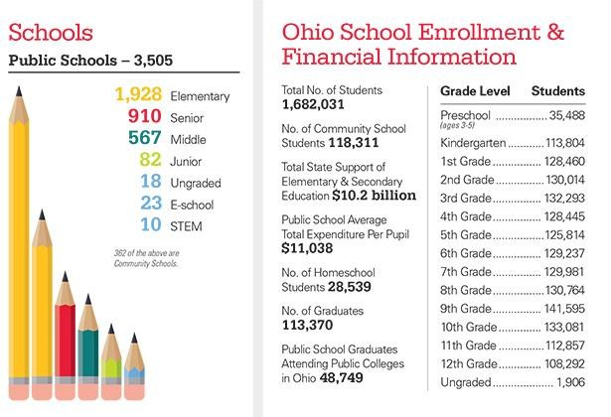
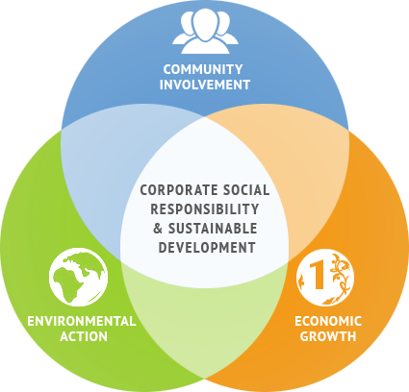
The Pipeline -- The Reality -- The Opportunity
~220,000 Juniors & Seniors in Ohio are in the pipeline every year
  ~43% elect College path
  ~57% enter Career path (~65,000 enroll in On-the-Job-Training….)
~400K College students in our State

Slide 10


Why Hire Interns – Practice says….
Reduce Brain Drain – Only 69% of
Ohio’s College Graduates stay in Ohio
Who stays in Ohio?
  61% of Engineers
  63% of Scientists
  71% of Business Professionals
Demand/Competition for Talent
Fuel Ohio’s In-Demand Jobs
Ohio needs world-class talent to attract/retain companies
https://www.ohiohighered.org/sites/default/f iles/hei/sp18_grads_0.pdf

Slide 11


Why Hire Interns – Research says…..
Cream of the Crop - 67% of college grads are offered full-time positions after their internship.
Find Future Employees - Year-round recruiting tool and ongoing pipeline.
Better Retention - Interns have significantly greater retention rates after five years when compared to outside hires. (52% vs 35%).
Test Drive - The best way to evaluate a potential employee is through an internship.
Inspire Your Best Thinkers - Interns bring fresh ideas and can work with or free time for your best employees to explore new territory.
Source: National Association of Colleges and Employers (NACE)

Slide 12
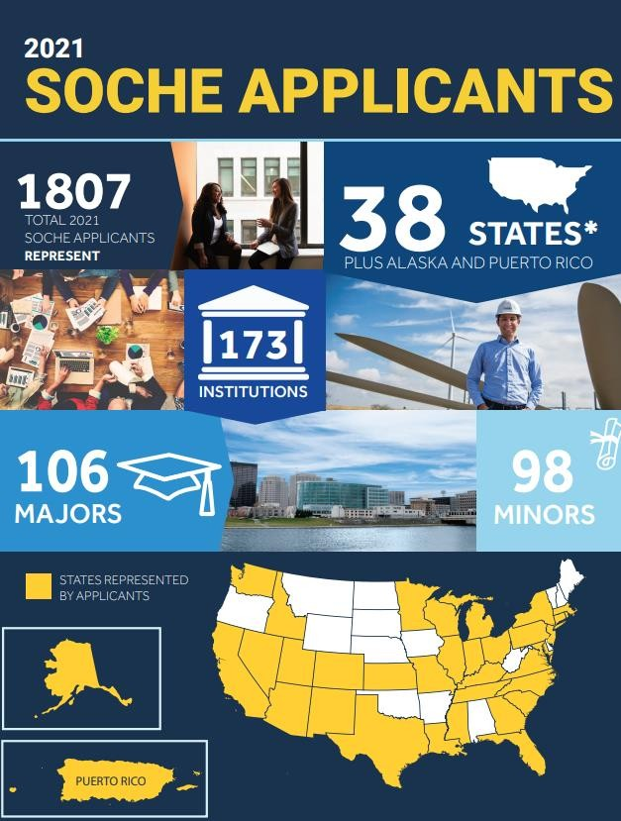

Slide 13
OhioMeansJobs - Job Readiness Skills
Reliability
Work Ethic
Discipline
Teamwork/Collaboration
Professionalism
Learning Agility
Critical Thinking/Problem Solving
Punctuality
Leadership
Creativity/Innovation
Oral and Written Communication
Digital Technology
Global/Intercultural Fluency
Career Management

Slide 14


Slide 15
Attributes of Gen Z in the workforce
Problem-Solvers
Leaders
Creative
Drive and Commitment
Seek Knowledge and Challenges
Contributors

Slide 16
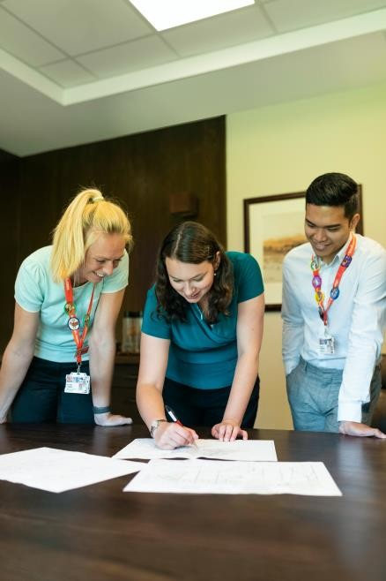
Tips for a Successful Internship
Define clear job duties, expectations, and goals
Explain company mission and intern’s role
Conduct 30-minute individual meetings with team
Designate a mentor
Encourage two-way feedback
Include intern in team activities
Allocate time to train intern and learn from intern
Communicate long-term employment plans

Slide 17
Steps for a Company to Hire an Intern
Create a job description
  Include job summary and preferred skillset, major and required hours
Set salary
Advertise position with appropriate schools
Interview applicants
Hire student
Assign mentor

Slide 18
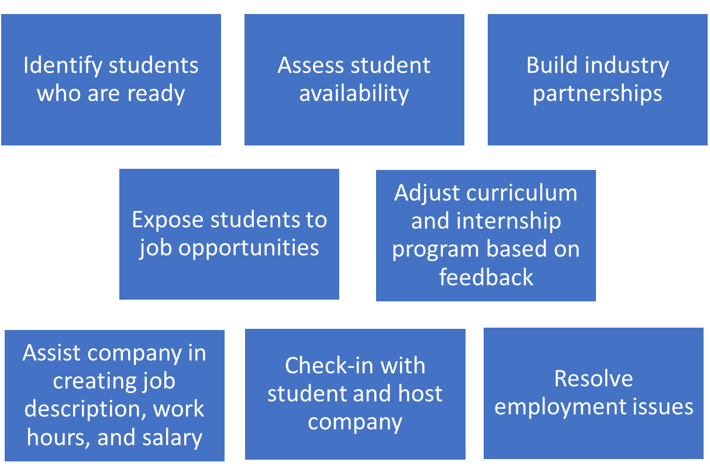
Steps for Schools to build an internship program

Slide 19
Need help building a work-based learning program?
Contact SOCHEIntern Team:
Creates Job Description based on company’s
need
Advertises and Pre-screens candidates
Sends best candidates to company for interviews and selection
Hires intern
  payroll, employee taxes, insurance, and professional development training
Converts intern to company payroll upon
graduation
Contact Patty Buddelmeyer at patty.buddelmeyer@soche.org

Slide 20


Partnering with SOCHE is easy
Step 1: (Form Partnership)
SOCHE and Business agree to work together to provide a student with an internship opportunity
Step 3: (Find Talent)
SOCHE works with School
Step 2: (Define Internshi
p)
SOCHE works with Business
to:
to:
Ensure skill expectations are realistic
Prepare Business for hosting a high school or college student
Develop job description
Define work conditions
Find qualified candidates for Business to interview
Coordinate hired student’s class schedule
Step 4: (Manage Employment Cycle)
SOCHE manages onboarding, orientation, hiring, payroll actions, taxes, and insurance
SOCHE invoices business monthly for the hours the intern works
Business focuses on providing intern meaningful work and guidance
School focuses on developing student through coursework
Student continues internship and employment opportunities through SOCHEIntern and DAGSI programming and no transfer fees to convert to business payroll

Slide 21

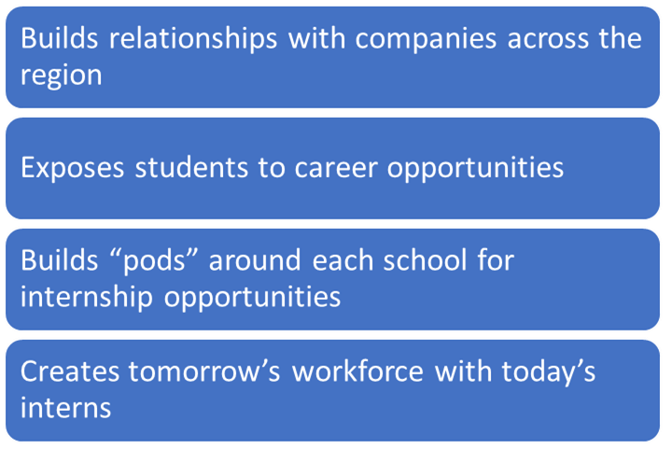
Financial Support for Companies who Hire High School Interns
Supplement’s student’s salary by at least 50%
and up to 100%
Grants made possible:
Engineering & Science Foundation of Dayton
Ohio College Tech Prep
ODE
DOE

Slide 22

Students who are paid for an internship are more motivated, valued, and committed
Students gain critical money management skills
The money earned during an internship helps support the student’s immediate financial needs and long-term savings goals like tuition and housing
Paid internships open the door for increased future wages and diverse opportunities
Unpaid internships eliminates the potential for internships for the underprivileged and underserved population

Slide 23
Questions?

Slide 24



INTERalliance of Greater Cincinnati
Growing and diversifying the IT talent pipeline by designing and delivering innovative technology programs, in partnership with businesses, high schools, and universities.

Slide 25



ABOUT US
WHO WE ARE
The INTERalliance of Greater Cincinnati is a non-profit, student-lead organization that is dedicated to helping other students explore the rich IT industry around Cincinnati.
OUR MISSION
To inspire and assist young talent to pursue an IT career in Greater Cincinnati
OUR VISION
To dramatically grow and diversify the IT talent pipeline by designing and delivering innovative technology programs, in partnership with businesses, high schools, and universities.

Slide 26



HIGH SCHOOL INTERNSHIPS
PROGRAM OVERVIEW
The INTERnship program makes hands-on, real-world learning
and workforce development a painless and meaningful experience.
1
2
3
The INTERalliance Intern Program allows students to take a deep dive into IT culture through a meaningful, paid opportunity.
Lasting between 8 and 10 weeks, High School Students are engaged in real-world projects.
With over 200 applicants, the INTERalliance program brings the top High School Talent to companies' doorstep.

Slide 27
HIGH SCHOOL TECH INTERN PROGRAM
Program Details
ADMINISTRATION: INTERalliance is the state-designated “intermediary” for the Program. Students are employed by INTERalliance. All admin tasks, onboarding, and HR concerns will be handled by INTERalliance. Organizations are billed for admin costs and program administration.
HIRING PROCESS: INTERalliance posts organization’s job descriptions. Orgs interview and choose. INTERns receive training from email etiquette to mock interviews. To be eligible for an INTERnship, students must have an approved LinkedIn profile and resume.
PAYROLL: Students are paid bi-weekly, based on hours logged through the INTERalliance portal. Once submitted and rationalized, the district approves for pay.
BILLING: A minimum of 1 pay period worth of INTERn Fees are required before the program start date. A minimum of Net-30 Terms is required, but Net-Zero is requested. INTERalliance also requests direct deposit for all invoices. State of Ohio Reimbursements will occur at the end of the INTERnship.

Slide 28










CONTACT
INTERalliance
Keith.Koehne@interalliance.org
513-218-7829
10290 Alliance Rd
Blue Ash, OH 45242
INTERalliance.org

Slide 29



Introduction
Tanikka Price, JD, EdD
Chief Education & Equity Officer

Slide 30
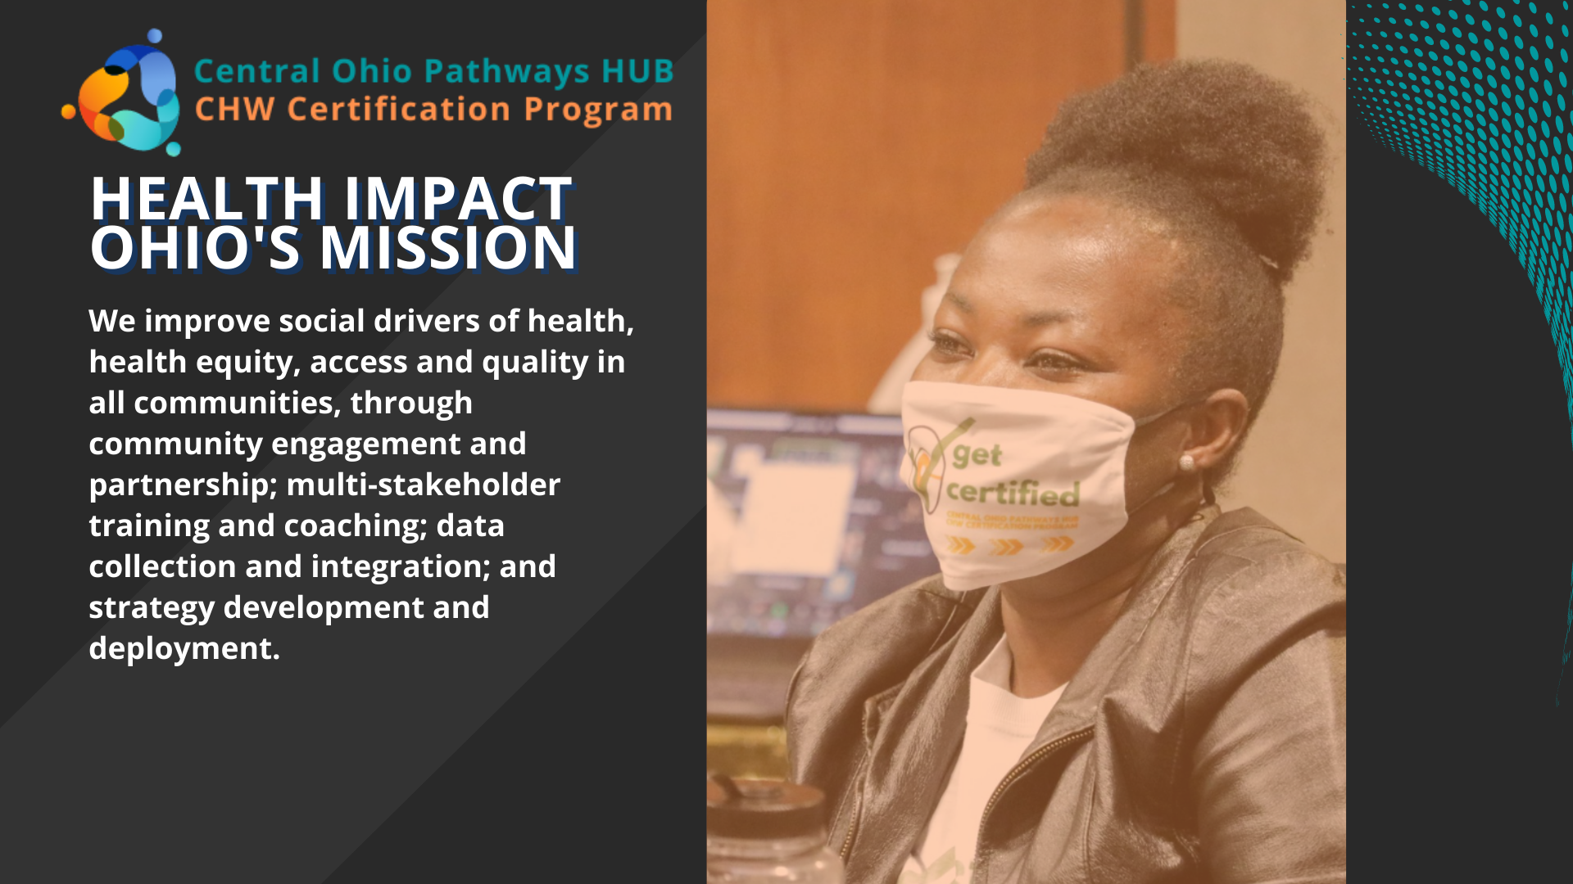

Slide 31


Slide 32



What is a Community Health Worker?
A Community Health Worker (CHW) is an individual, known in the HUB as a care coordinator, who lives, works, or worships in the community that they serve. CHWs are employed at Care Coordination Agencies (CCA) as well as various medical and social service providers. CHWs are experts at connecting their clients with quality care and services to address the health risks that affect their lives as they reside in at-risk communities. By making connections that link individuals with the resources and services which specifically meet their needs they help address their clients Social Determinants of Health (SDOH).

Slide 33
The Role of the CHWs
Health care competencies
  Basic anatomy and physiology, CPR, Radial pulse, Knowing when to call 911, documentation methods
Community resources
  Identifying and referring to local resources
Communication skills
  Interpersonal communication, written communication, non-verbal communication, health literacy
Individual and community advocacy
  Self-care, recognizing diversity, advocating for underserved populations
Health education
  Lifestyle choices impact on health, addiction identification, oral health, first aid
Service skills
  Safety, basic office skills, time management, conflict resolution.

Slide 34
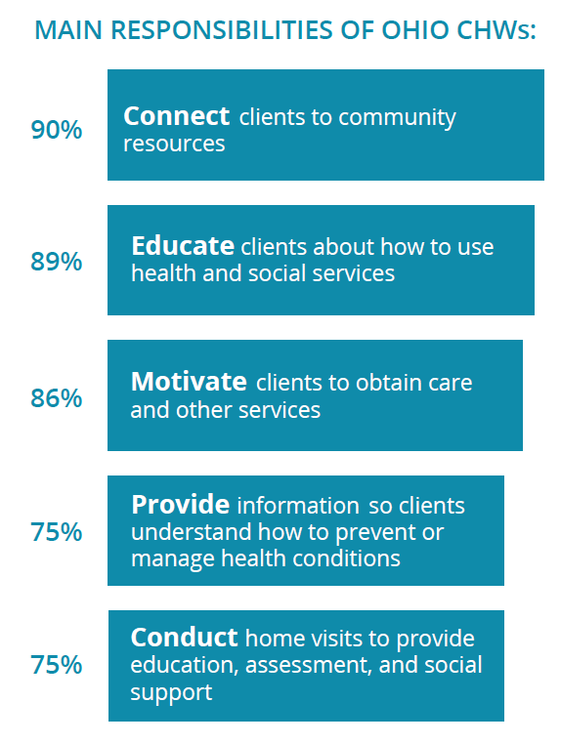
Notes:
Ohio Department of Health and
Ohio Colleges of Medicine
Government Resource Center
2018 Community Health Worker
Statewide Assessment

Slide 35
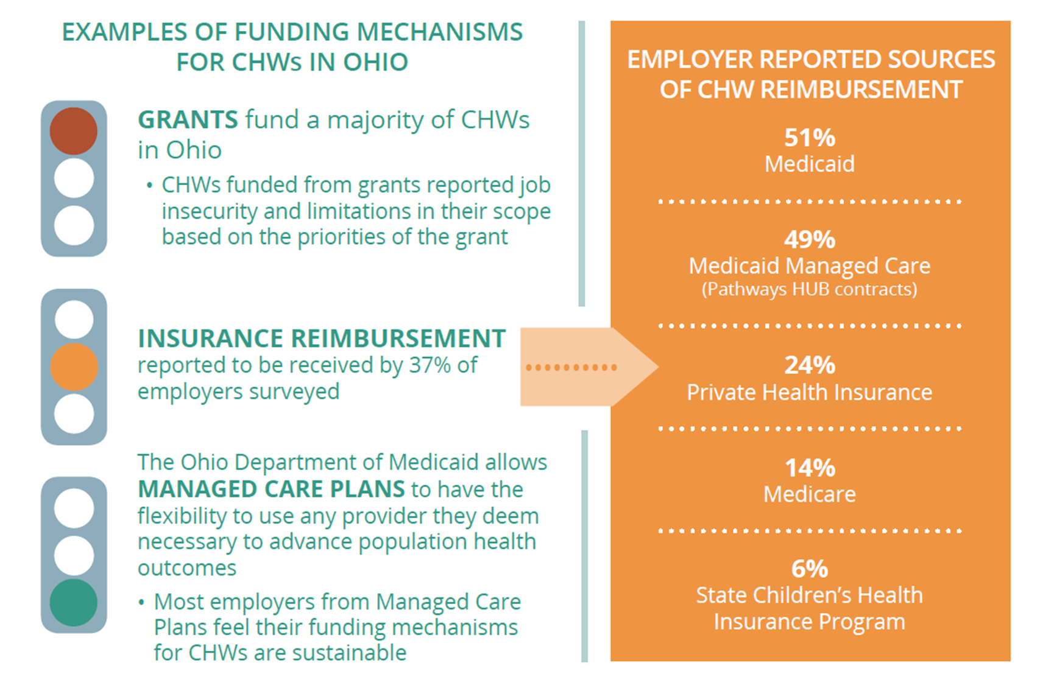
Notes:
Ohio Department of Health and
Ohio Colleges of Medicine
Government Resource Center
2018 Community Health Worker
Statewide Assessment

Slide 36
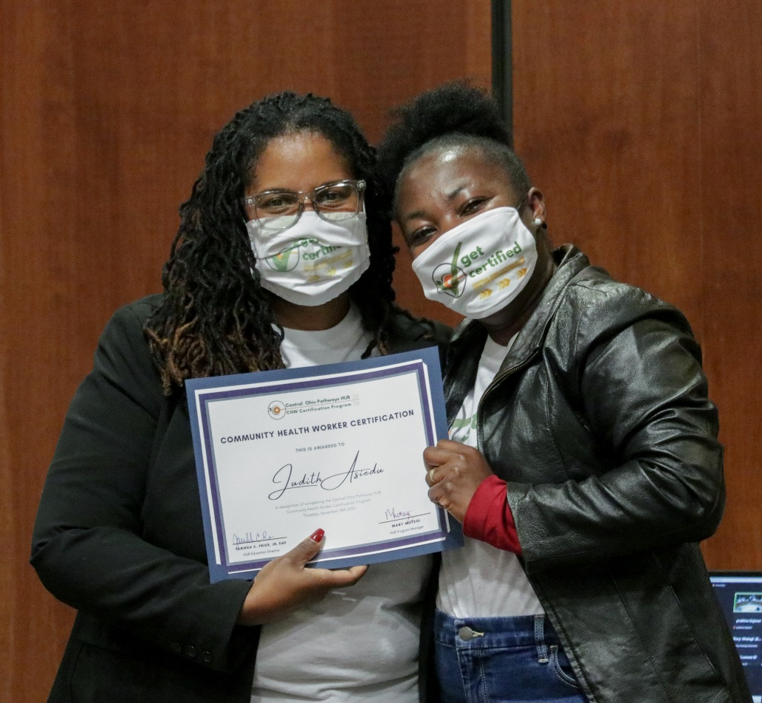
CHW Certification Training
Central Ohio Pathways HUB Certification
Training Program
  July 2020 got approval from Ohio Board of Nursing
  Since August 2020- 4 Cohorts have been Certified
  Currently teaching the largest class- 43 students
    High School Students
    Individuals currently working as CHW
    One individual with a PhD!

Slide 37
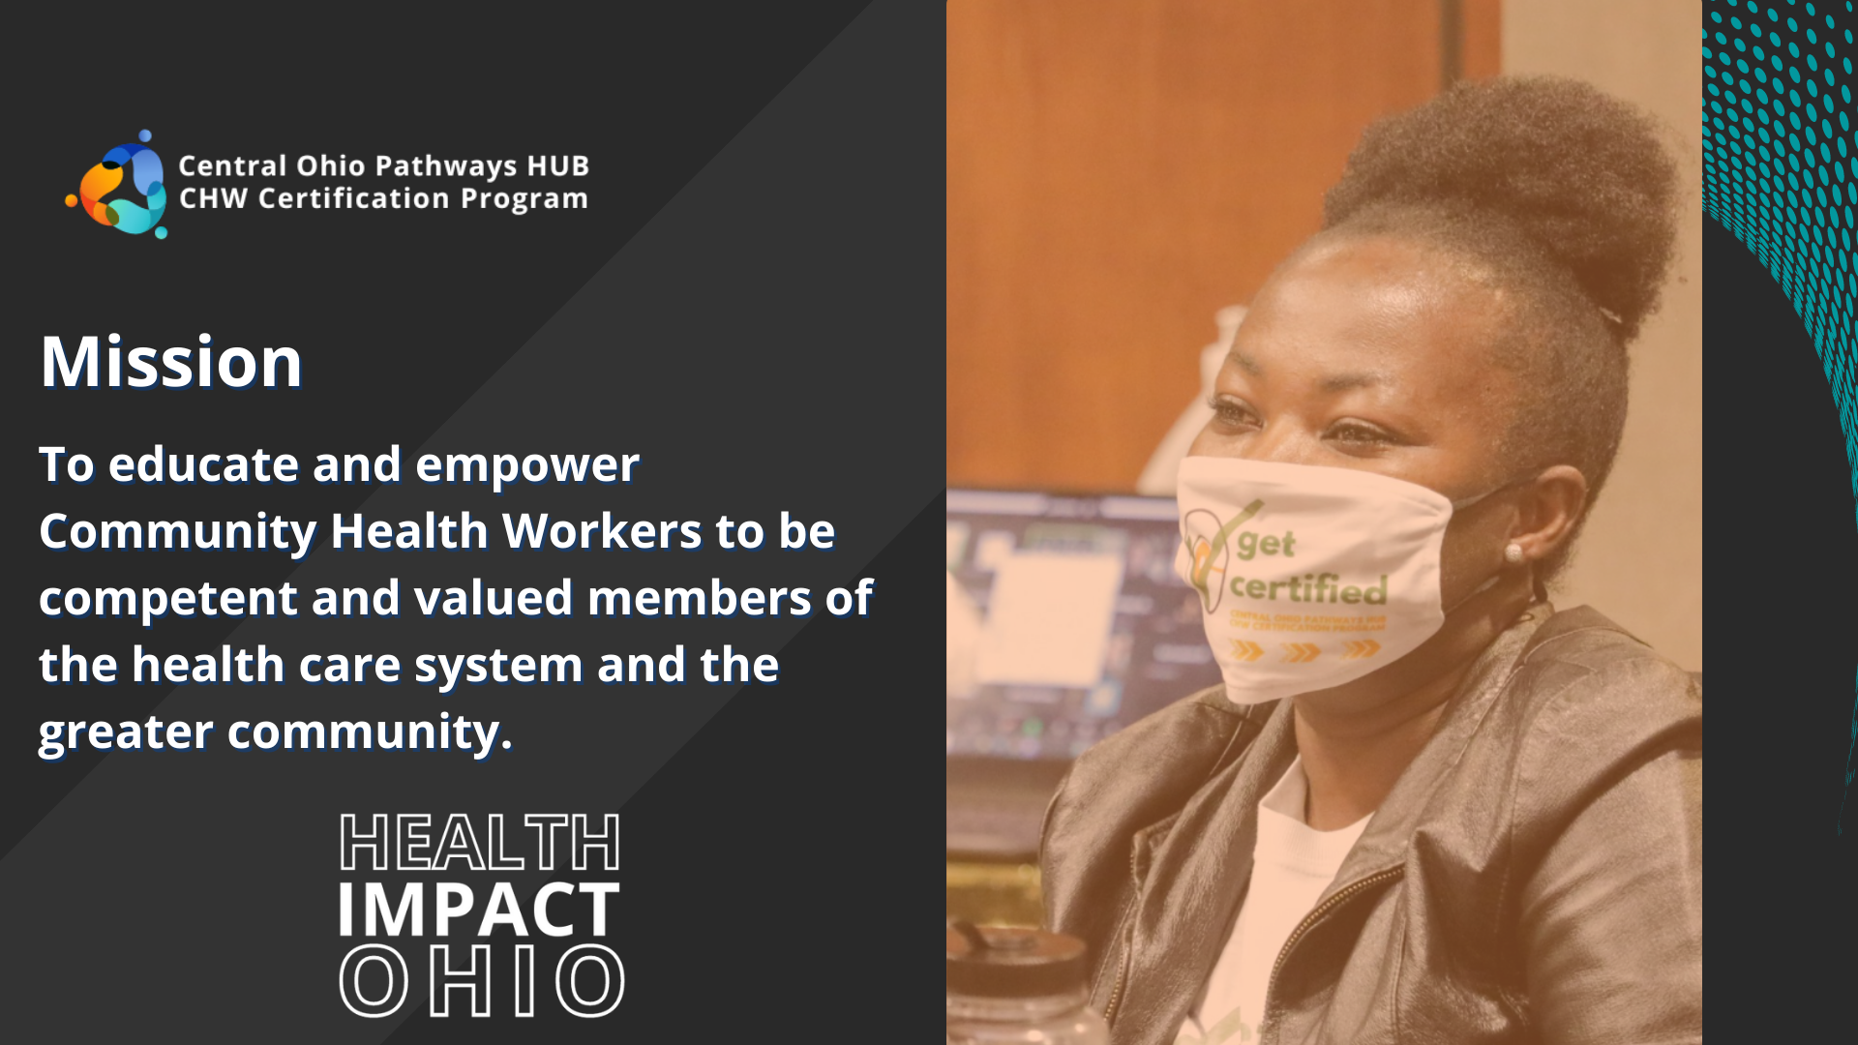
CHW Certification
Training
Central Ohio Pathways HUB Certification
Training Program
  July 2020 got approval from Ohio Board of Nursing
  Since August 2020- 4 Cohorts have been Certified
  Currently teaching the largest class- 43 students
    High School Students
    Individuals currently working as CHW
    One individual with a PhD!

Slide 38
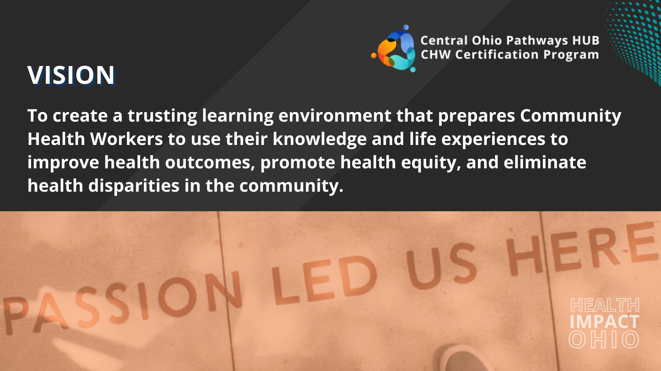
CHW Certification Training
Central Ohio Pathways HUB Certification
Training Program
  July 2020 got approval from Ohio Board of Nursing
  Since August 2020- 4 Cohorts have been Certified
  Currently teaching the largest class- 43 students
    High School Students
    Individuals currently working as CHW
    One individual with a PhD!

Slide 39
CHW Certification Training
Central Ohio CHW Certification Program is offered each Spring and Fall.
  Provides virtual training
  Allows for practicum placement at the CCA where they are employed
  12 weeks, 2 hours a day, 3 days a week
  Upon completion, HIO assists with their application to the Ohio Board of Nursing
  Requirements for the Ohio Board of Nursing:
    High School Diploma/GED
    18 years of age or older
    Be able to pass a BCI background check

Slide 40

High School Preceptor Program
7 High School students from Reynoldsburg HS completed the program
5 were enrolled in Practicum Placement Sites
Currently 5 students are enrolled
  4 from Reynoldsburg and 1 from Columbus International HS

Slide 41
Summer Program
  This summer we will be offering the Community Health Worker Summer Acceleration Program where students will get their CHW didactic training and the 130 hours of practicum placement in 5 weeks!
    Located in Linden and Whitehall
    Students from Reynoldsburg, Columbus City Schools and Kipp Columbus
    Hosted by local Community Business Organizations

Slide 42

tanikka@healthimpactohio.org
614-370-9601

Slide 43


HIGH SCHOOL
PRECEPTORSHIP PROGRAM
A Collaboration Between
HEART OF OHIO FAMILY HEALTH
&
Whitehall-Yearling High School
(Whitehall City Schools)

Slide 44
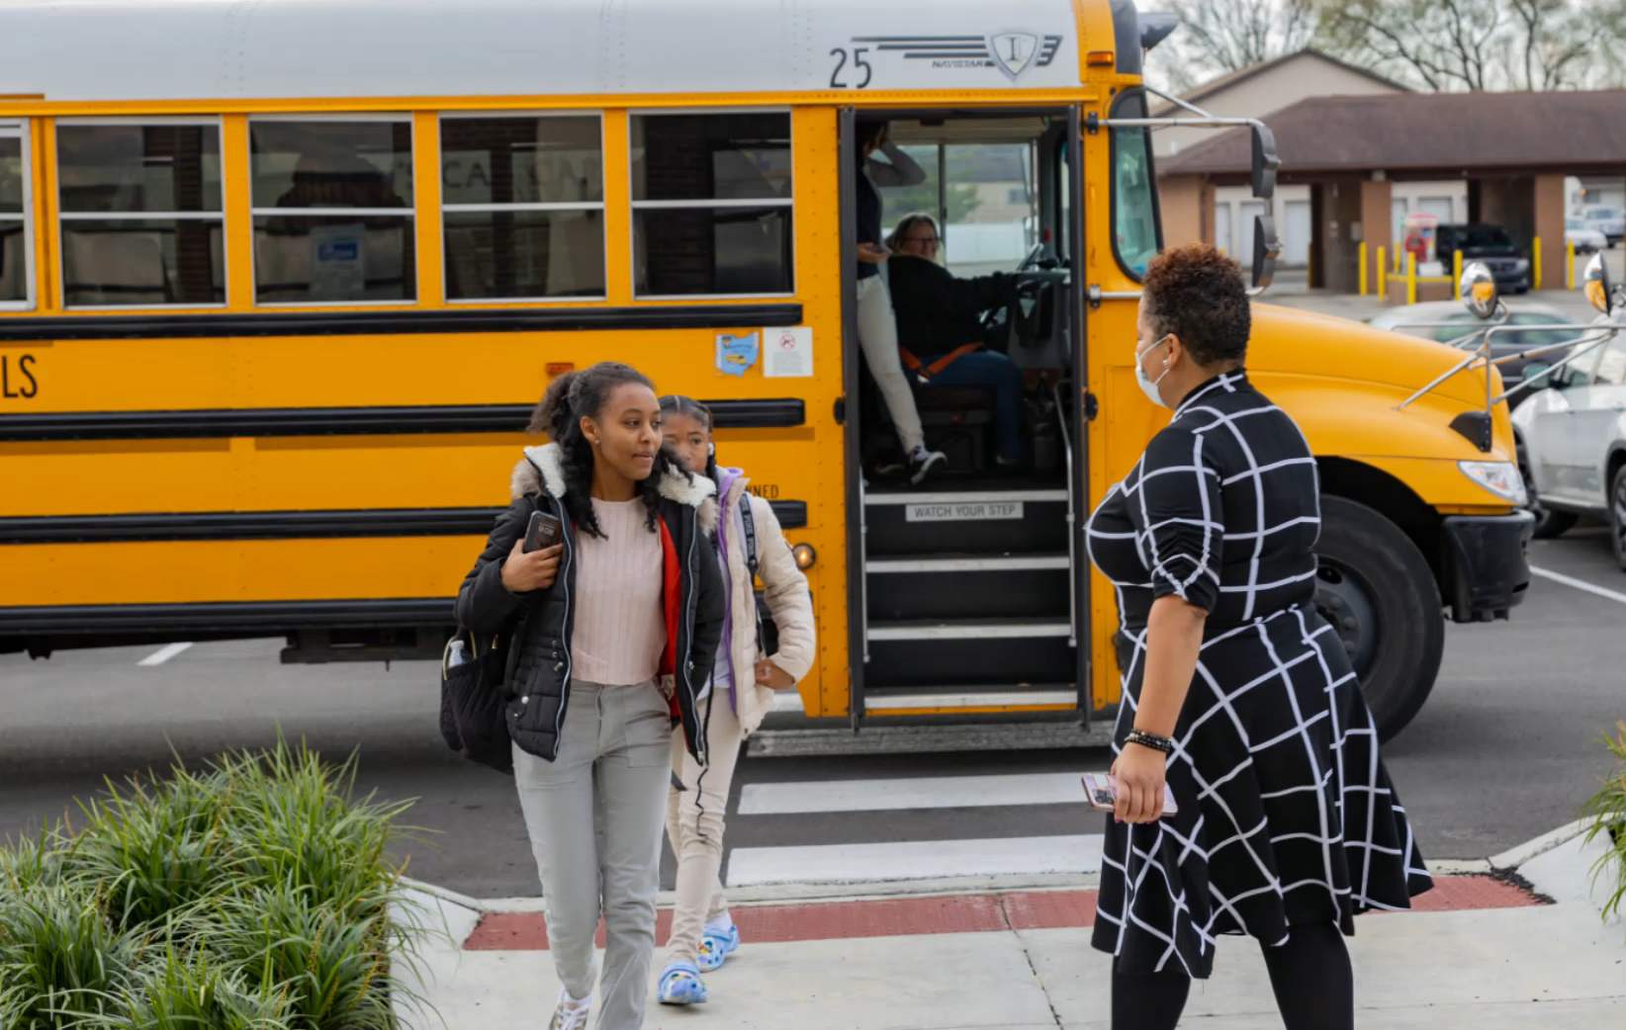
ENGAGING & ENCOURAGING STUDENTS
VISITING THE PRECEPTORSHIP
LEARNING SITE & ORIENTATION:
Whitehall-Yearling High School Students
Grades 10th-11th grades
(VIDEO)

Slide 45
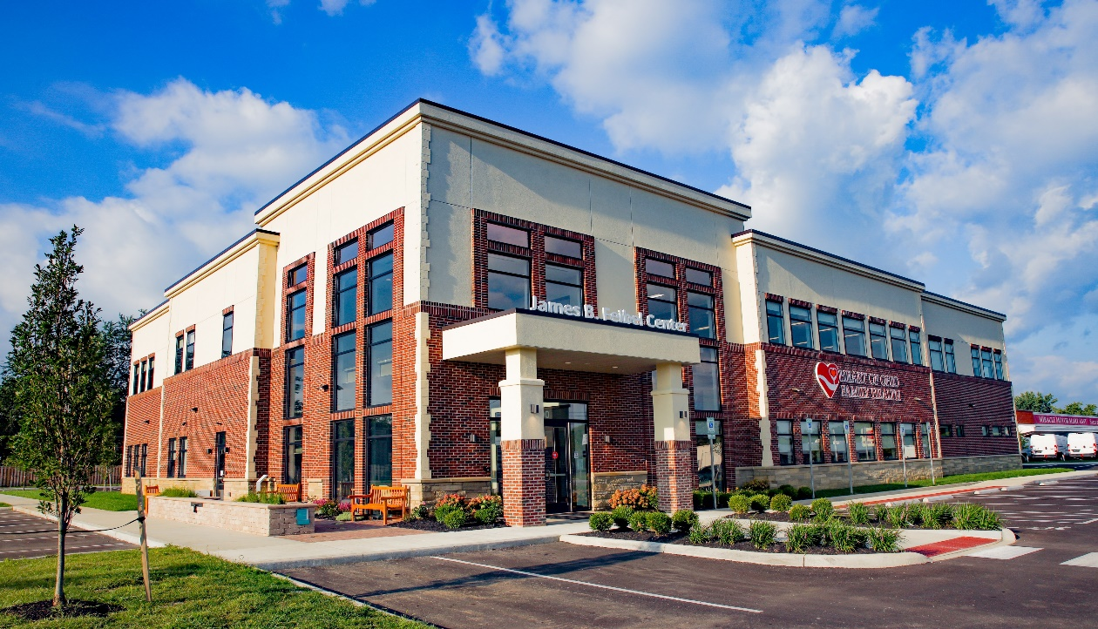

COLLABORATING TEAM
HEART OF OHIO FAMILY HEALTH
James B. Feibel Center & Whitehall-Yearling Clinic
Mission Statement:
Our mission is to provide high-quality, holistic, and compassionate care to meet the healthcare needs of everyone in our diverse community, one heart at a time.
WHITEHALL-YEARLING HIGH SCHOOL
Whitehall City Schools
Mission Statement:
To create success through personalized learning for every student, every day.

Slide 46
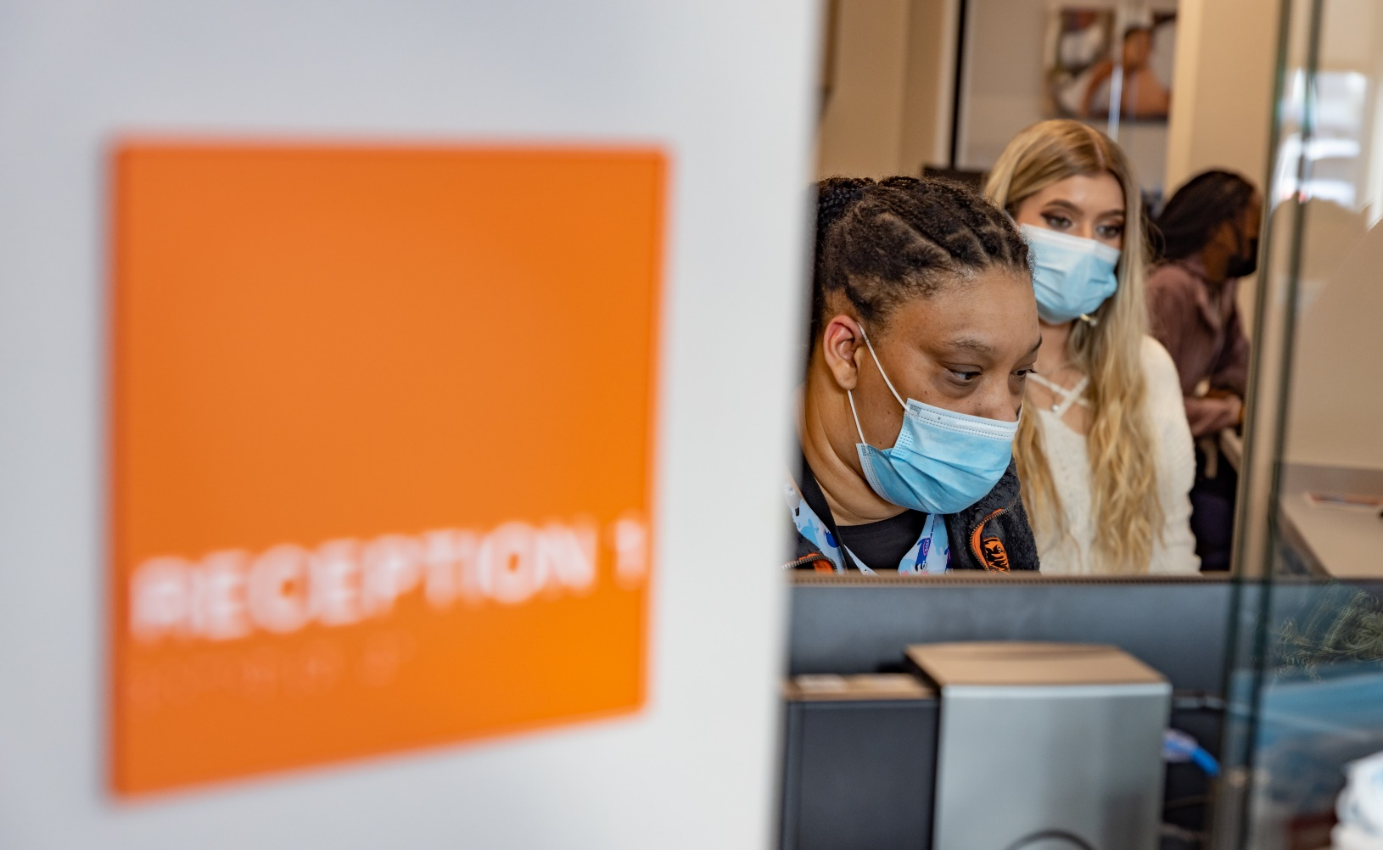
PATIENT CARE COORDINATOR
HEART OF OHIO FAMILY HEALTH
provides various experiences and oversight for students based upon their area of interest in the Healthcare Industry.

Slide 47
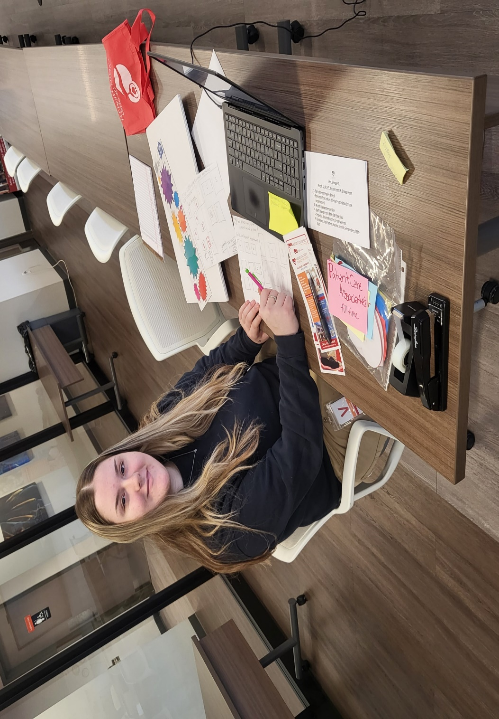
HUMAN RESOURCES
HEART OF OHIO FAMILY HEALTH
provides employment processing and orientation for all program participants as with all new hires.

Slide 48
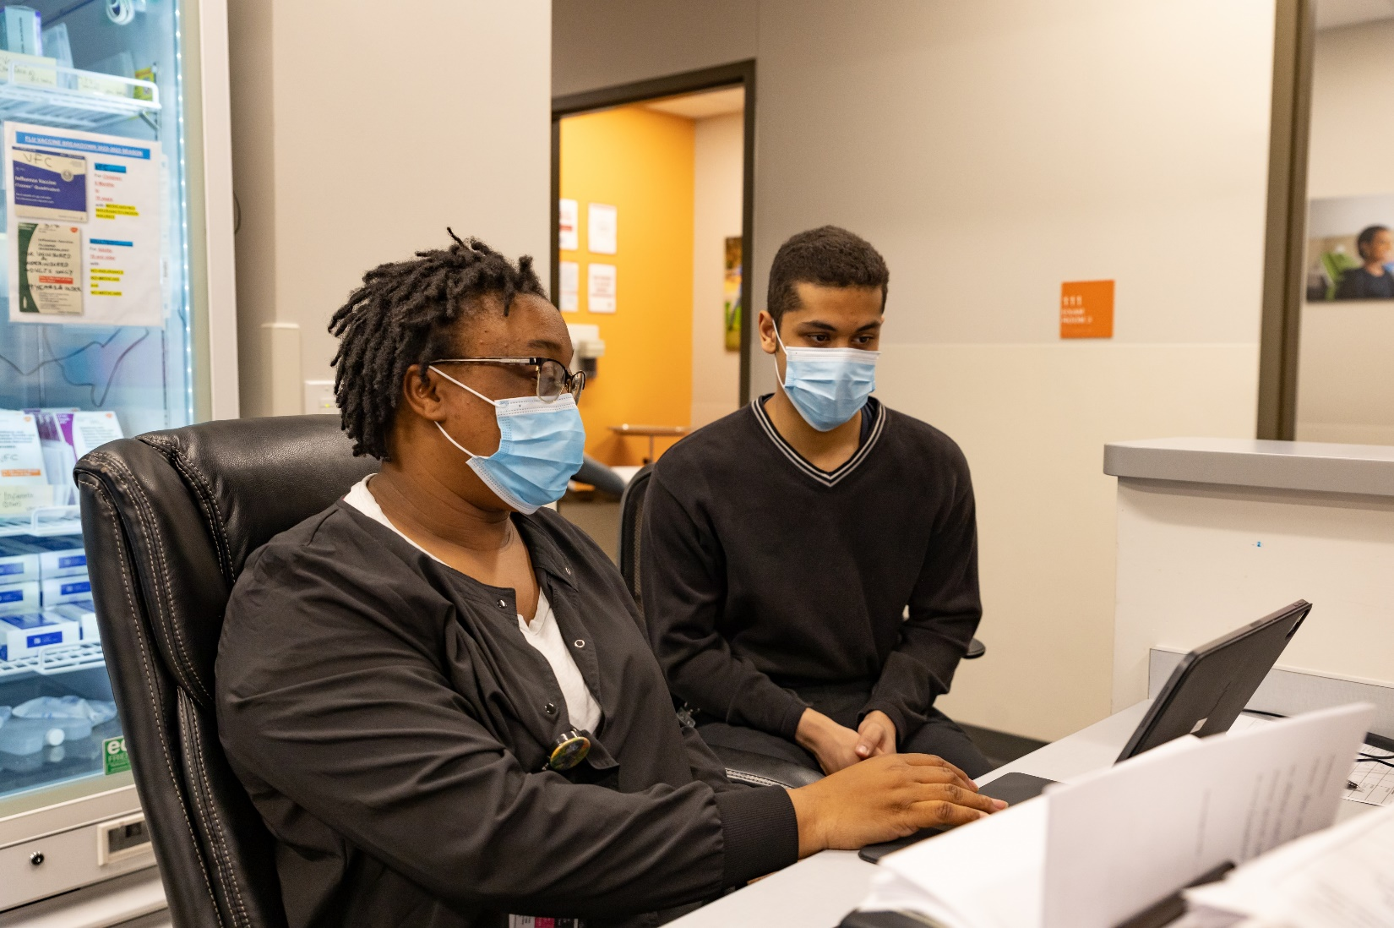
FINDING TIME:
Helping students to scheduled precept opportunities?
● Students work with a Preceptorship
Coordinator to schedule hours for
them to work in the clinics.
● Afterschool hours works best.
● Hours were also scheduled over
their school breaks.
● Extended hours are offered on
Tuesdays since to clinic have
extended hours and are open
until 8:00 p.m.

Slide 49

STUDENT SELECTION
● Work-Based Learning Offerings
promotional forms were shared with students.
● Preceptorship Coordinator created a
Microsoft form for students to complete that
included student demographic information.
● Selected students were transported to
Heart of Ohio Family Health New-Hire
Orientation that included a tour of the facility,
an overview of all of the locations, and insight
into the various professions available for
career choices in the healthcare field.
● Students were required to participate in online
trainings that included HIPPA requirements
and clinic safety.

Slide 50
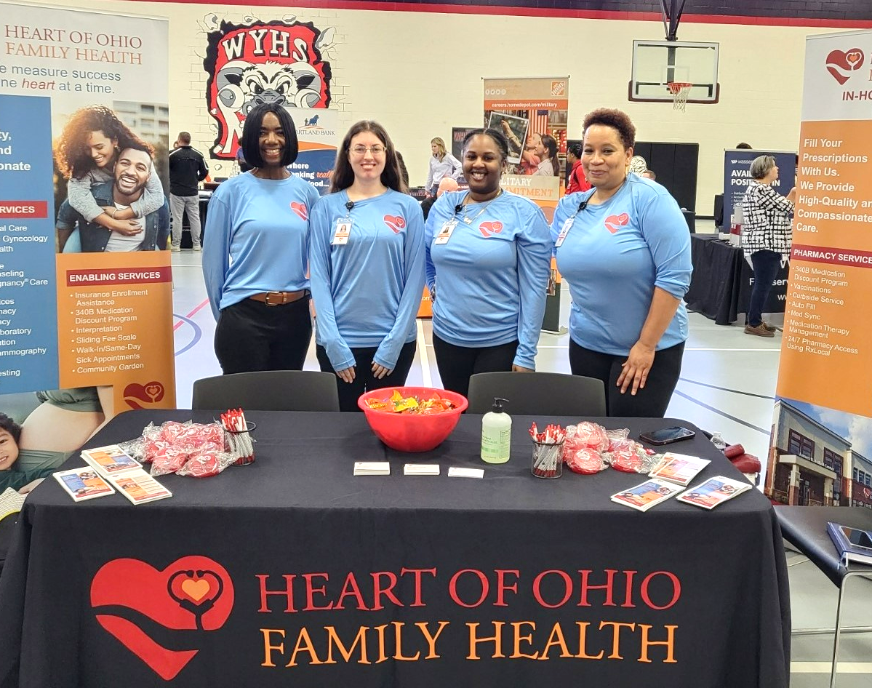
CAREER DAY @ WYHS
An impactful Career Fair was offered to Whitehall-Yearling High School students, as well as community residents in March, with the intent to provide opportunities to speak with potential employers in local business, public service, military, and educational institutions regarding jobs & careers that may not require 4-year college degrees.

Slide 51
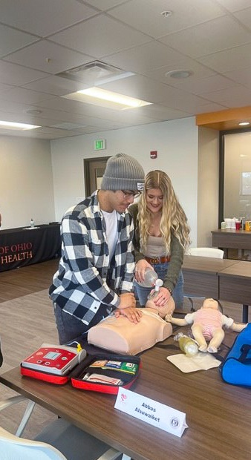
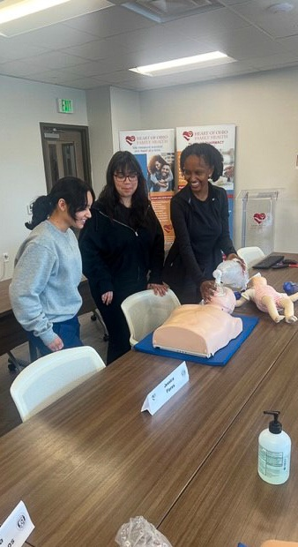
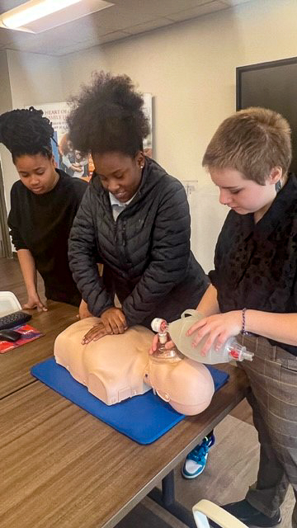
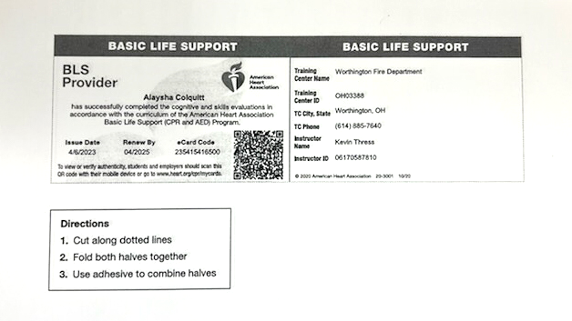
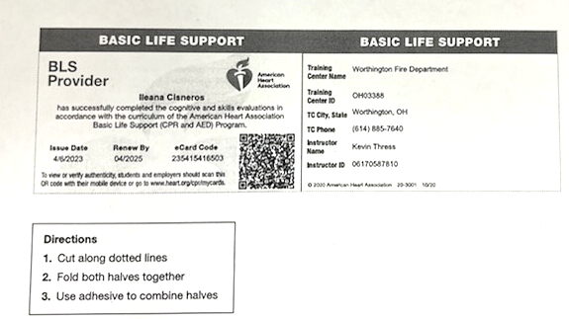
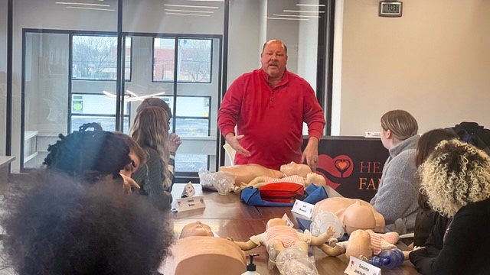
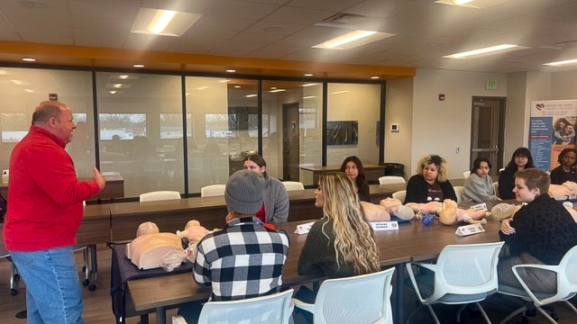
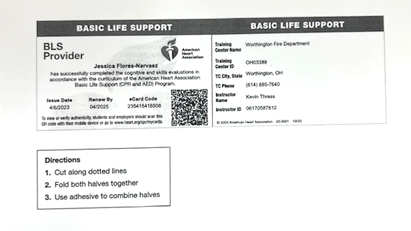
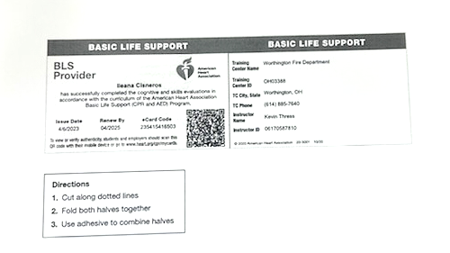
LIFE SUPPORT: BASIC CPR TRAINING FOR STUDENTS
The American Heart Association’s Basic Life Support course trains participants to promptly recognize several life-threatening emergencies, give high-quality chest compressions, deliver appropriate ventilations and provides early use of an AED. The course also reflects science and education from the American Heart Association’s Guidelines Update for CPR and Emergency Cardiovascular Care (ECC).
WEBSITE: https://cpr.heart.org/en/cpr-courses-and-kits/healthcare-professional/basic-life-support-bls-training
CURRICULUM SNAPSHOT:

Slide 52
SHOWCASING SCHOOL SUPPPORT
“The fact that so many of our students took their CPR training over their Spring Break speaks to their dedication to the cause, and of the connections you all at Heart of Ohio are making with our students. They must know you all care about them and their futures.”
Doug Shoemaker
Director of Employee Engagement, Partnerships, and Legal Services
District Civil Rights and Title IX Coordinator
Whitehall City Schools
“I have great news! We are able to provide busing for the 12 students who will do their orientation on November 14. They'll be picked up in front of the high school at 8:45.They'll be picked back up right at 2:00 p.m. to be taken back to the high school”.
Anna Telerski Shultz
Director of Special Services
Whitehall City Schools

Slide 53
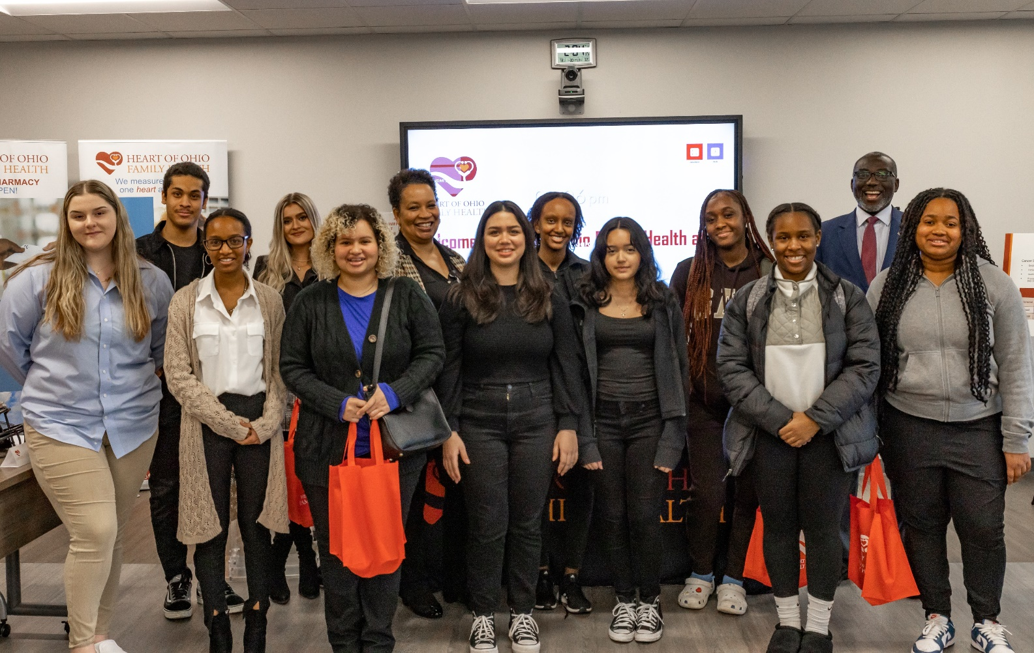
STUDENT FEEDBACK
“I hope that this will help me decide on what I want to do, and grow my experience.”
Jessica N. – Interest Area: Medical Assistance
“Directly working with patients is always my favorite part of interning here at Heart of Ohio. I like to directly speak and listen to patients.”
Catalina H. – Interest Area: Medical Assistance
“Helping people and getting them in the right place and making sure they get what they need.”
Lexi K. – Interest Area: Human Resource
“I hope to learn how to interact with software and I hope to takeaway work standards and social cues from employee as well.”
Aurora R. – Interest Area: IT

Slide 54
CONTACT INFORMATION
SPRING LAWSON
School-Based Health Center Coordinator
HEART OF OHIO FAMILY HEALTH
Office: 614.235.5555 ext. 1116

Slide 55






@OHEducation

