Slide 1

Automating the tedious to make space for the magic
GradLeaders® www.gradleaders.com

Slide 2

About Us
GradLeaders is a Columbus, OH based software-as-a-service company.
We have served the Higher Education, K-12, Workforce Development, Professional Associations, Non-profit and employer sectors since the 1990’s.
Our north stars include:
  Accessible and unparalleled customer support
  Private label, highly customizable and configurable solutions
  Value creation
  Data security and privacy

Slide 3
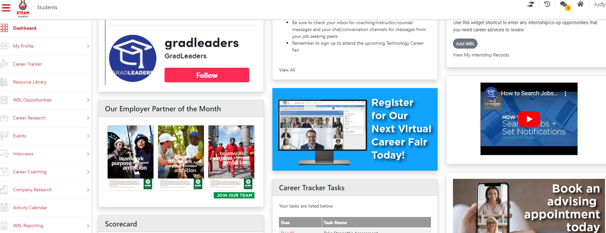
GradLeaders
Career Center
End-to-end or supplemental careers and work-based learning program management platform.
Student, Alumni, Administrator and Employer Directory
Automated communications – email, text, chat, direct messaging, surveys and evaluations
WBL task and activity assignment and tracking
Mobile access for students and alumni
Customizable branding, configuration and access capabilities
Limited/customizable student data access
Robust, real-time reporting
Educator, Student/Alumni and Employer Solution

Slide 4
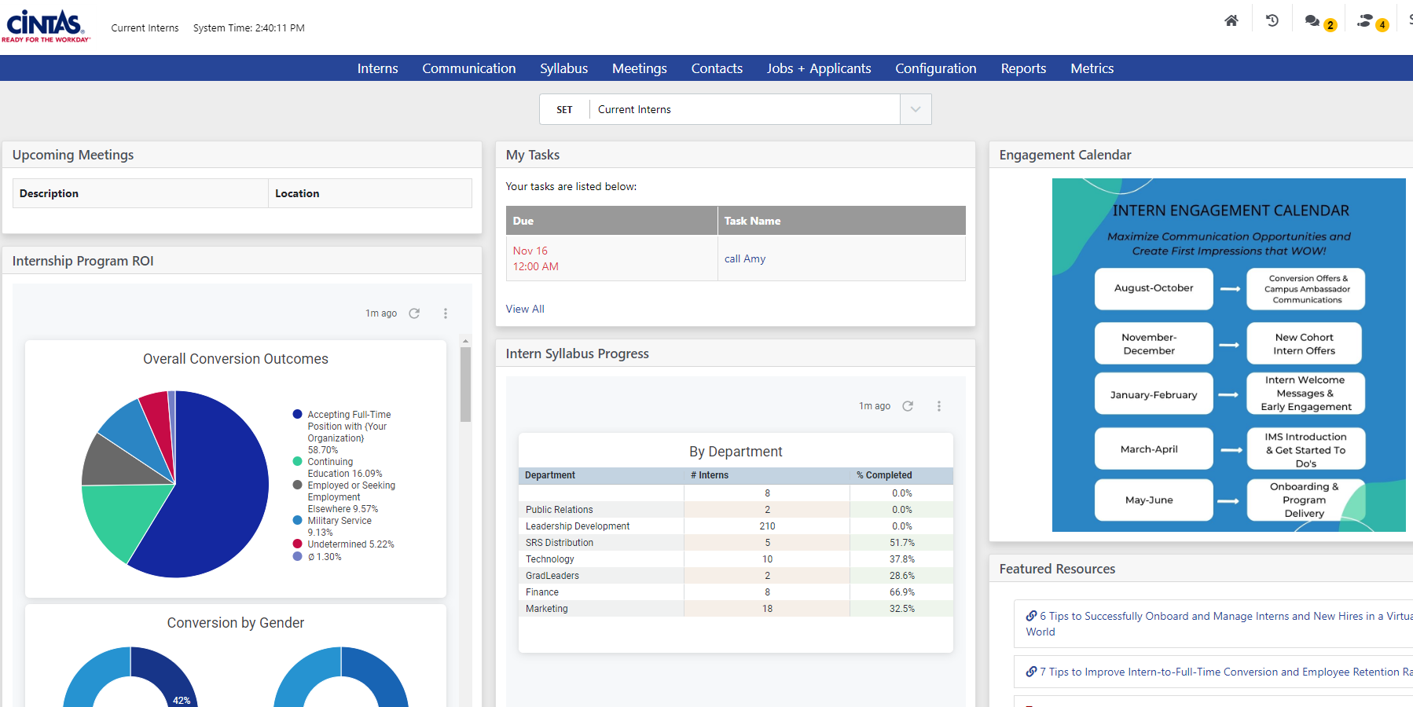
Intern Management
System
End-to-end experiential learning program management
Student, Alumni and Administrator Access
Automated communications – email, text, chat, direct messaging, surveys and evaluations
Job/work-based learning opportunity management
Career Pathways task and activity management
Mobile access for students and employers
Robust, real-time reporting
Customizable branding, configuration and access capabilities
Add client screenshot
Employer Solution

Slide 5
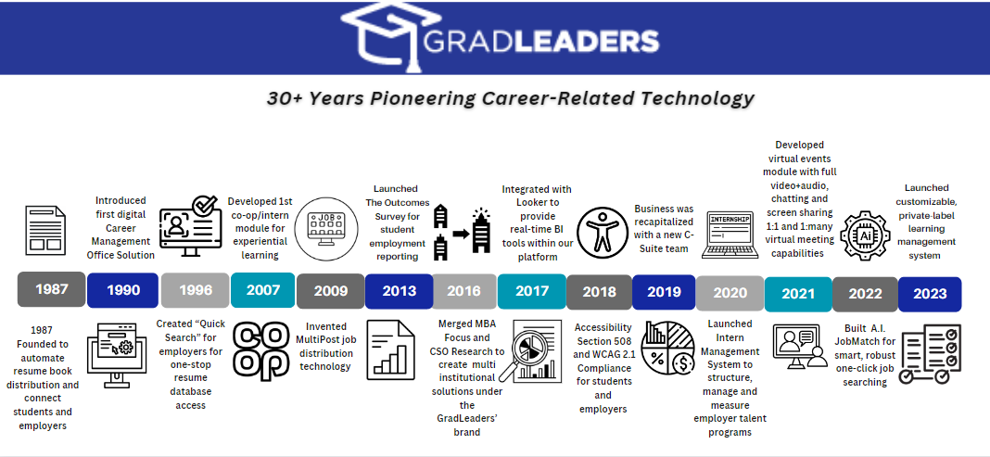
5

Slide 6

Different roles | Shared Purpose
Help students become career ready through career exploration, education and exposure
Provide real-world work-based learning experiences
Build a robust and scalable local talent pipeline
Strengthen education and industry partnerships through regular collaboration
Common Mission

Slide 7

Robust. Configurable.
Scalable.
Your System. Your Processes.
Created in Partnership with Career Centers
Over the Past 30+ Years
“A deficit of 6.5 million skilled workers is projected over the next decade in the U.S.”
Source: Korn Ferry (2018) Future of Work: The Global Talent Crunch
The good news is that high school students and graduates, are a robust pipeline to address the talent gaps.
Further, an awakening is underway, likely accelerated by the COVID-19 pandemic, that college is NOT the only viable career pathway. Stackable credentials, certifications, apprenticeships, direct to work, delayed post-secondary education, the military, are all in the mix.

Slide 8
Robust. Configurable.
Scalable.
Your System. Your Processes.
Created in Partnership with Career Centers
Over the Past 30+ Years
But for adolescents, the gravity of choosing a pathway often is heavy so early exploration and exposure are ESSENTIAL. Each require the participation of local industry and dedicated career educators.
“89% of employers are more likely to hire high school graduates if the students learned more real-world skills”
Source: 2021 Future of Learning Research Survey

Slide 9
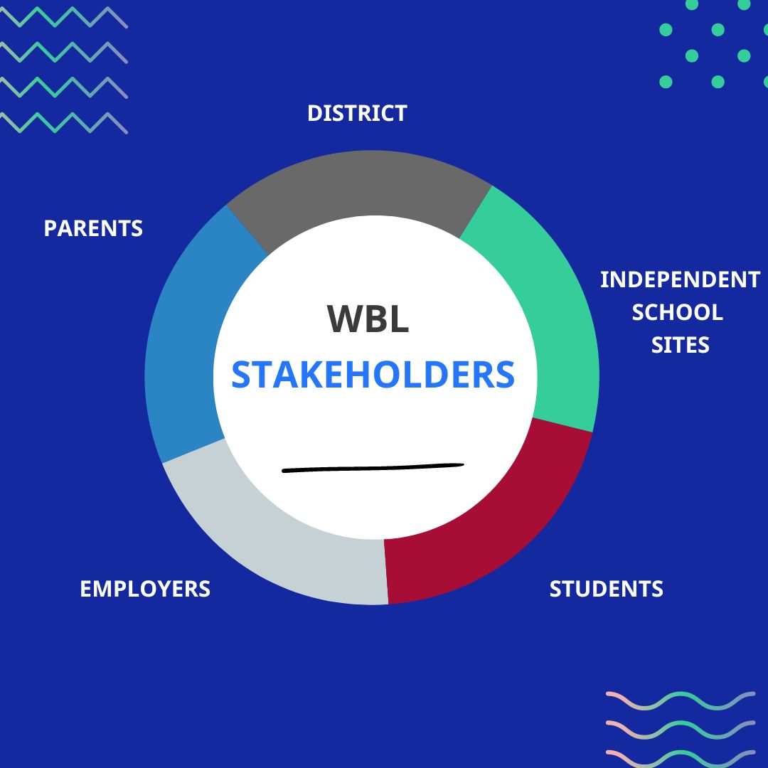
Robust. Configurable.
Scalable.
Your System. Your Processes.
Created in Partnership with Career Centers
Over the Past 30+ Years
“See it to be it”
Easy to say, challenging to manage and measure

Slide 10

Use your network, ask for help.
If you don’t have a network, build one!

Slide 11

Resources to launch or scale your WBL program
Connect with your local Chamber of Commerce or workforce development agency
Join a business Advisory Council – (Employers)
Attend an ACTE, Ohio ACTE, or Ohio Dept. of Education webinar or event
Reach out to your local Educational Service center
Host a community career/talent forum
Connect with a careers/CTE educator on LinkedIn (Employers)
Build your network

Slide 12
Educator Challenges
Employer challenges
Unsure how to start
Lack of network/career education contacts
Unfamiliar with work-based learning policies
Misperceptions about employing minors
Limited resources – no one “owns” the process
Managing the WBL experience – too many moving parts and manual processes
Lacking corporate/industry needs and process insights
Need for customized WBL approval process and evaluation workflows to accommodate parents and multiple key stakeholders
Manual employer/industry partner management
Lack of robust, real-time reporting
Inefficient post graduation career pathway status reporting process
Large student/alumni populations often equate to expensive solutions
One-size fits all tools “Don’t Fit!”
Educator and Employer Needs

Slide 13



Universal Tips
Prioritize short-, mid-, and long-term goals
Enlist champions
Identify automation opportunities
Determine
KPIs
Articulate your WHY
Progress, not perfection is the goal
DETERMINE
POPULATIONS
To Keep In Mind

Slide 14
Mission critical considerations when vetting platforms/partners

Slide 15
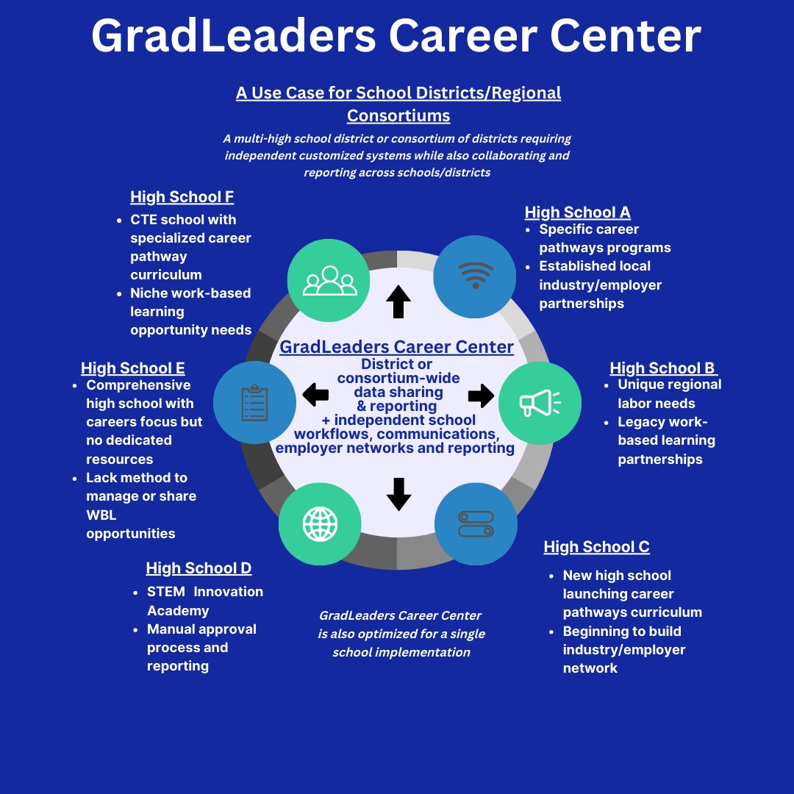
Every region, district, school, program and employer is unique.
Some states or districts are further along in their career readiness programming as are some employers in their K-12 talent programs.
It’s OK! Accept where you are and focus on where you need to go.
One Size Does NOT Fit All

Slide 16

Automation drives efficiency
API or other data feeds from other systems – e.g. Aeries, Follet, Aspen, SCOIR, SCUTA, YouScience, ATS, LMS, Microsoft Calendar sync, etc.
A single platform to streamline labor-intensive, repetitive processes
Track all activity, communications, and data in one central location for all stakeholders
Event, appointment, and calendaring tools with automated attendance tracking and embedded video meeting technology
Work smarter, not harder

Slide 17

Serves all stakeholders
Portal for district/school administrators, students, alumni, and employers
Mobile experience with optional SSO and calendar integration
Scheduled report delivery for non-system using stakeholders
Custom experience per unique population set served
FERPA compliant and partner determines level of access for employers, students, alumni, etc.
Communication preferences by user

Slide 18

Measures outcomes in real-time
Self-serve, mobile employer experience for representatives on-the-go
Proprietary surveying and reporting tools for all profile data and system activity
Additional Survey Monkey access for unlimited feedback loop
Integrated texting messaging (SMS and MMS)
Perkins post graduation reporting

Slide 19

Creates value
Module/capability pricing model vs. user-based pricing
Robust end-to-end system eliminates need for multiple platforms
Ability to serve a district, a region, consortium or individual school with independent and cross entity capabilities and reporting
FERPA compliancy and overall data security paramount
Exceptional network performance and uptime

Slide 20

Prioritizes support
Dedicated customer relationship manager
Live chat M-F/8-5
Guided walk throughs
Knowledge base and support portal
Monthly best practice webinars
User forum events and collaboration opportunities

Slide 21

Consistent product & service iteration
Agile development cycle with frequent product releases and service enhancements
Customer product input regularly requested
Monthly new feature webinars and email communications
Custom development available

Slide 22
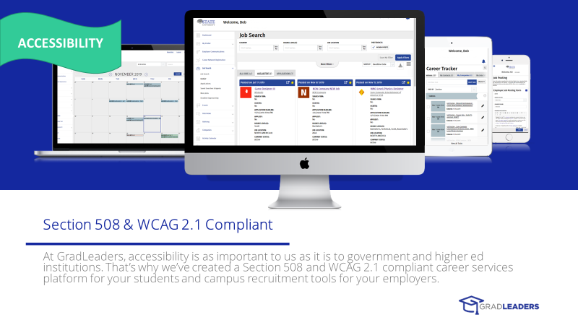

Slide 23

Open Discussion

Slide 24

Thank You!
For more information:
Visit www.gradleaders.com
Reach out
Amy King, aking@gradleaders.com
740-815-1825
Ben Groff bgroff@gradleaders.com
24

