Slide 1
Celebrating Students’ Future Plans
A Playbook for Celebration

Slide 2
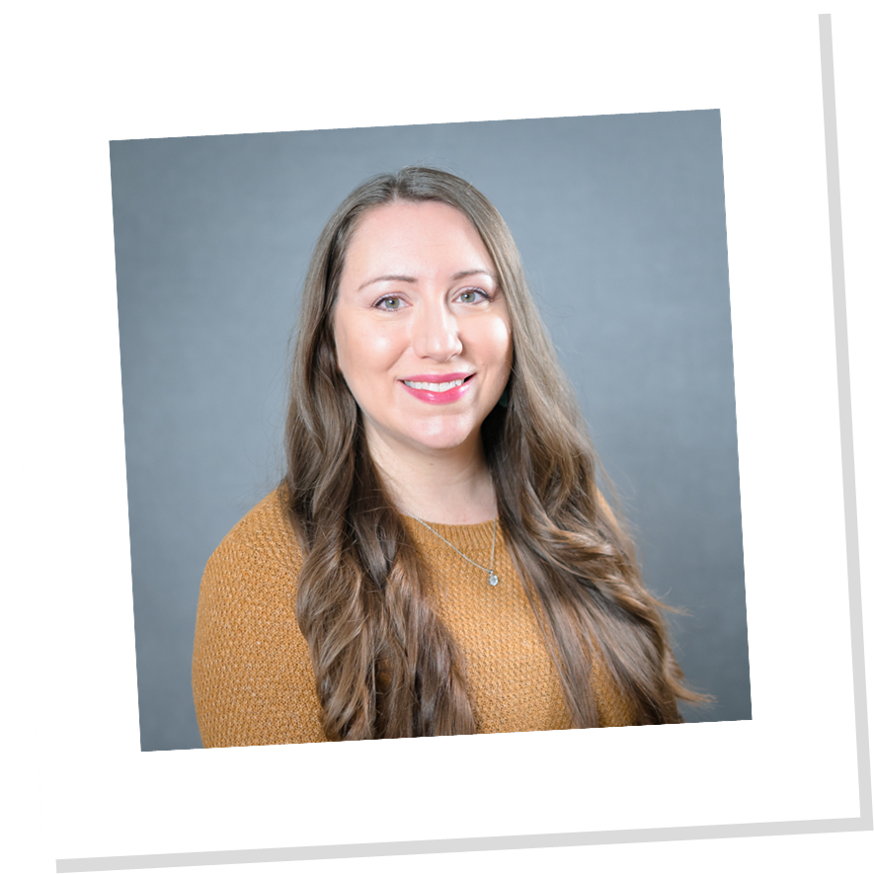
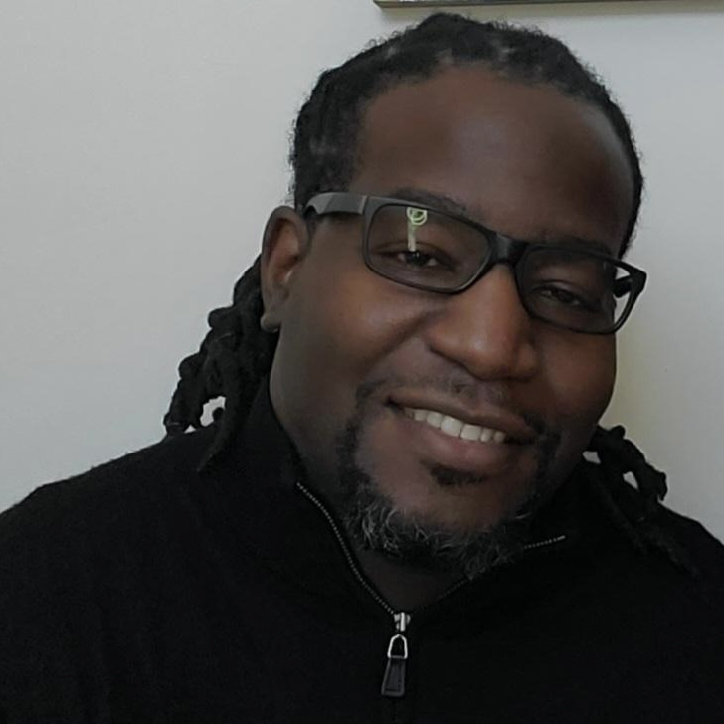
Welcome
Kelly Garrett, Director, TRIO Talent Search
Marion Technical College
Carlos Bing, Director, College Access Programs
Ohio Department of Higher Education

Slide 3


Slide 4
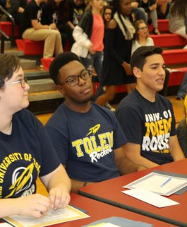


Easy as 1, 2, 3
FAFSA | Apply | Sign

Slide 5
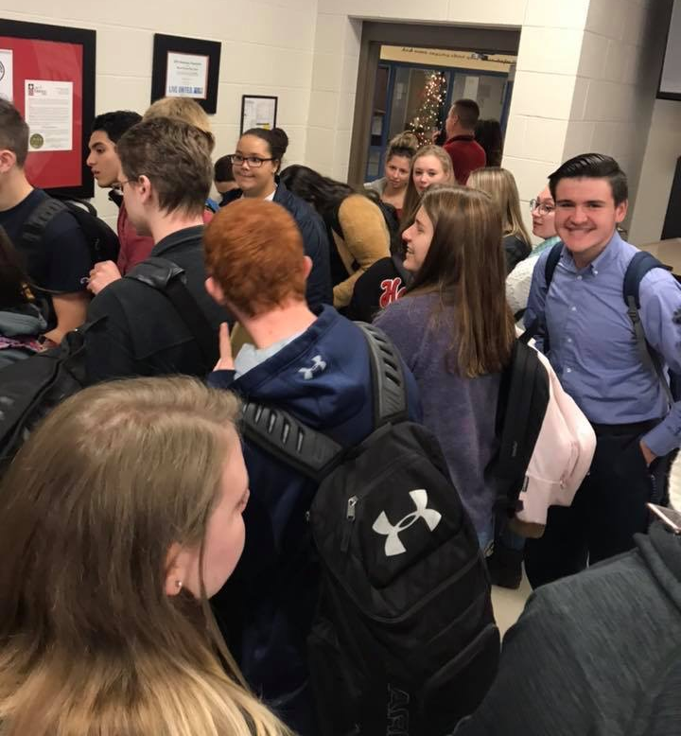
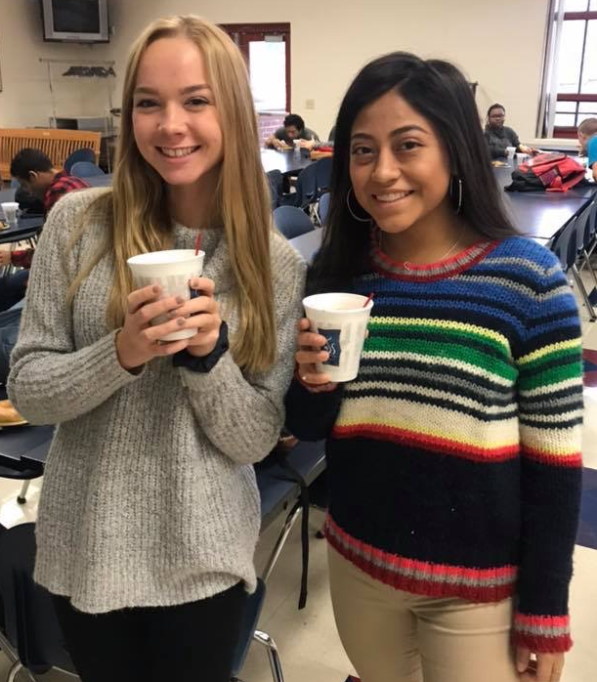
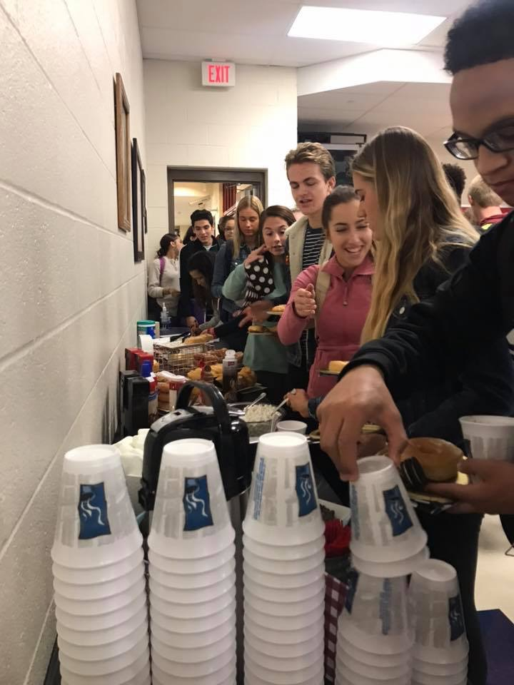
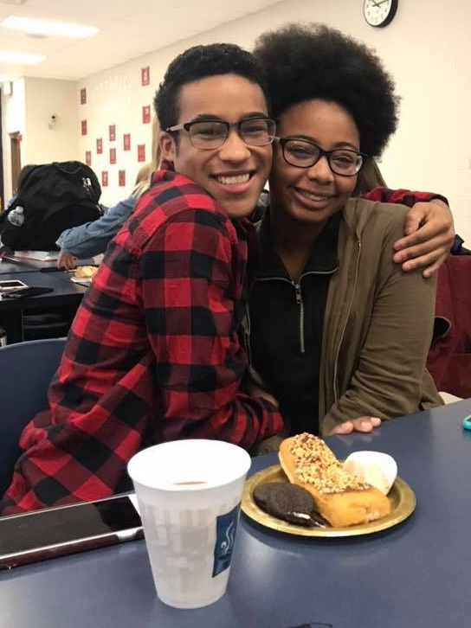
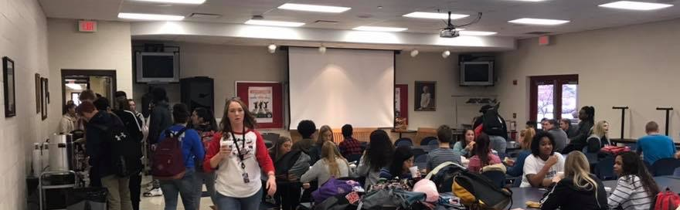
FAFSA

Slide 6
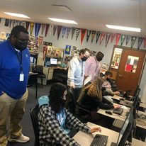
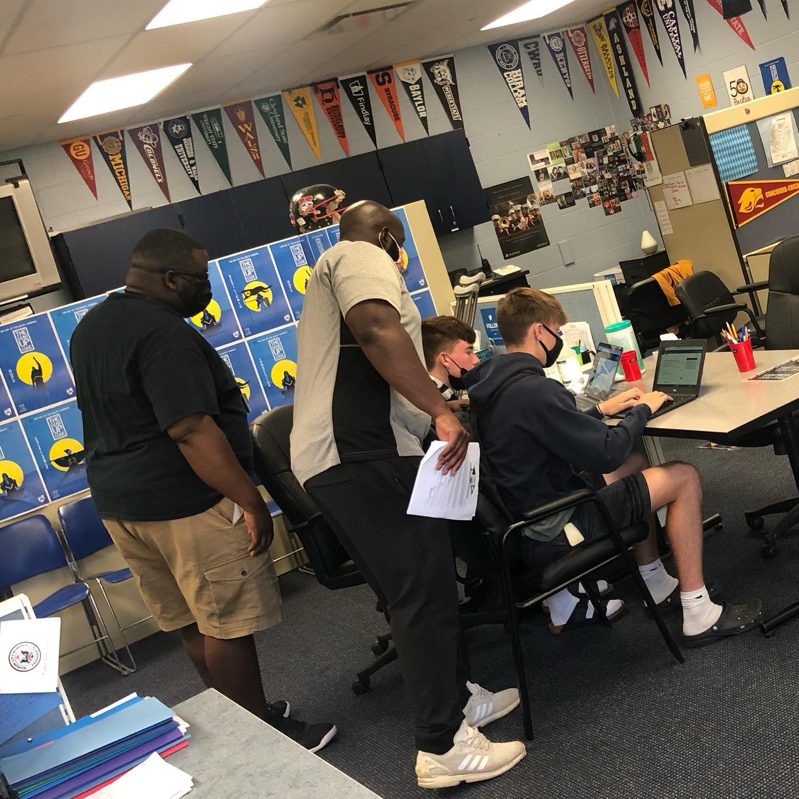
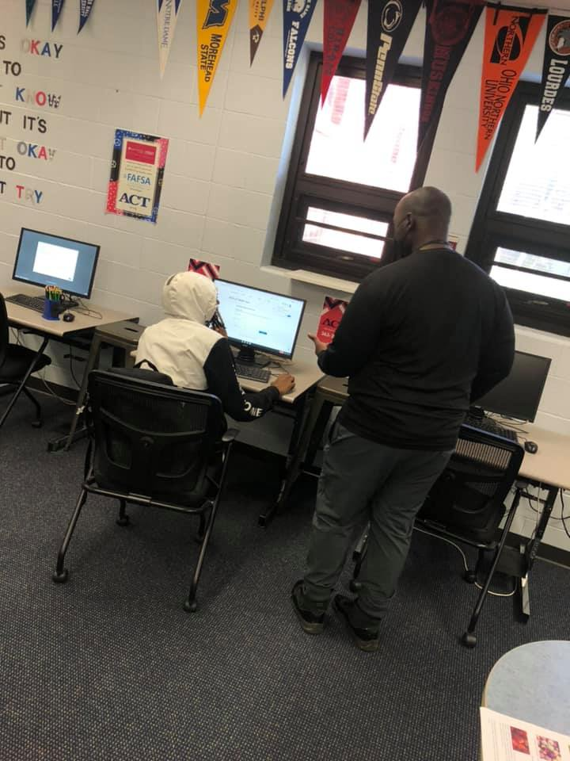
College Application Month

Slide 7
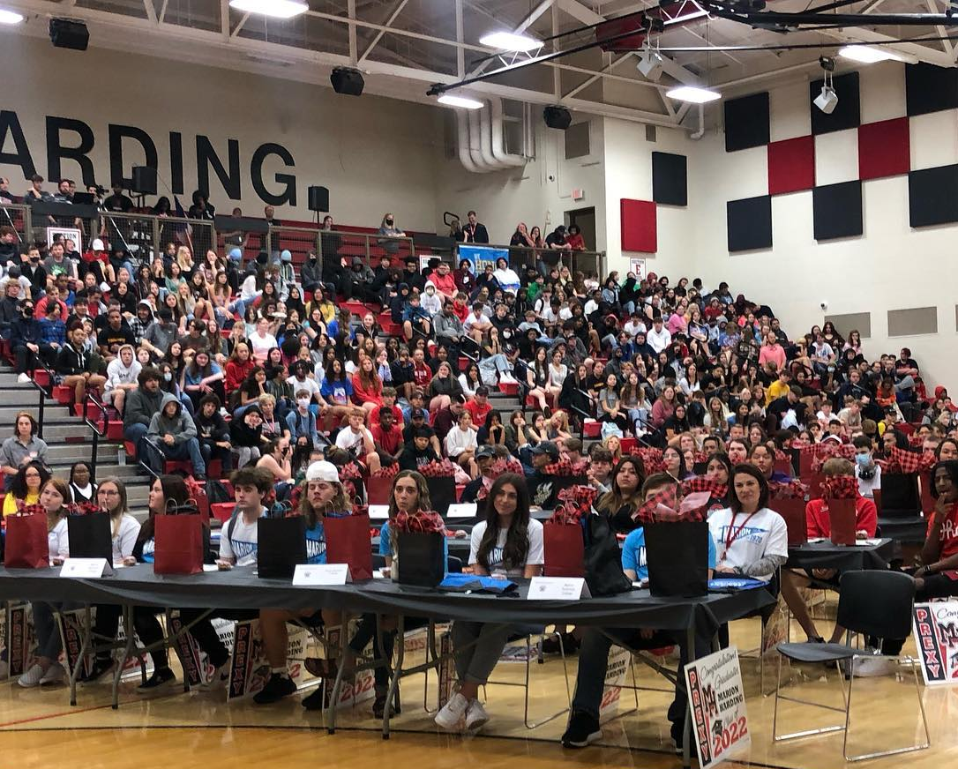
Signing Day
School-Wide Assembly
Attended by all students, school & district administrators, school board members, and…

Slide 8
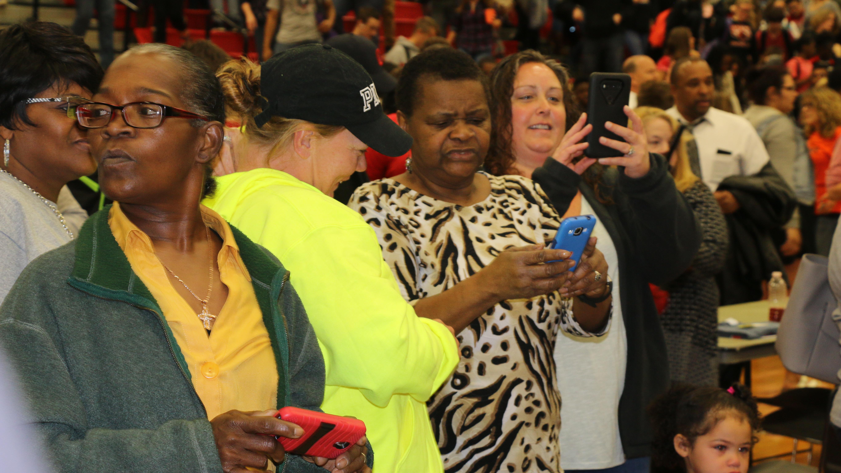
Parents!

Slide 9

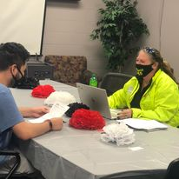
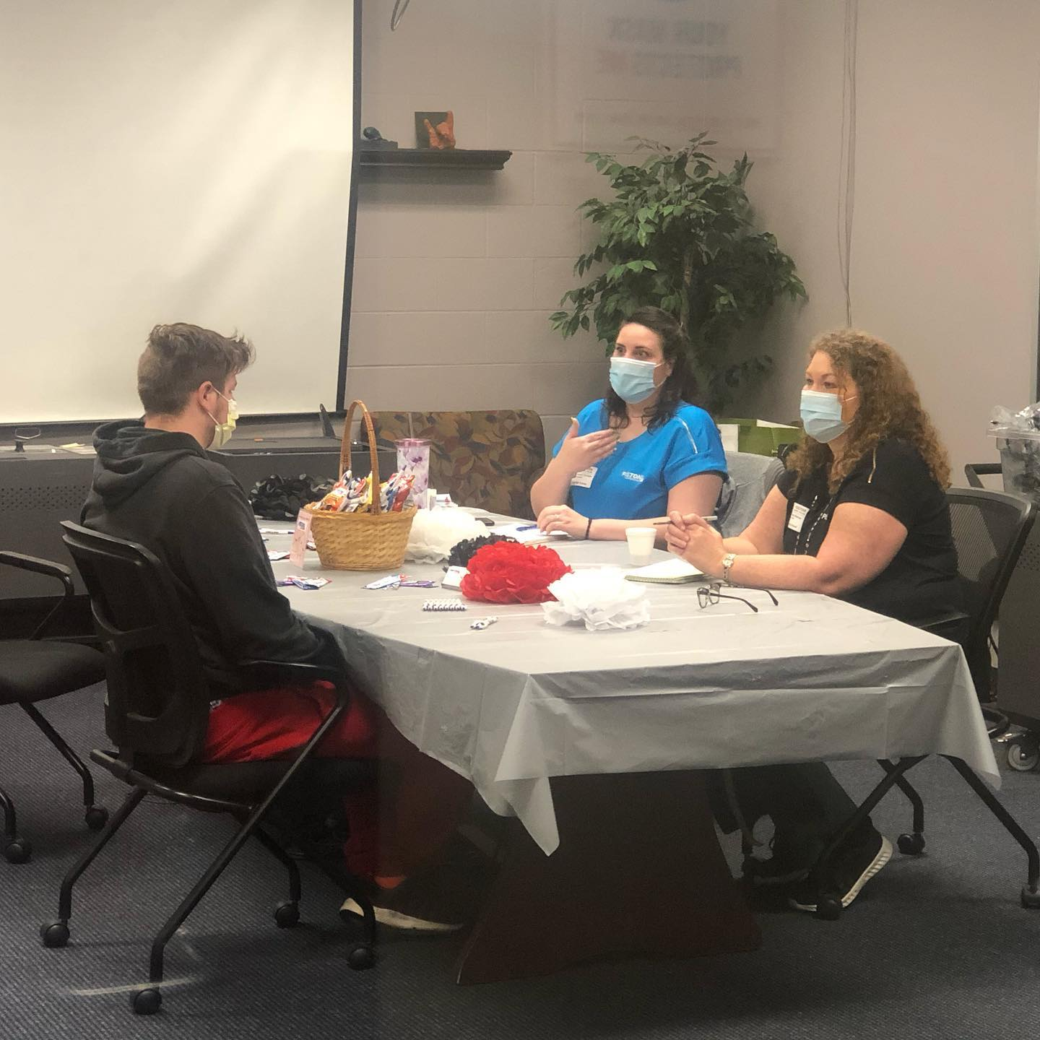


Pre-Work
In-house (in high school) interviews

Slide 10

Pre-Work
Senior survey informs table set-up and layout
Certificates are created for EVERY students with a plan

Slide 11
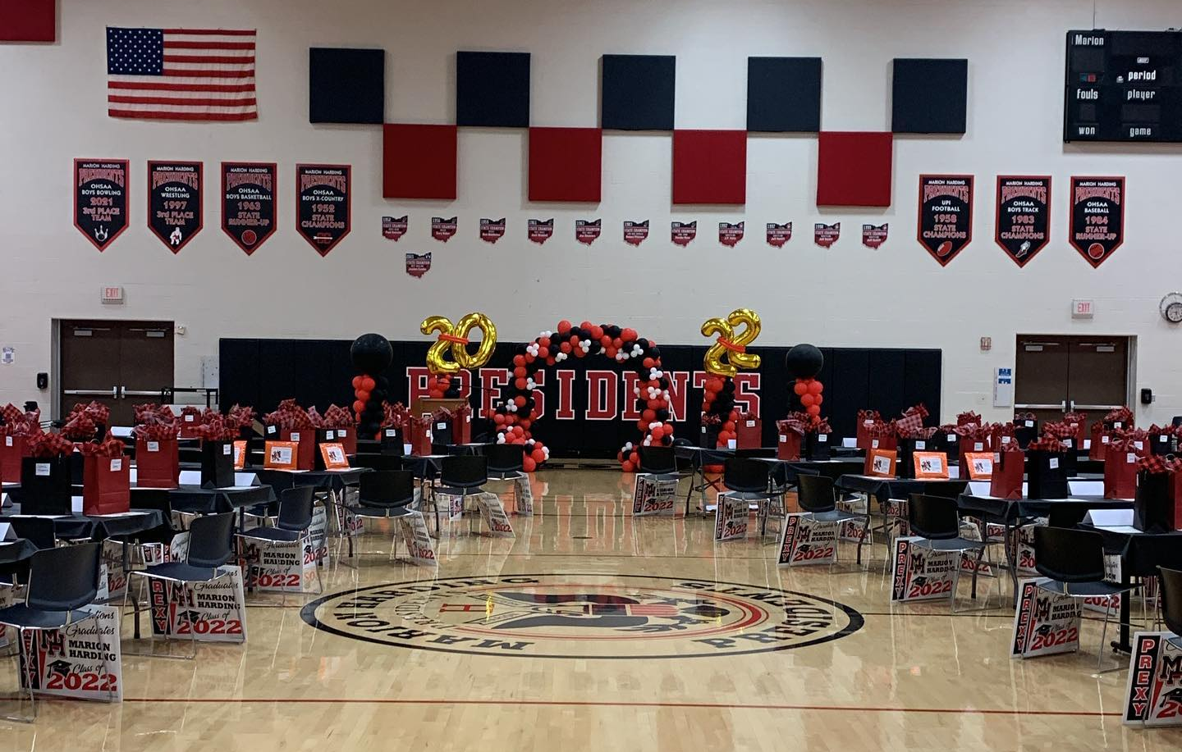
Prepping
Set up tables and seat for EVERY student with a plan
Staff and community are encouraged to dress in college, military or work spirit wear

Slide 12
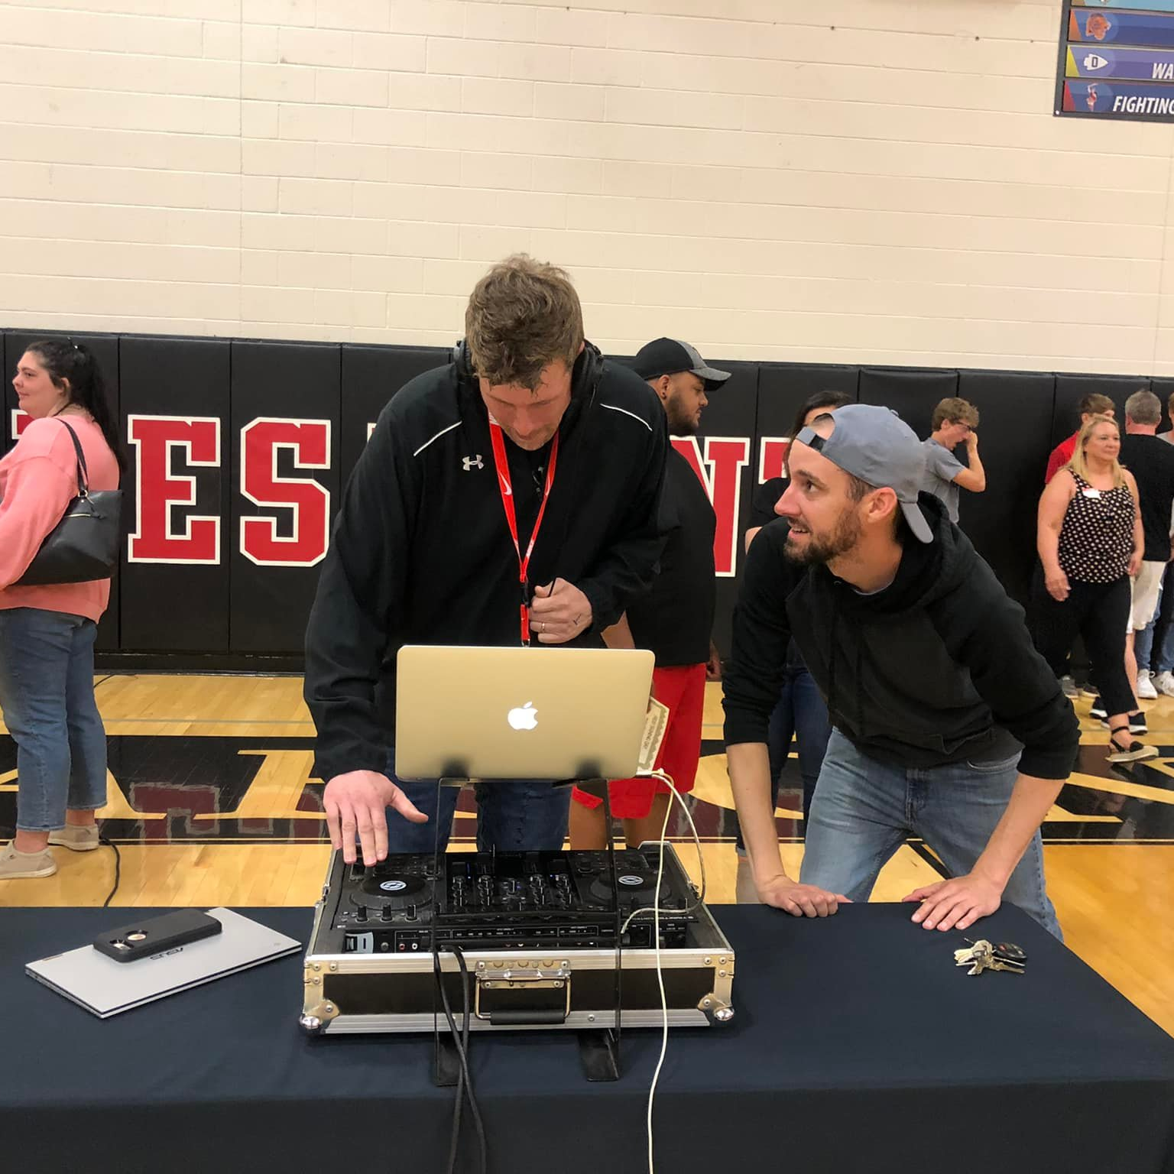
Setting the Stage
Reps arrive early to set up their space (many of them bring swag)
We also have a DJ that sets the tone for the celebration

Slide 13
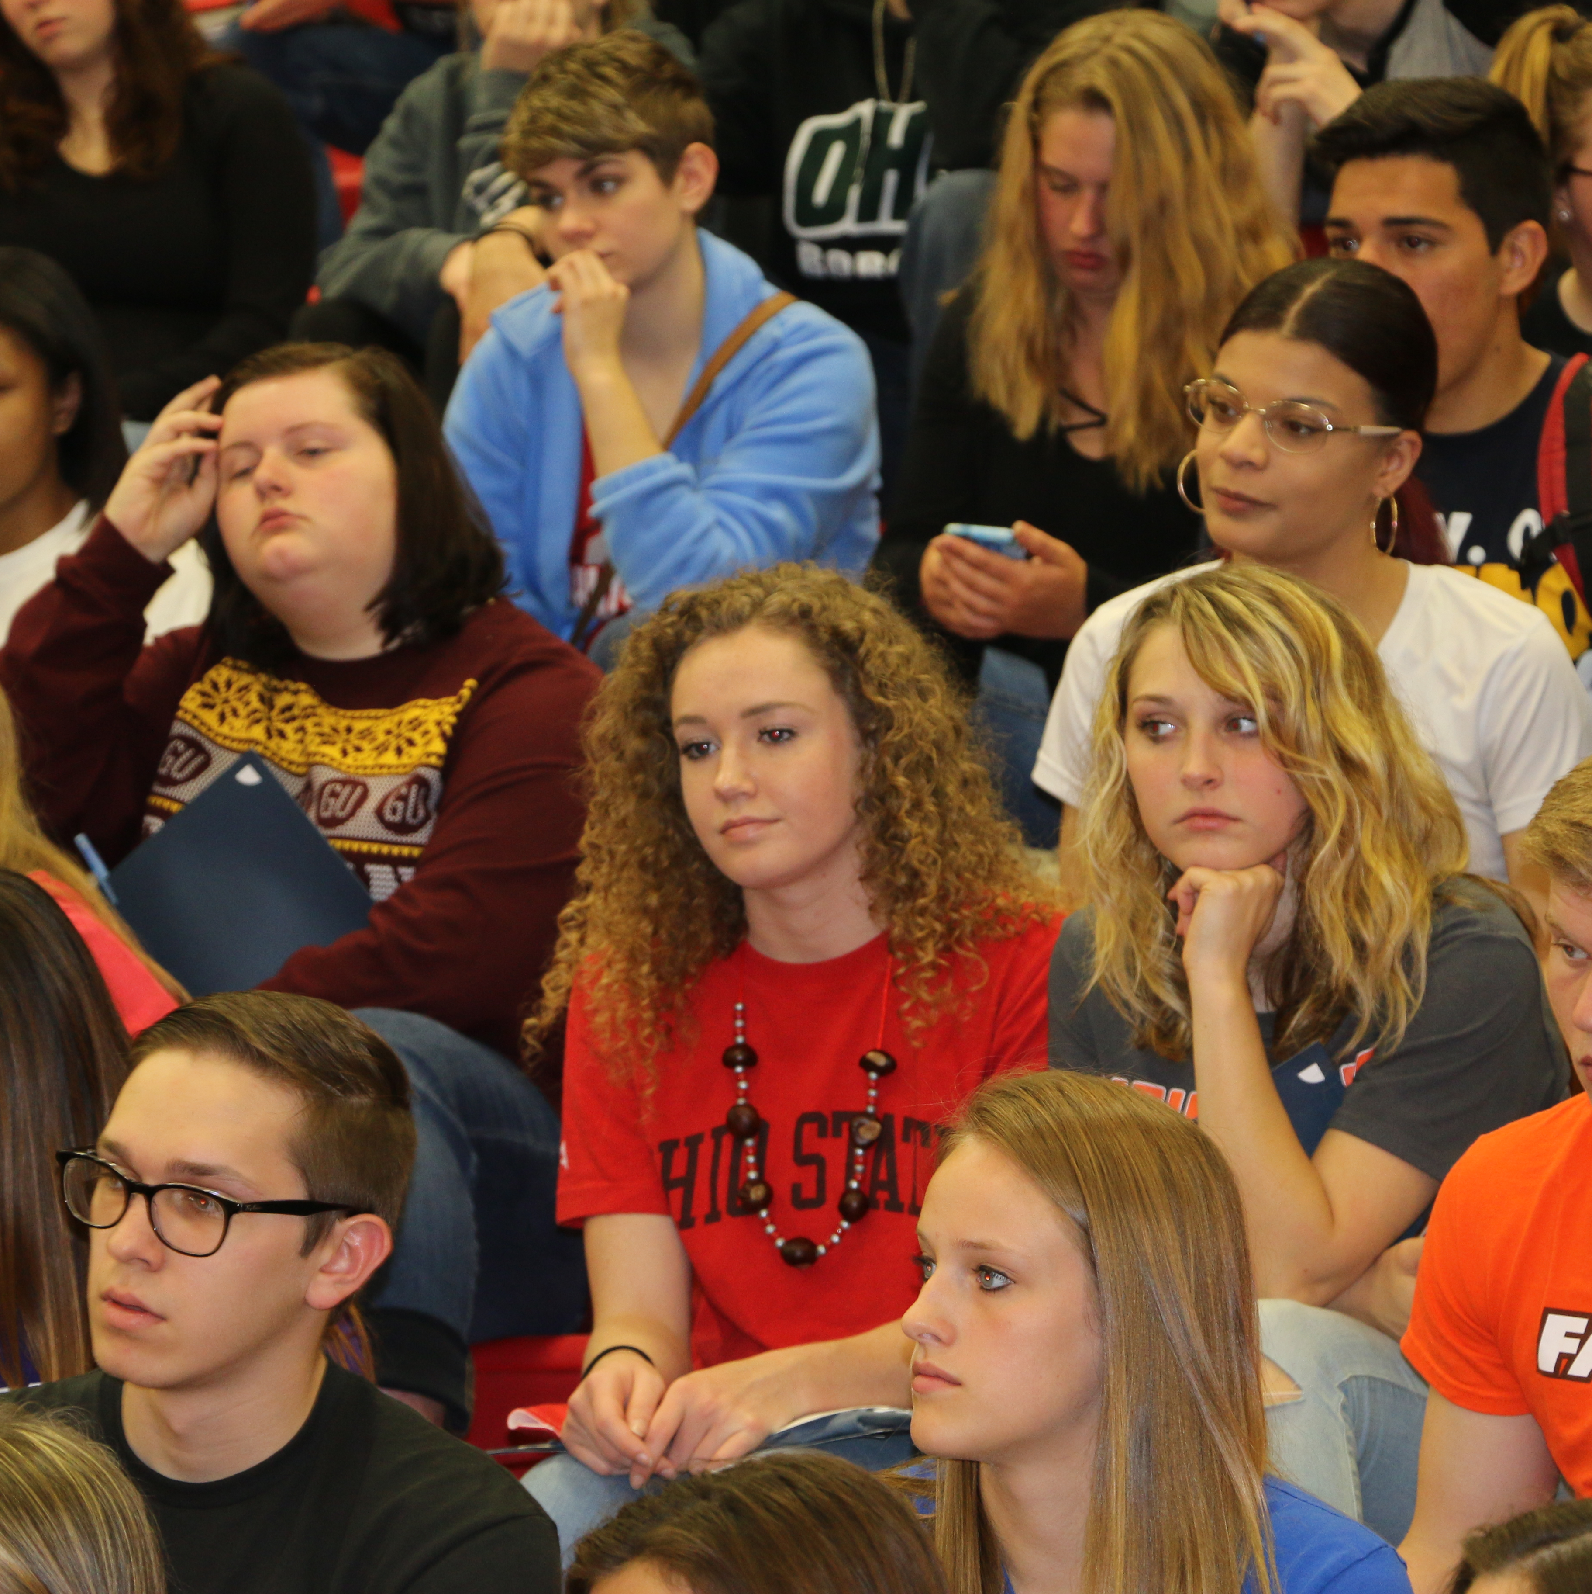
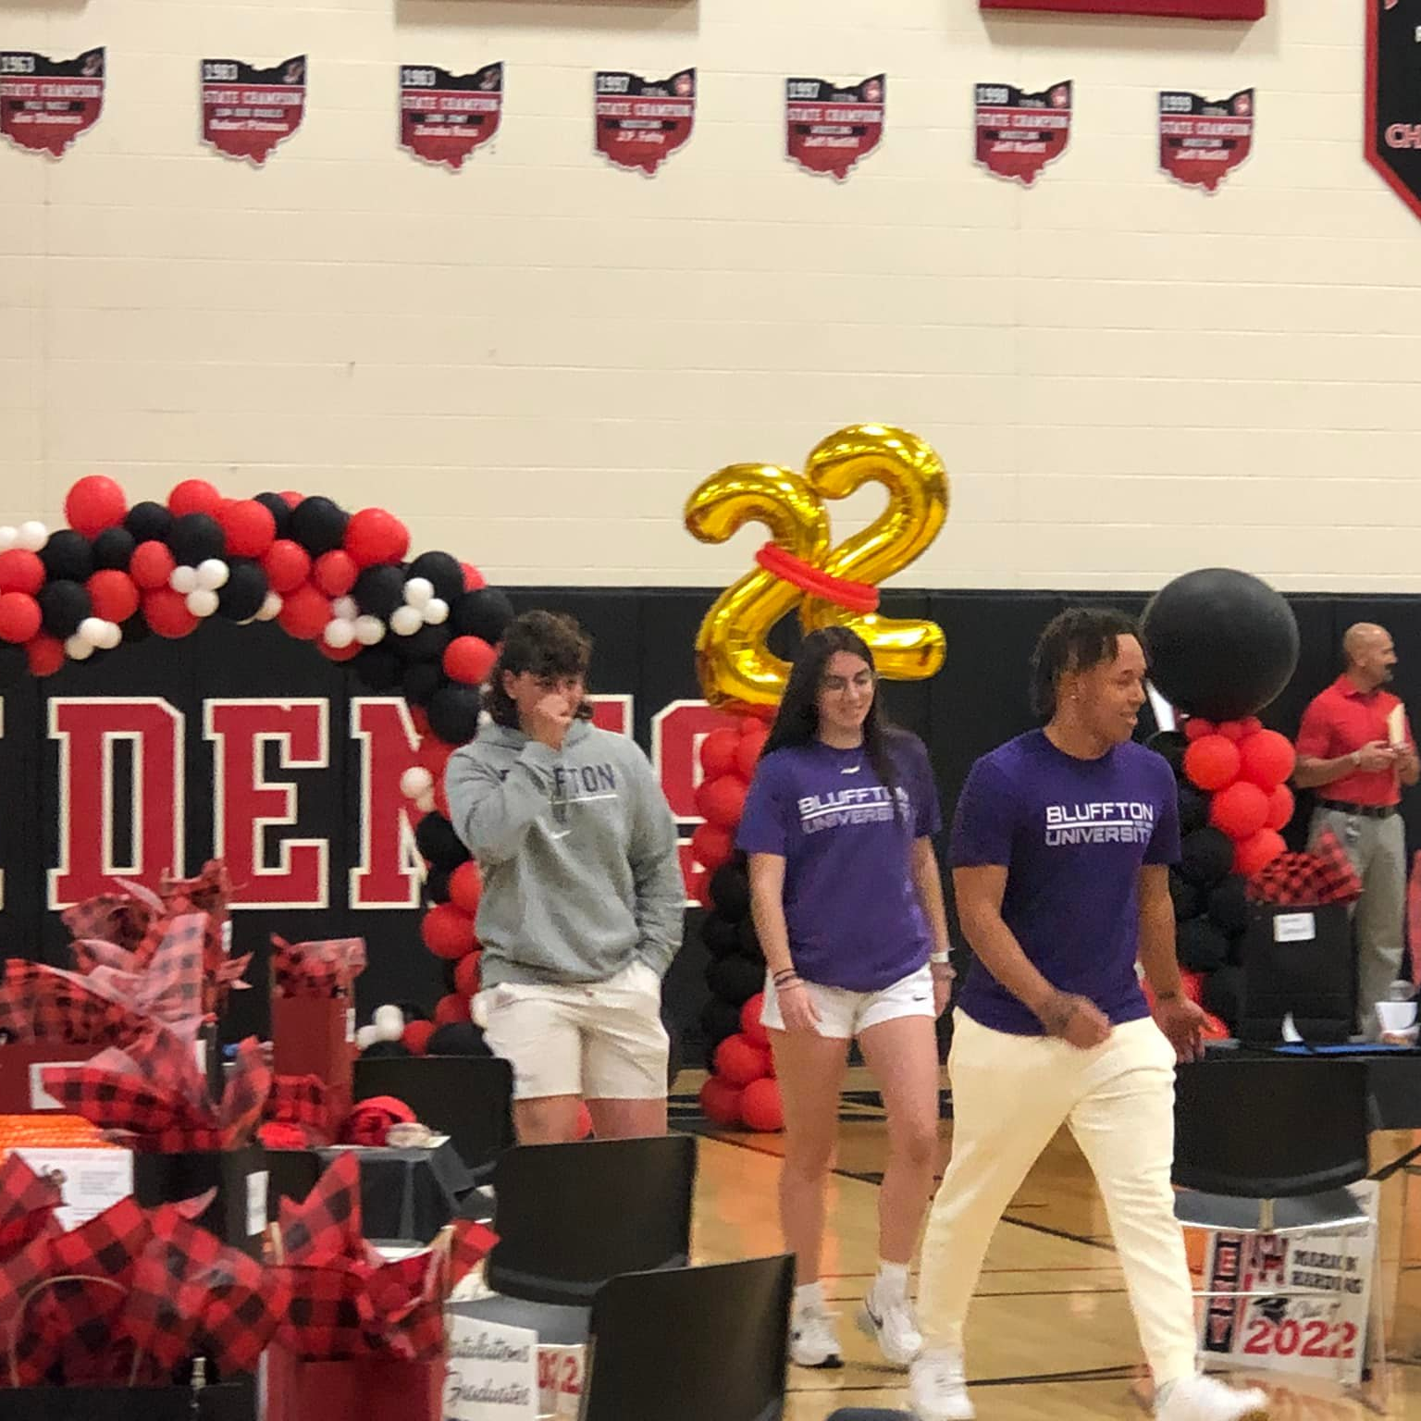
Practice Makes Perfect
Seniors come down early for a dress-rehearsal
Then general student population joins

Slide 14
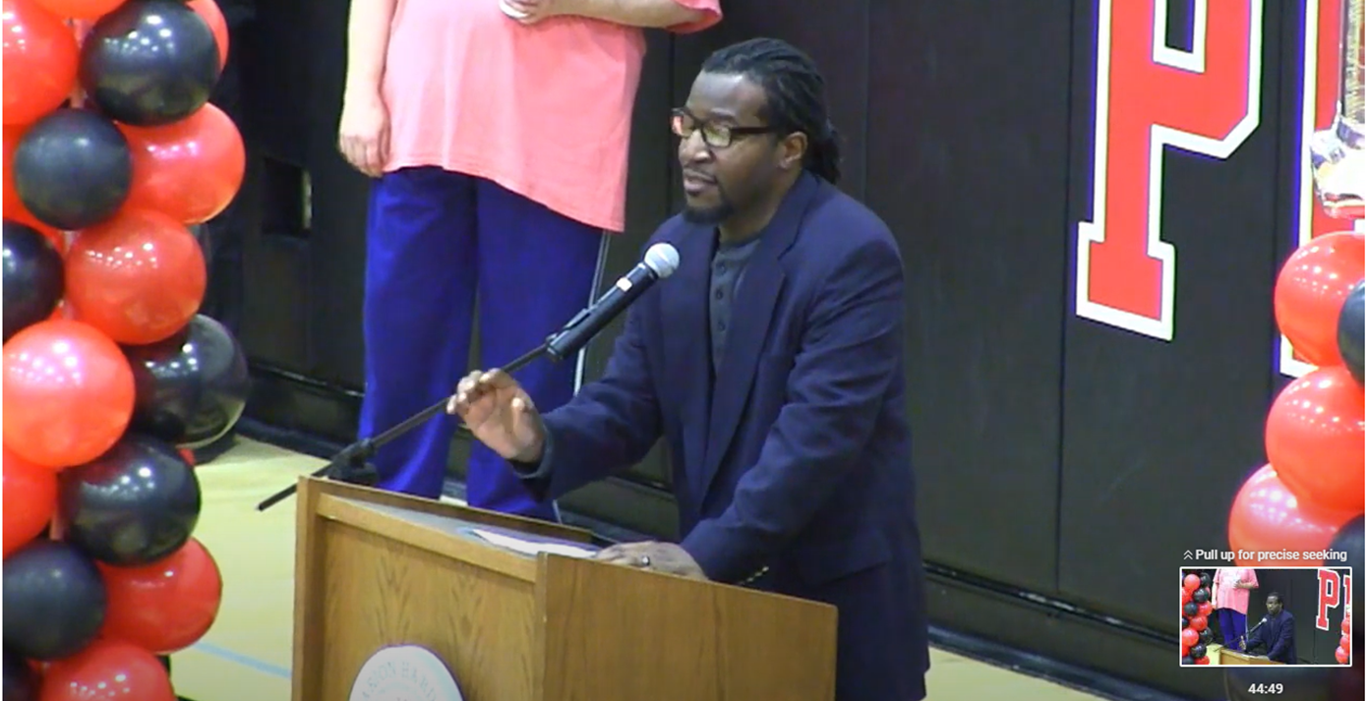
The Big Speech

Slide 15
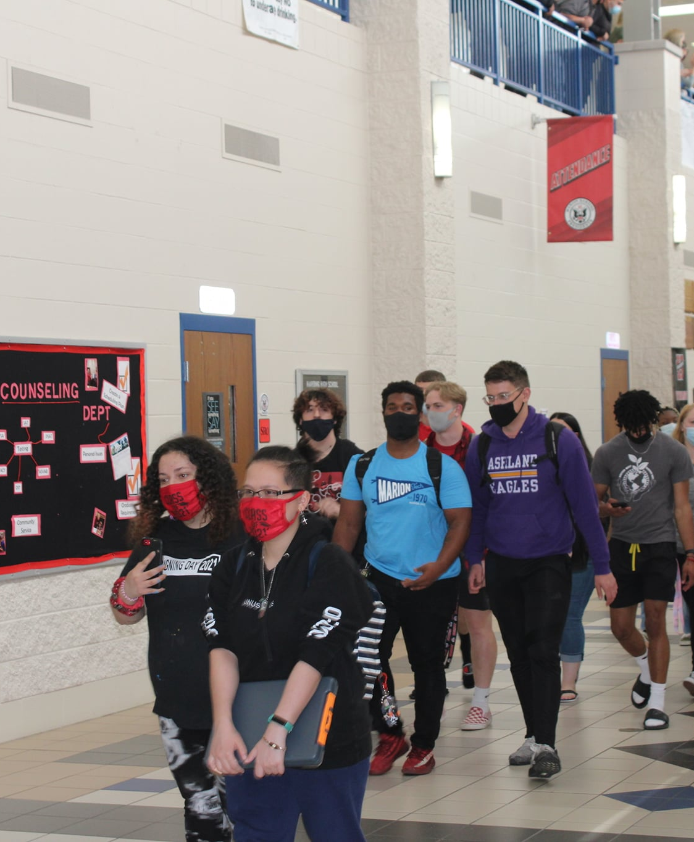
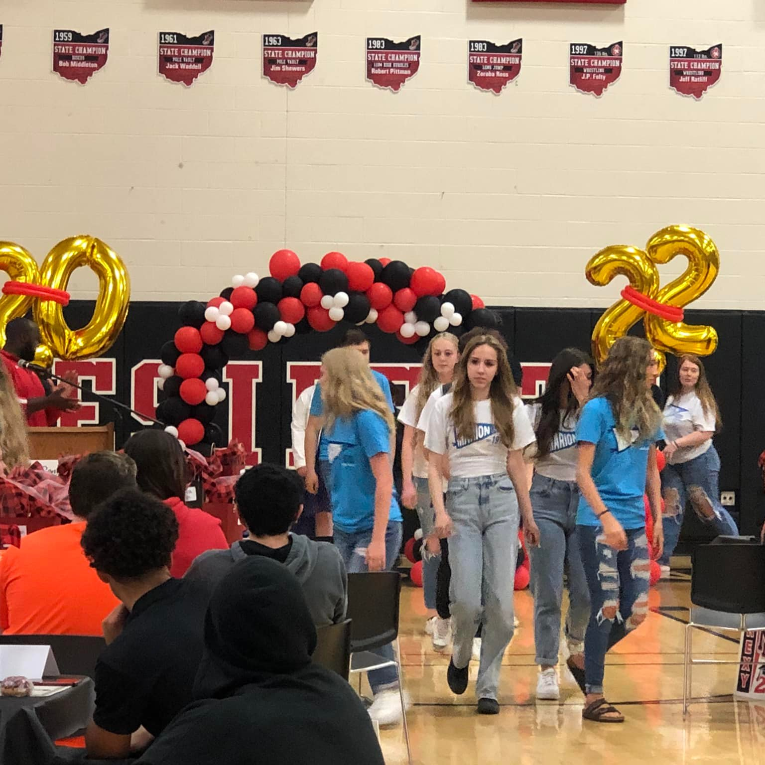
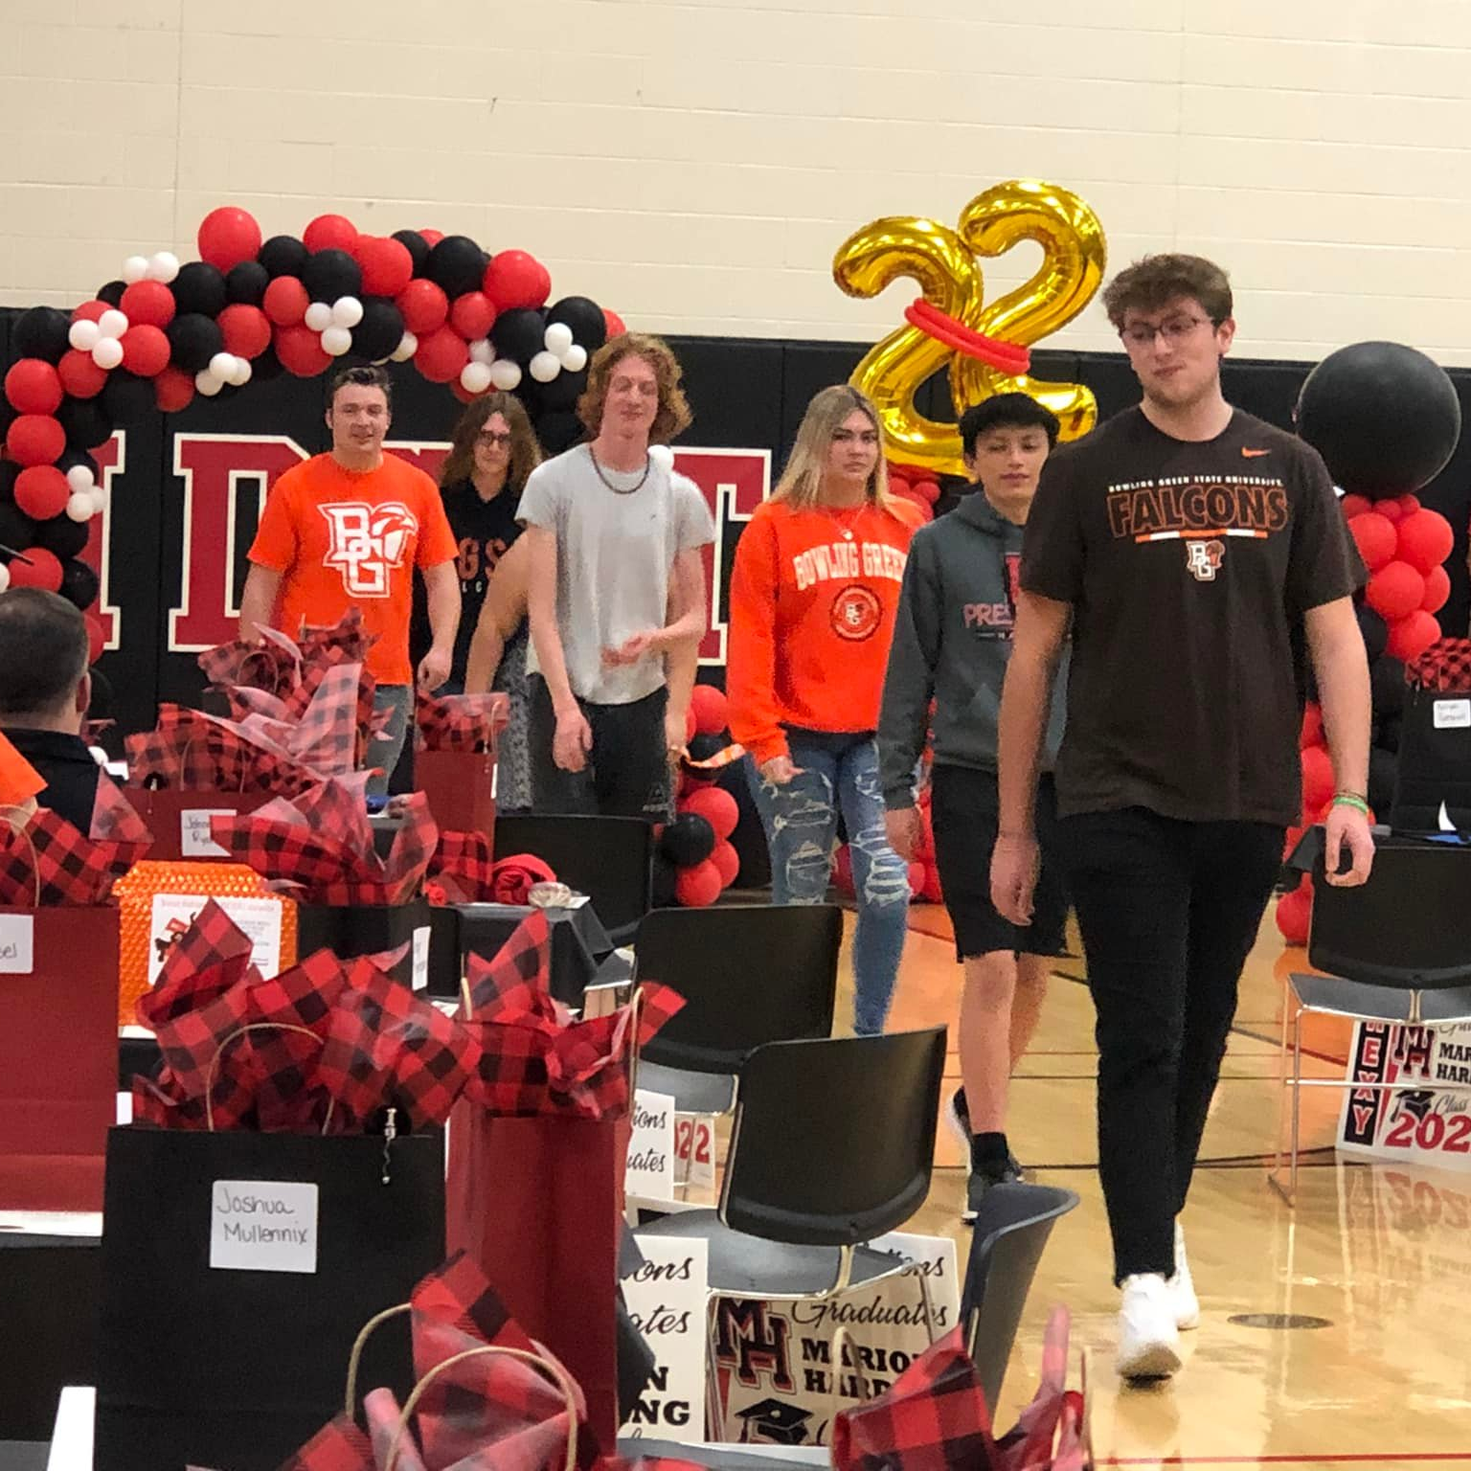
The Parade
Seniors are called down by institution
Institutions are alphabetical, except Marion Technical College and The Ohio State University

Slide 16
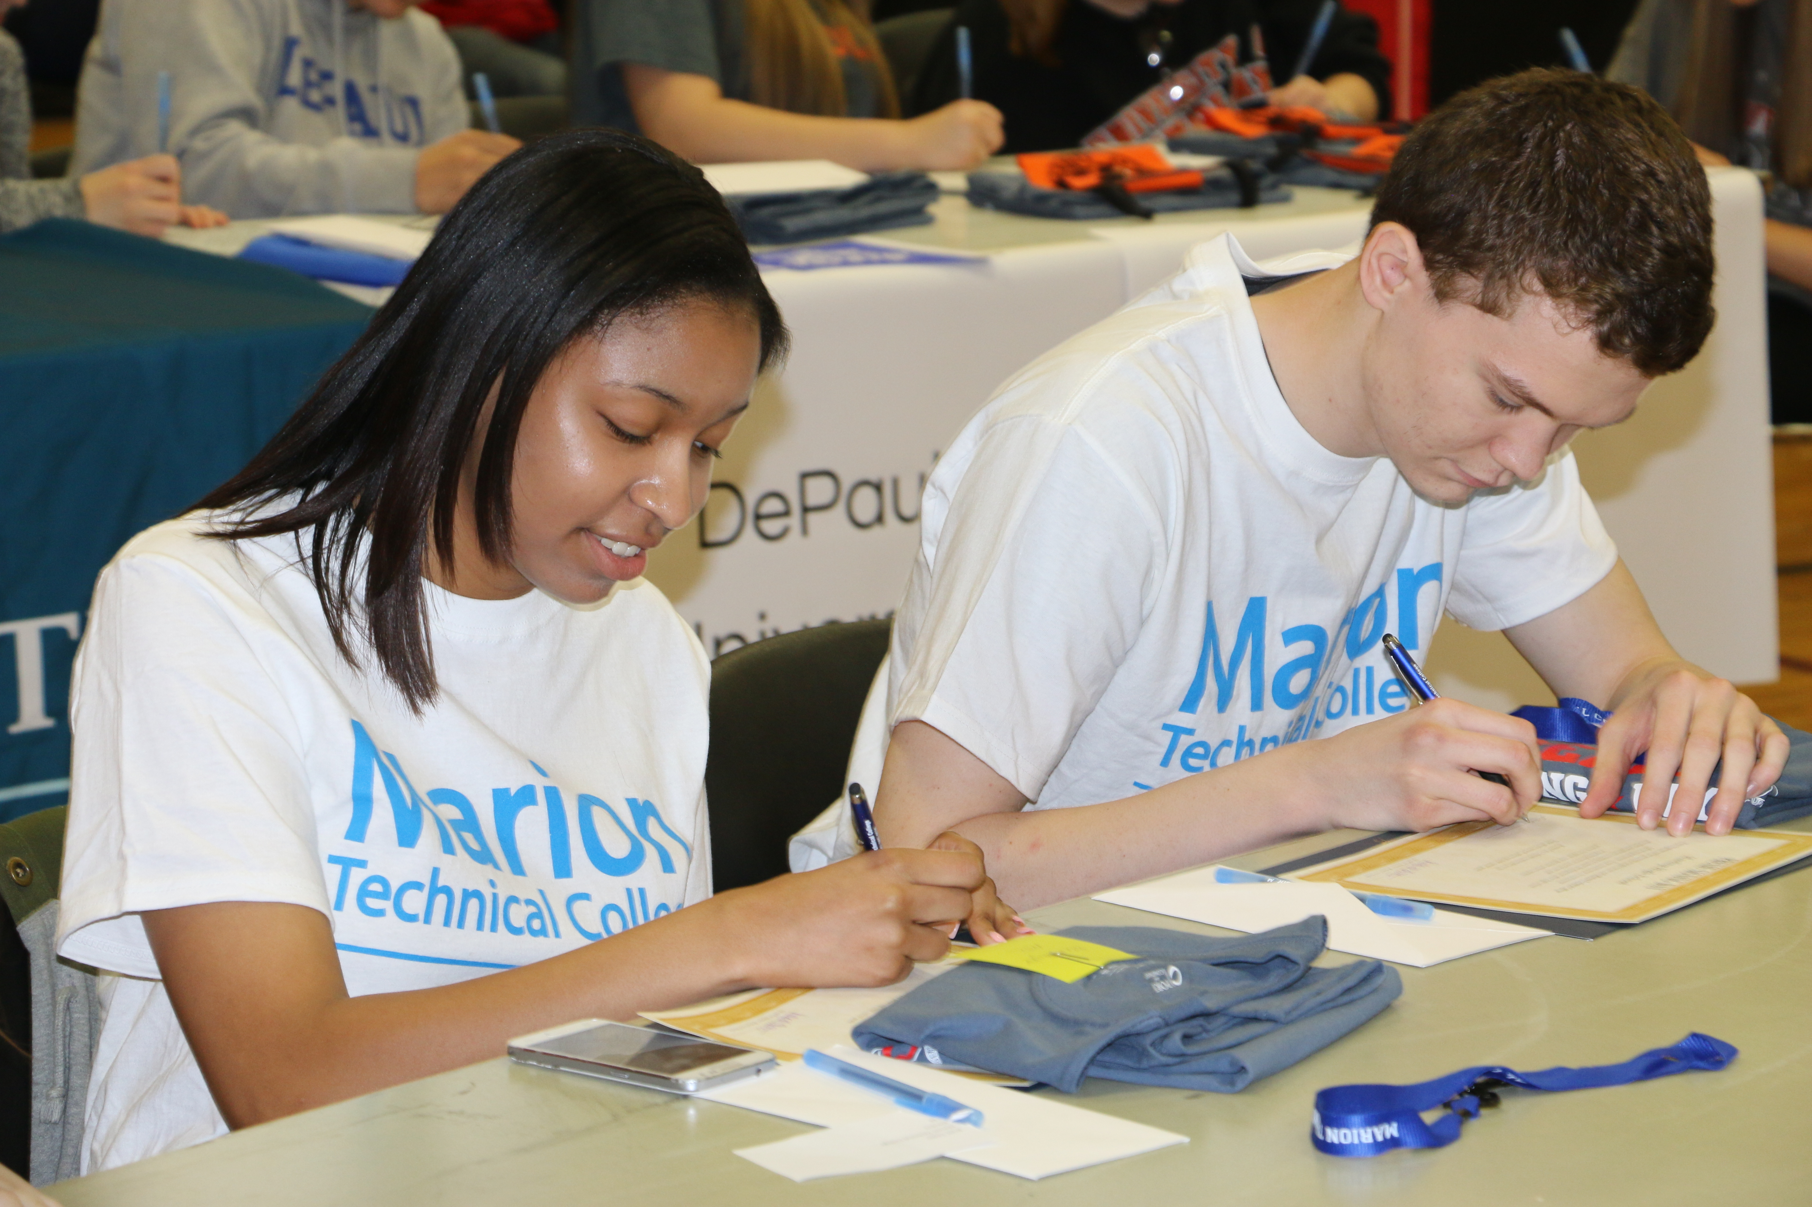
The Commitment
Seniors sign a commitment to their plan

Slide 17
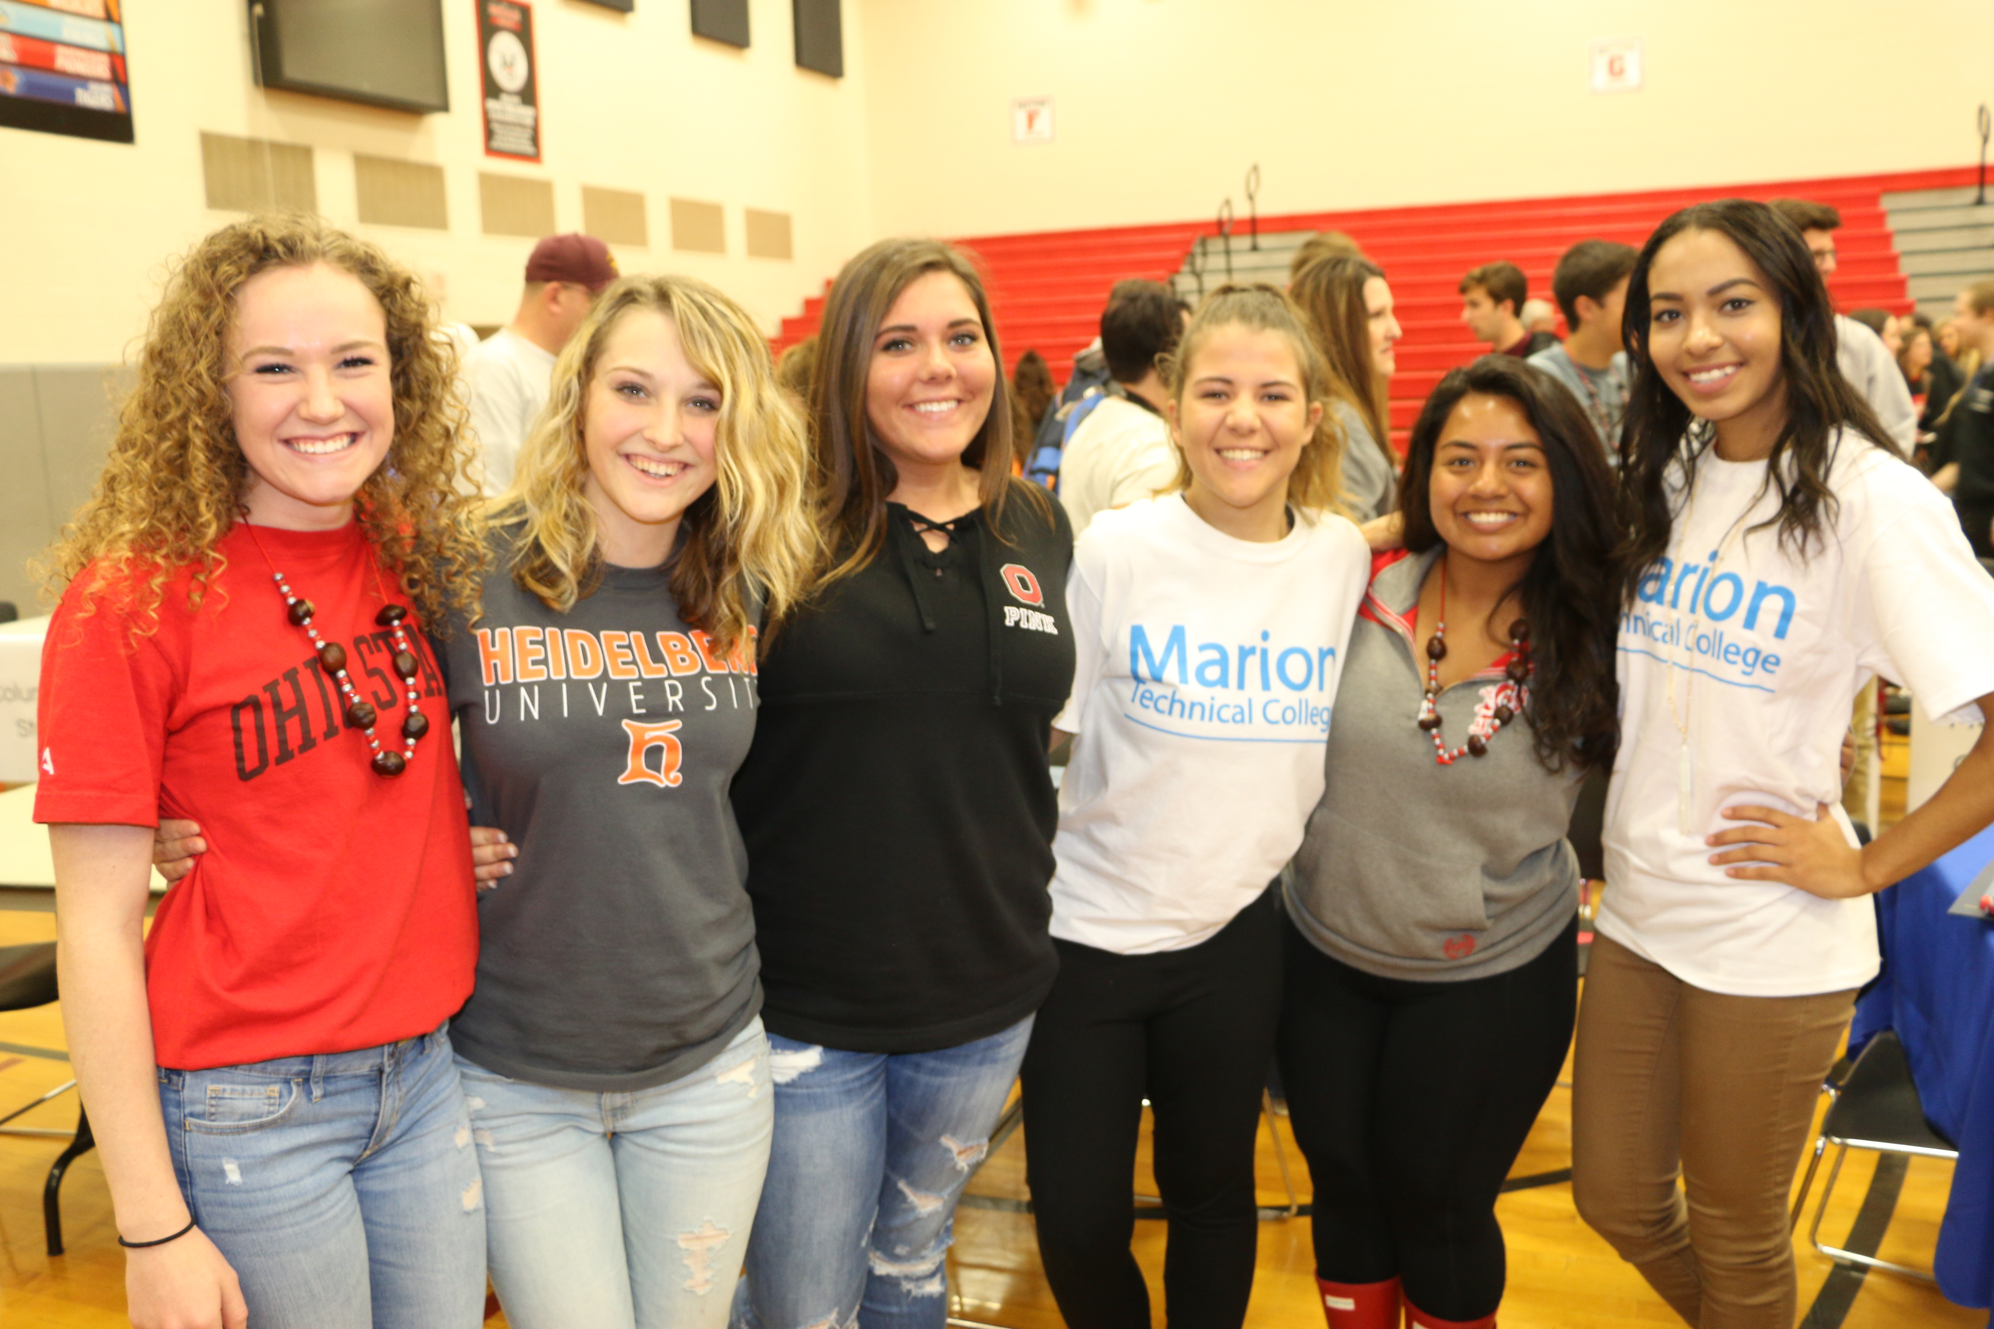
Celebrate!
Allow plenty of time for pics afterwards
Be sure to use the power of #

Slide 18
Resources
3 To Get Ready, 4 To Go – College Signing Day
https://highered.ohio.gov/initiatives/access-acceleration/3tgr-4tg/3tgr-4tg-signing/3tgr-4tg-signing-day
3 To Get Ready, 4 To Go – Register for trinkets
https://highered.ohio.gov/initiatives/access-acceleration/3tgr-4tg/welcome
American College Application Campaign Resources
https://equityinlearning.act.org/acac/resources/why-apply/
Better Make Room – College Signing Day – Toolkit
https://www.collegesigningday.org/event/999382b8-a333-41f6-bf1c-36bda032db82/summary

Slide 19
Contact Info:
Carlos Bing
Director
College Access Programs
Ohio Department of High Education
cbing@highered.ohio.gov
Kelly M. Garrett
Director
TRIO Talent Search
Marion Technical College
garrettk@mtc.edu

