Slide 1
Success Bound Conference 2023

Slide 2
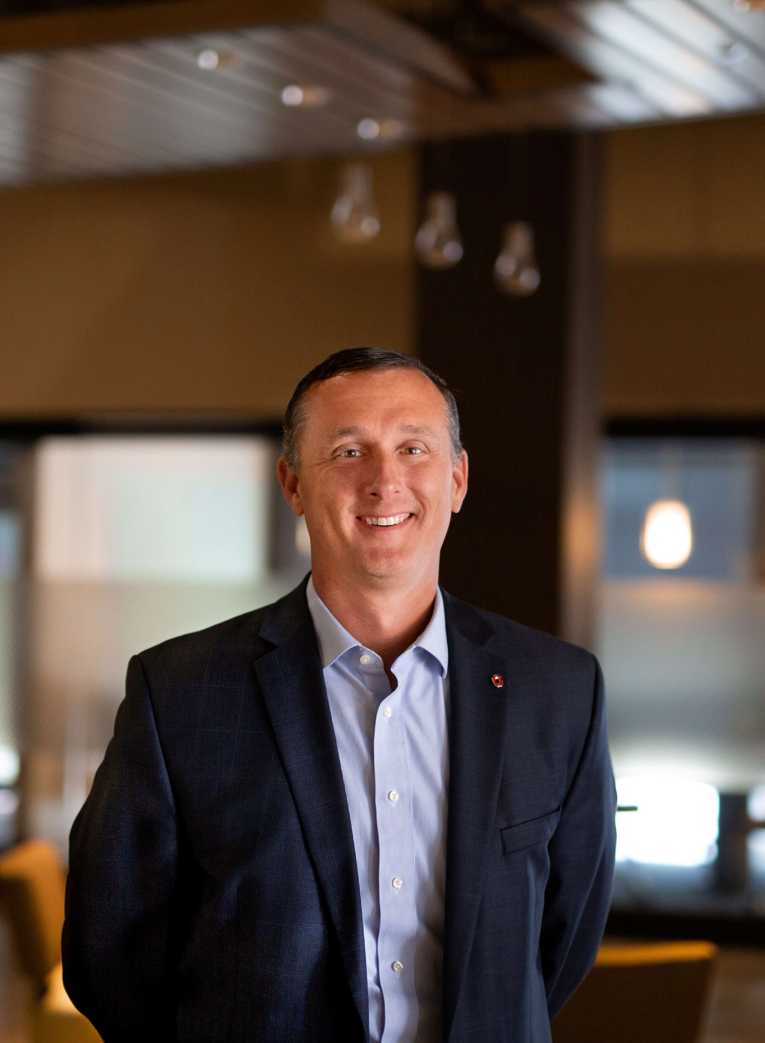
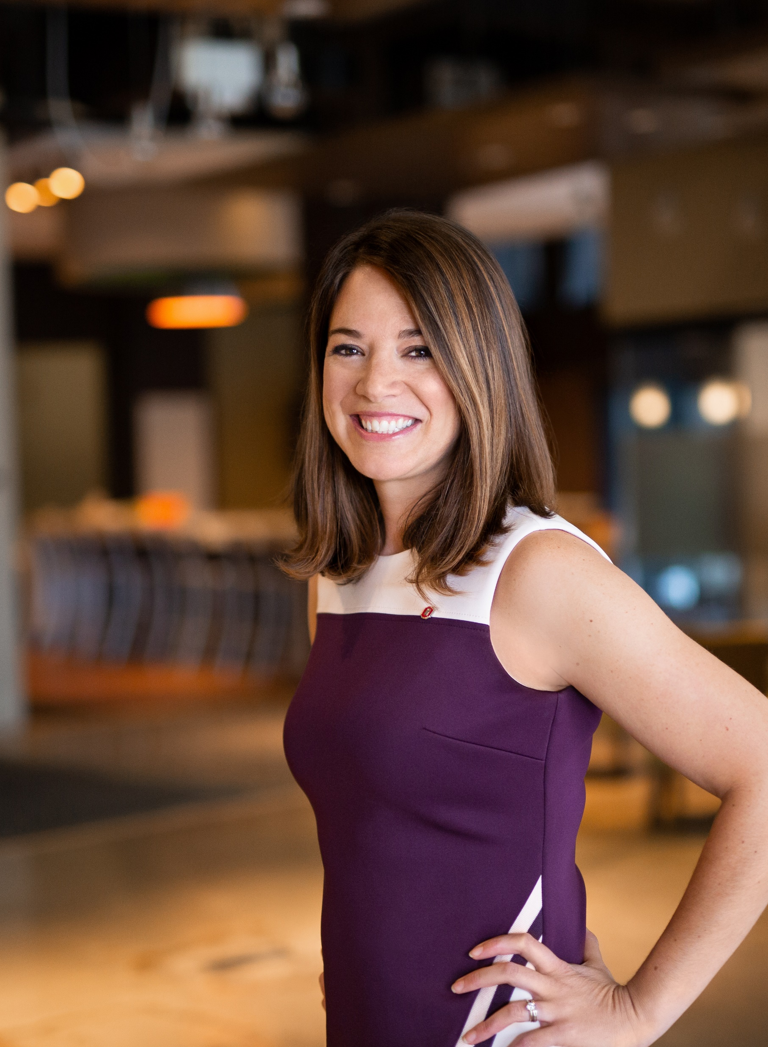
Meet the Co-Founders
Chris Svec, Co-Founder BridgED
Christy Bertolo, Co-Founder BridgED

Slide 3
Introductions
UNITE – an Ohio State portfolio company using an Ohio State technology. Focused on solutions to help higher education work more effectively with companies.
BridgED – UNITE’s sister company focusing on corporate partnerships within K-12. Specializing in activation and integration of corporate partners into school districts.
Notes:
Christy-
Why BridgED was formed
Persistency Rates
Great Meetings

Slide 4
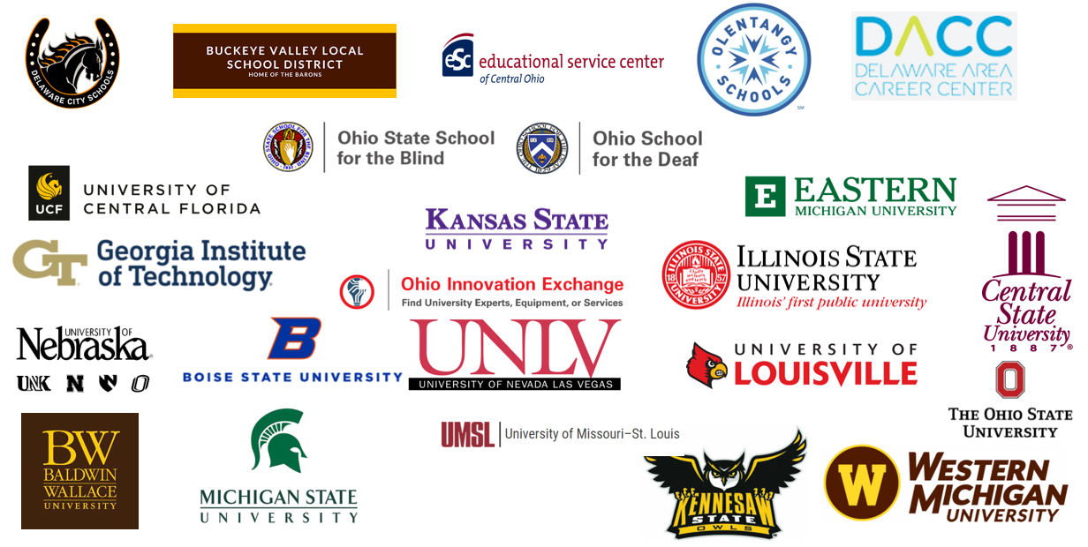
UNITE and BridgED Partners
Notes:
Chris

Slide 5
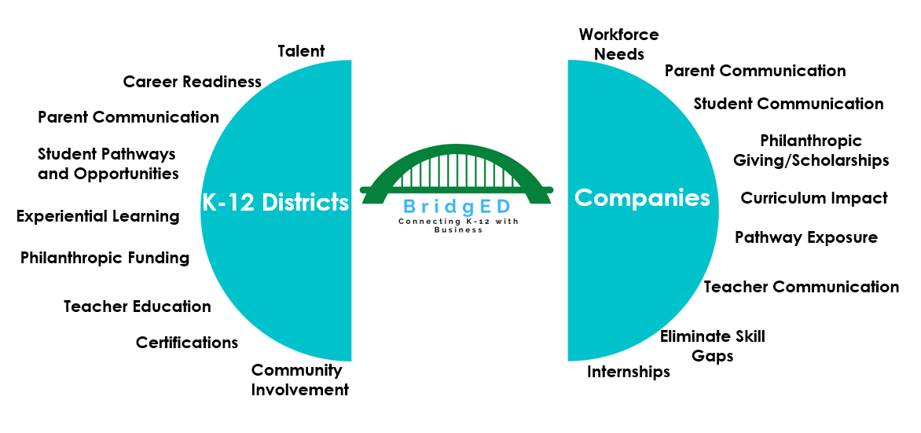
The BridgED Model
Notes:
Chris

Slide 6

Corporate Partners
Notes:
Christy

Slide 7
Why k12? Why Now?
Assessment Meeting Themes
Tremendous amount of growth
Aging workforce
Labor participation rate
Not enough people to fill current jobs
Lack of awareness of careers and roles
Stigma elimination
Notes:
Christy top
Chris bottom

Slide 8
Barriers to Entry
Not feeling welcome
Resources and capacity
Navigating the district
Turnover
It’s nobody’s job
It’s a long game
Company policies
Notes:
Chris Top
Christy Bottom

Slide 9



Is Your Company Ready?
Define your strategy
Who/
resources
Know
your “why”
Notes:
Christy

Slide 10
Consider Minors Policies
Do you have a current policy regarding minors
What next steps need to be taken
What are the areas that you may want to engage to meet your priorities
Understand your timeline
Notes:
Christy

Slide 11
How To Engage
Find a district that is a fit
Demographics, proximity, diversity, size
Consider three audiences
Determine current corporate programs
Notes:
Chris

Slide 12
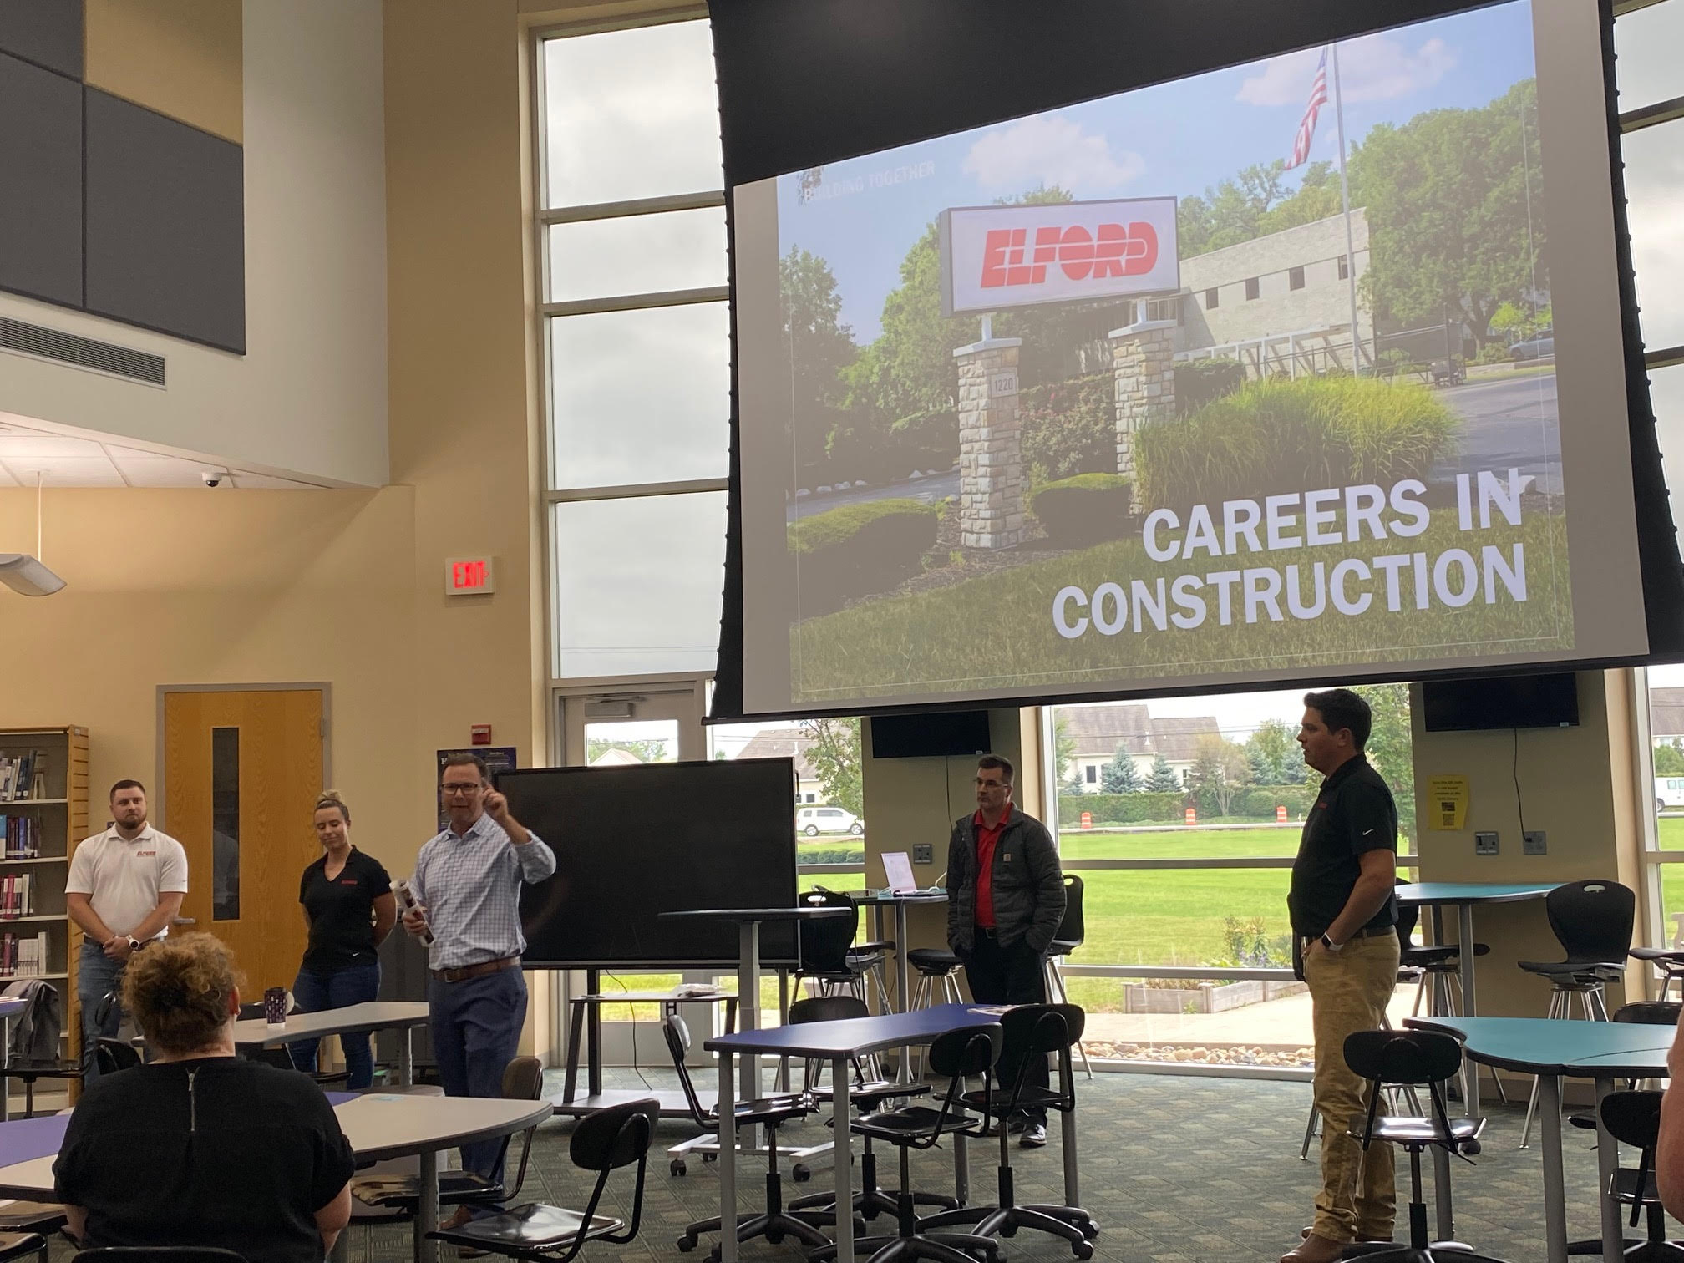
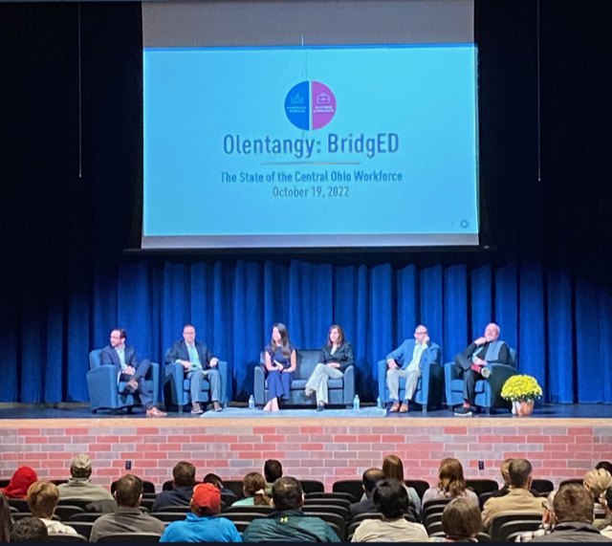
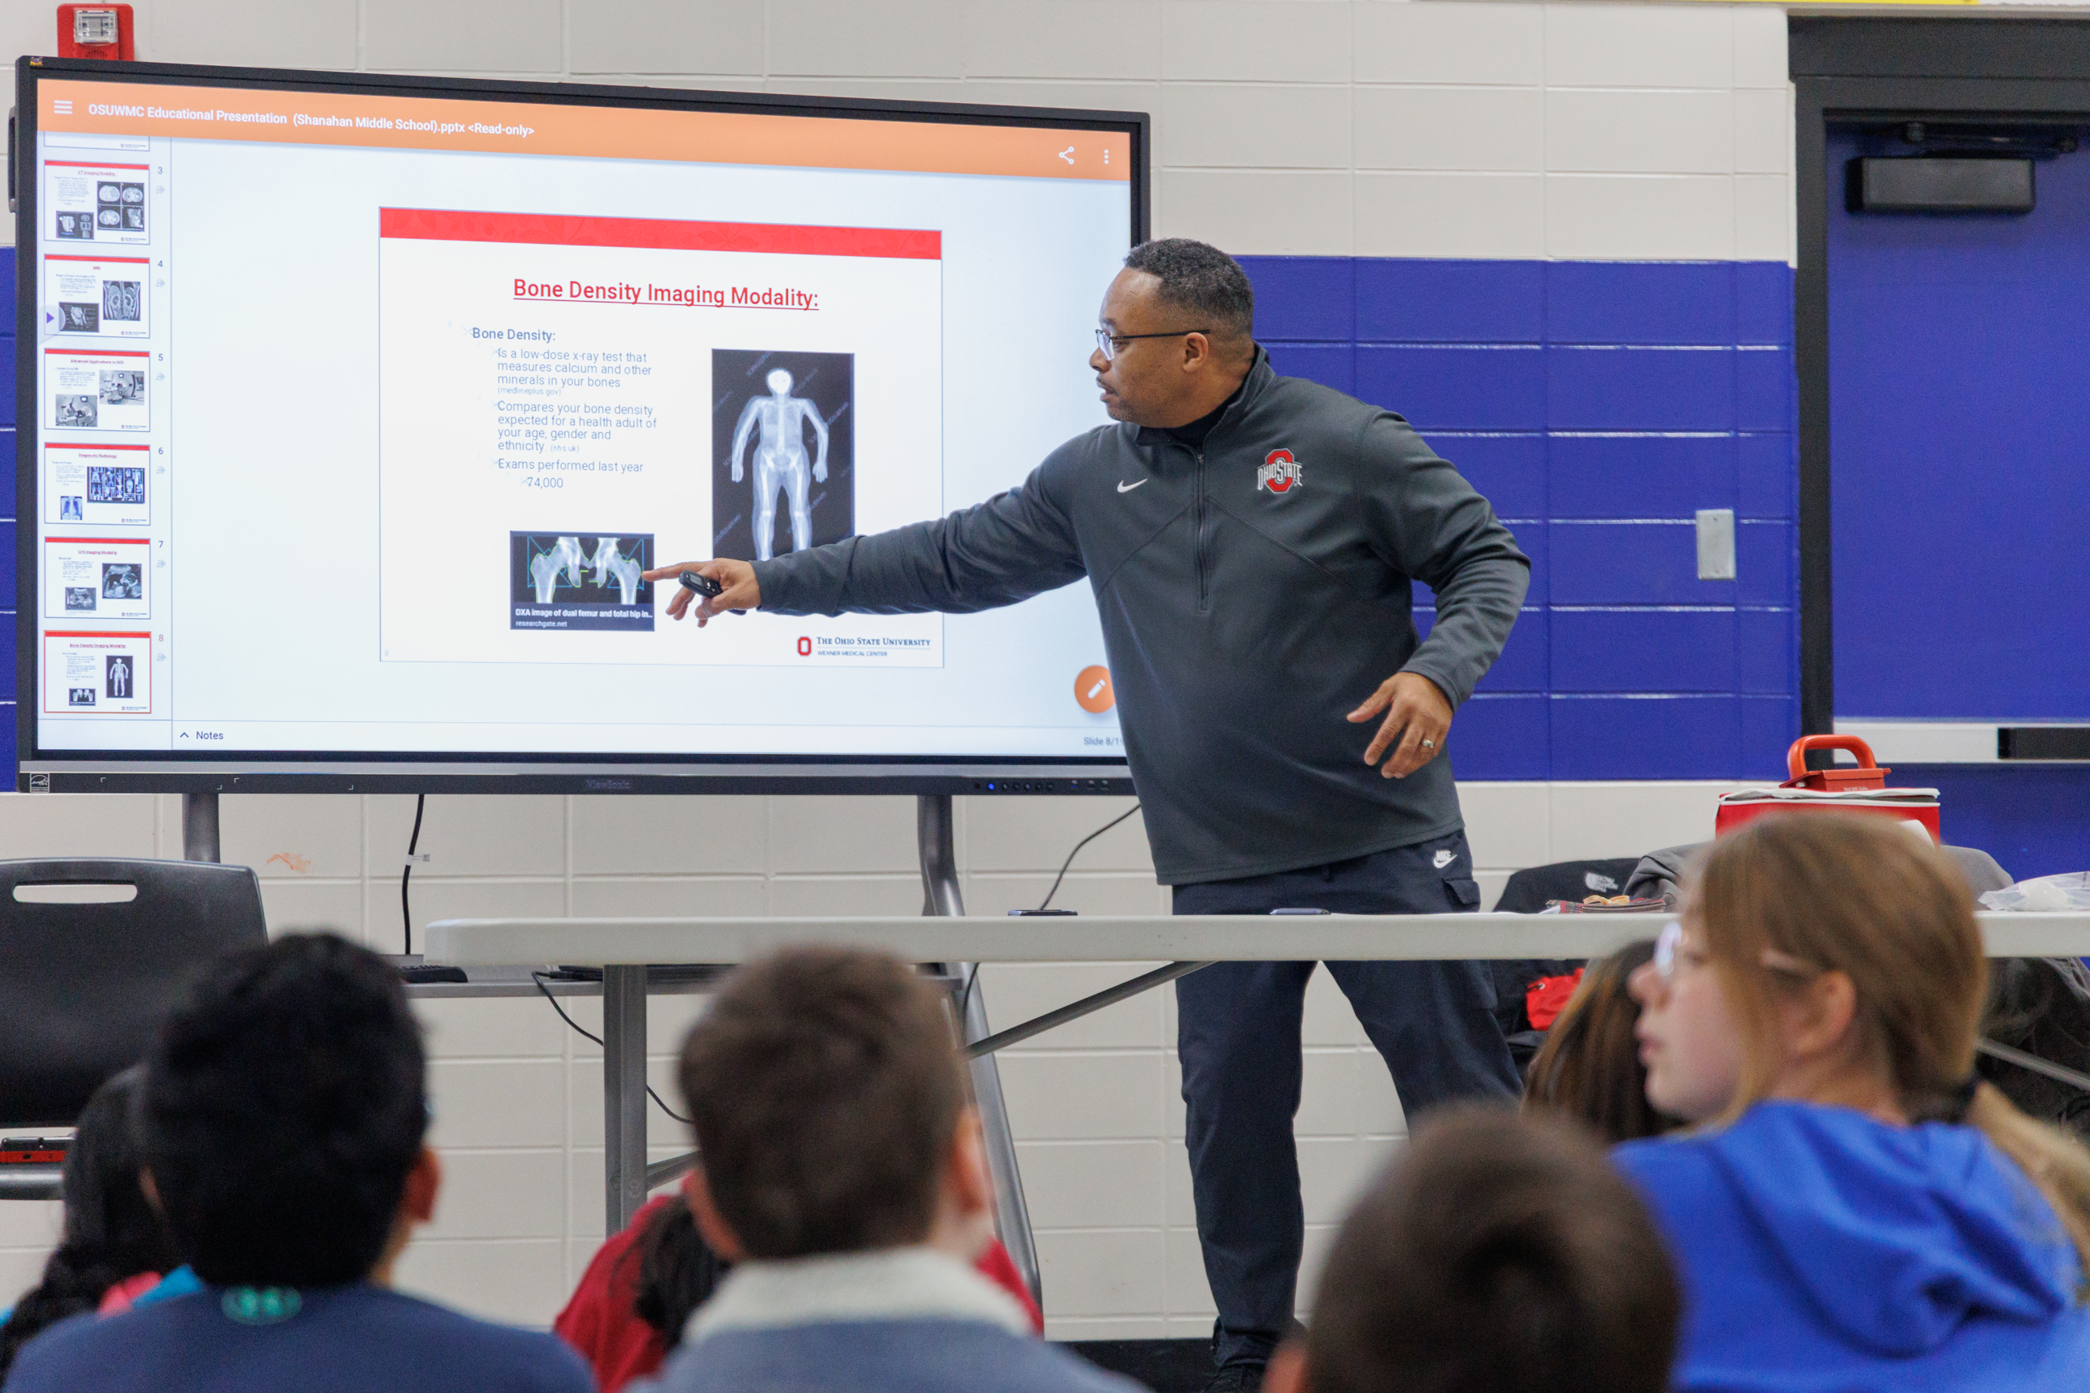
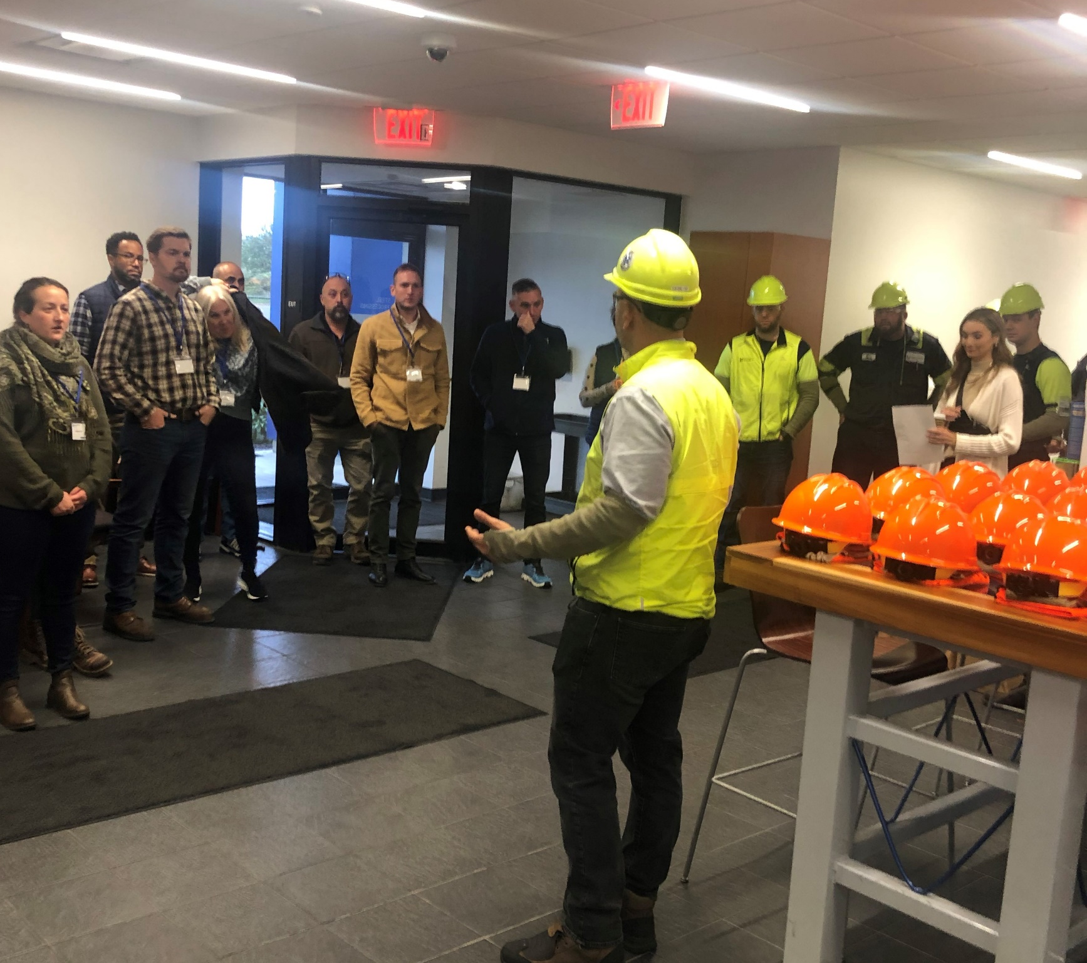
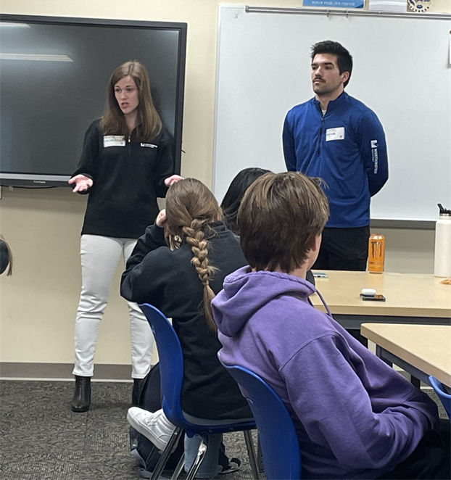
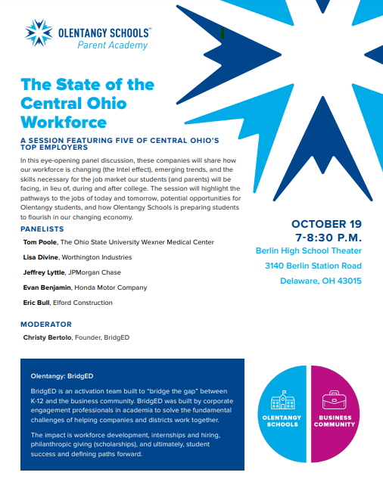
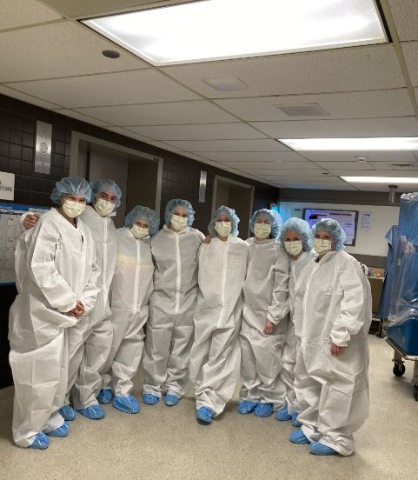

Slide 13
Thank you
www.BridgEDk12.com
Chris@UNITECorporateEngagement.com
Christy@UNITECorporateEngagement.com

