Slide 1


Career Support for High School Students: Surprises & Light Bulb Moments
Beth Probst
Founder & CEO
© 2023 At The Core LLC

Slide 2
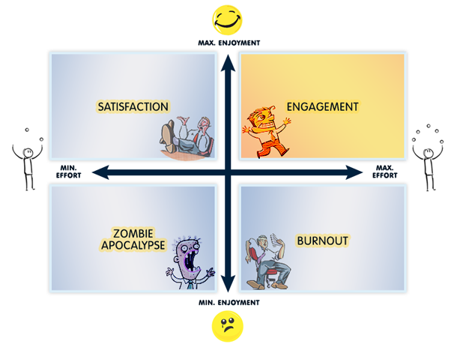
A preface to our discussion…
Employers want happy and motivated employees!
Students engage more deeply with things they find interesting and relevant
Teens know very little about real-world careers and how to connect them to their strengths and interests
Graphic by Human Performance Technology by DTS
© 2023 At The Core LLC

Slide 3

Goals for this session
Let’s back up a few steps in the teens and careers discussion
Share some lessons learned from our many years of interviewing teens
Plant seeds that may impact your interaction with teens
© 2023 At The Core LLC

Slide 4
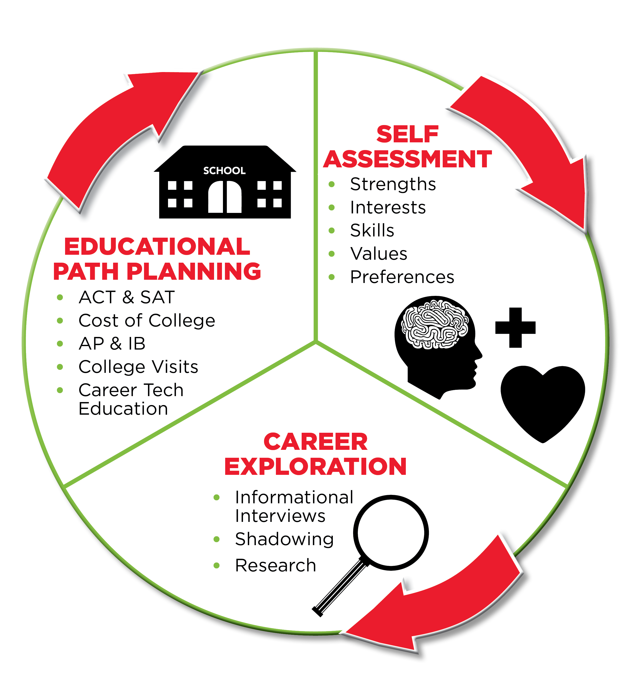
Who is At The Core?
Supporting teens & families since 2012
Our work encompasses:
  Self assessment
  Career exploration
  Educational path planning
Partnered with CTE schools for years
Our team of professionals includes higher ed career advisors, HR/business professionals, teachers, counselors, etc.
© 2023 At The Core LLC

Slide 5

Reality for most teens today
Their “heads are down”
Their friend group/peers have strong influence
The urge is to fit in, not to stand out
Lack of engagement with “life after high school” thinking
  Money – for education, for living
  What does it really feel like to work full-time?
  Other adult responsibilities seem distant
And yet, everyone hopes they’ll magically select a path at the end of high school
© 2023 At The Core LLC

Slide 6



Teens and careers – It’s a challenge!
“Career illiteracy” is very, very real
Career thinking is not on the radar
“What do you want to be when you grow up?”
“My kid should not pick a career at 17. They’ll go to college and figure it out.”
“My child will go to college.”
“My child wants to be an engineer/doctor.”
Resistance to using high school as a time of exploration
Lack of maturity
© 2023 At The Core LLC

Slide 7

The opportunities we see
Self assessment
True career exploration as it’s related to self assessment
Understanding the concept of “first job” and career path
Sizing up educational requirements for jobs of interest
Equalizing all paths after high school
© 2023 At The Core LLC

Slide 8




Summarizing those ideas
We teach this order:
  Take stock of your strengths, struggles, interests, values, preferences, lifestyle goals
  Begin to connect those truths about you to potential jobs that play to your strengths
  Explore those careers fully and focus on the educational requirement of the jobs of interest to you
  Then, consider where/how you can gain the skills/experience/education needed to do the work you desire!
© 2023 At The Core LLC

Slide 9

1:1 Student Interviews
As part of Guided Self Assessment

Slide 10

Things we’ve learned after thousands of hours interviewing teens
Teens want to make good decisions and have a confident path toward work they will love BUT they don’t know how to get there
Most teens and families fall into the trap of focusing on “insert college name here” and not why they are going
The noise around teens is loud (peers, parents, coaches, society, social media, etc.)
Irrelevant schoolwork (as a teen might call it) is a pretty significant roadblock
© 2023 At The Core LLC

Slide 11
Things we’ve learned after thousands of hours interviewing teens
Online inventories & career assessments can be troublesome
  They may not answer honestly
  Their real answer may not be black and white (more “it depends”)
  If results feel off, they’ll toss the whole thing
  Students don’t gain a greater sense of self after these exercises
Exposure to careers helpful but limited
© 2023 At The Core LLC

Slide 12
Things we’ve learned after thousands of hours interviewing teens
Students can articulate “lifestyle goals” and note some job characteristics they find appealing/unappealing
  “I want to wear comfortable clothes.”
  “I don’t want to sit at a desk all day.”
  “I want to travel.”
  “I don’t want someone’s life to depend on me.”
Deep self assessment work is engaging for teens – “I’ve never thought about these questions before!”
What others tell a teen (“you’re good at xxx”) is less important than what the teen can tell us about themselves – the true light bulb moments come from self-claimed traits, etc.
© 2023 At The Core LLC

Slide 13
Things we’ve learned after thousands of hours interviewing teens
Self assessment work on a continuum (starting early) is easily tied to evaluating experiences. That evaluation refines the student’s self assessment—their “what I know about me” list
Self assessment work can align with choices in high school (electives, summer programs, etc.) – making wiser choices
Every student is an individual with their own “self assessment portfolio” (but part of a large group each school is serving)
© 2023 At The Core LLC

Slide 14

Knowing this…a little brainstorming
How can we boost every student’s self knowledge?
What opportunities exist for more time for teens to evaluate experiences?
What techniques can you share that you’ve found useful?
© 2023 At The Core LLC

Slide 15
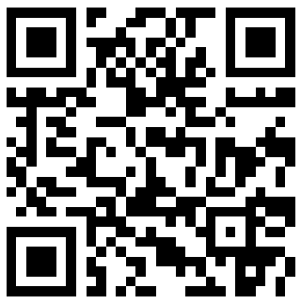
Thank you!
Beth Probst
Founder & CEO
info@gettingatthecore.com
(614) 404-0646
www.GettingAtTheCore.com
© 2023 At The Core LLC

Slide 17
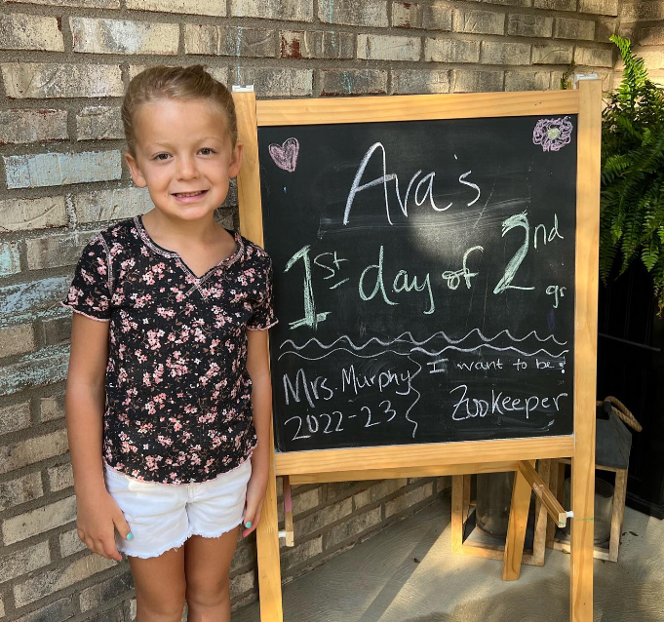



Slide 18
