Slide 1
SB166 Tax Credit Certificate for WBL Experiences
Cadie Allen
April 2023

Slide 2
Agenda
Background Information
Eligible Businesses and Important Definitions
Tax Credit and Funding Limit
Application Requirements and Process
FY2022 Review

Slide 3
Tax Credit Certificate for Work-Based Learning Experiences
Passed in Senate Bill 166, ORC 5747.057
Opportunity to expand WBL experiences
Credit is allowed against a taxpayer’s aggregate tax liability

Slide 4
What Businesses are Eligible?
Must be a taxpayer or pass-through entity (ex. LLC)
Must employ an eligible student employee in fulfillment of a work-based learning (WBL) experience associated with an approved CTE pathway in which the student employee is enrolled
Does not need to be a new WBL experience

Slide 5
Important Definitions
Eligible Employee: an employee who is nineteen years of age or younger and enrolled in an approved career-technical education (CTE) pathway.
To be considered enrolled in a CTE pathway, a student must be enrolled in at least one CTE course within the approved pathway. Students enrolled in CBI and FCS Programs are eligible.
Eligible compensation: compensation paid on and after the effective date of March 23, 2022, from which the employer is required to deduct and withhold income tax.

Slide 6
Tax Credit and Funding Limits
May receive the lesser of $5,000 per eligible employee or 15% of wages paid to an eligible employee
Tax Credit Certificate is submitted with employer’s Ohio income tax return and provides a credit against aggregate tax liability
Total amount of funding is not to exceed $5 million within state fiscal biennium (2023-2024)

Slide 7
Application Process
Meet with CTE Partner to outline goals, POC and review application
School gives ODDEX form to student to give to business
Employer creates an OHID account and SAFE account
Employer completes Tax Credit Certificate Application (Upload ODDEX and WBL docs)
ODE Reviews Application
If approved, certificate is available to download within 60 days
Employer submits certificate with income tax return
Notes:
Employer completes Tax Credit Certificate Application (Upload ODDEX and WBL docs)
ODE Reviews Application
If approved, certificate is available to download within 60 days
Employer submits certificate with income tax return

Slide 8
Student Information
Schools will be able to provide a form with necessary student information to businesses using ODDEX
Each document is assigned a unique 10-digit Document ID
Used to identify the documentation along with student name
No SSIDs included
Unique document ID is sent to ODE
Program of concentration/pathways list
Only those CTE-26 approved
Includes FERPA information and Parent/Guardian Signature

Slide 9
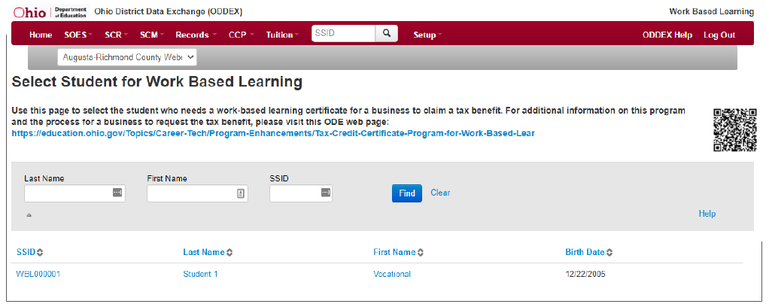
Accessing Document

Slide 10
Creating Document
All courses listed
User Interface Input
Select Pathway
Enter Local Program Name
Expected to continue?
Expected to graduate?
Generate PDF

Slide 11
Example ODDEX Form

Slide 12
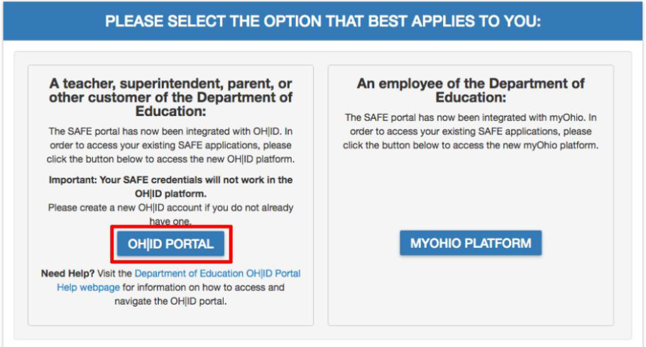
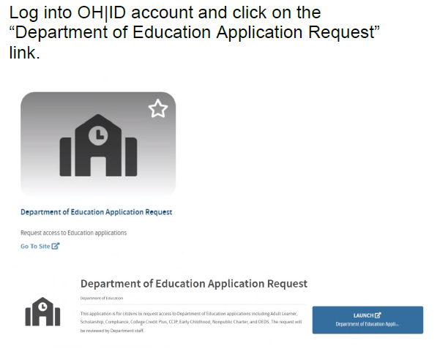
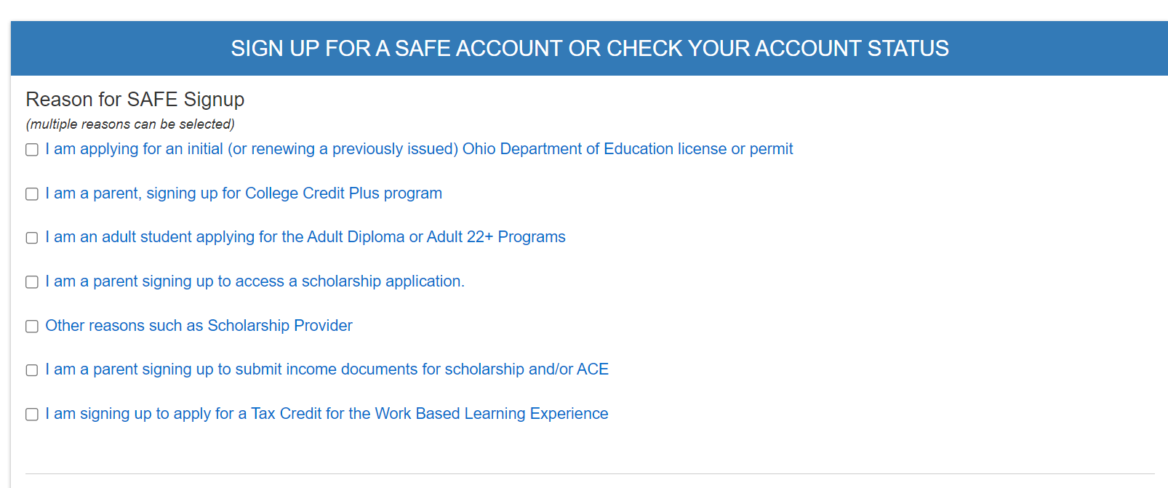
OHID and SAFE Account

Slide 13
SAFE Account - Tile
Once the account is linked to the role for APPLICANT-WORK-BASED LEARNING TAX CREDIT, the Tax Credit Application tile will appear. This tile will be used to start the Tax Credit for Work Based Learning Experience Application.

Slide 14
Prior to beginning the application….
Have the following
WBL Tax Credit Documentation
Work-Based Learning Agreement
Amount of Student Compensation
Application Window: December 31, 2023 – February 1, 2024

Slide 15
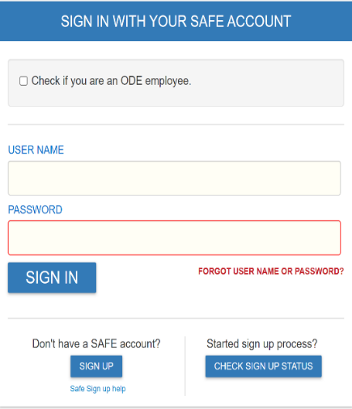
Accessing the Application

Slide 16
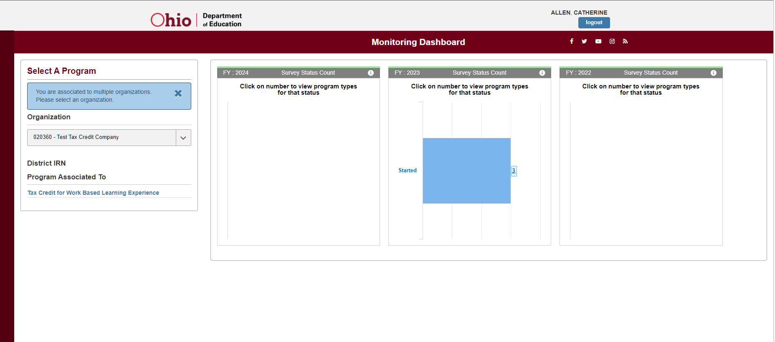
Dashboard

Slide 17
Senate Bill 166 Tax Credit
Application window was open Dec. 31 to Feb. 1
87 businesses applied and were approved
Approximately $225,000 allocated

Slide 18
Recommendations
Expand eligibility to include more businesses
Increase percentage of wages eligible from 15%
Lengthen application window
Increase awareness of opportunity

Slide 19


Social Media Campaign

Slide 20

For more information, visit the Department website. Tax Credit Certificate Program for Work-Based Learning Experiences | Ohio Department of Education
Contact
Cadie Allen
Catherine.Allen@education.ohio.gov
(614)466-0057

Slide 21






@OHEducation

